Slide 1
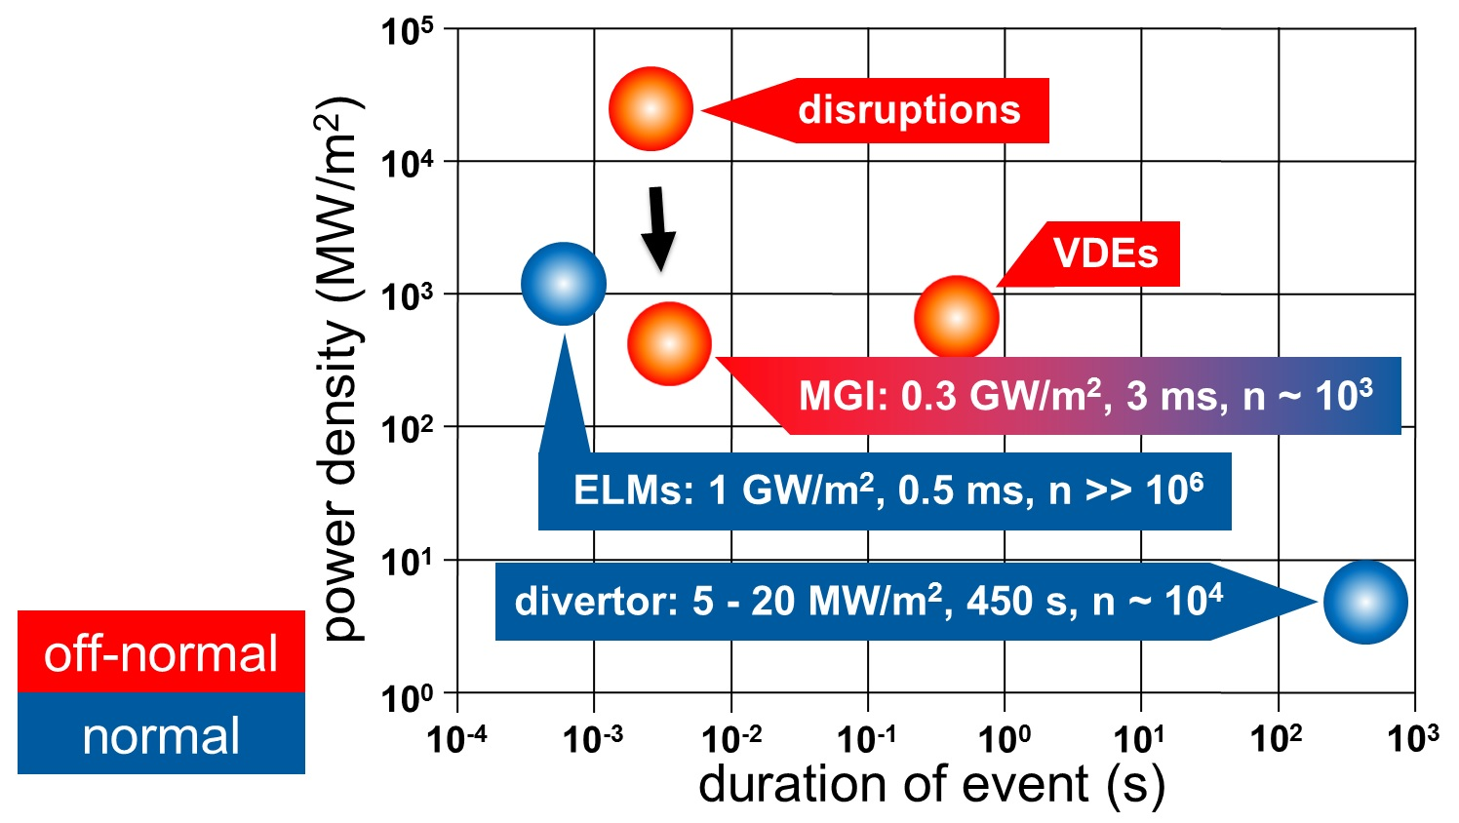
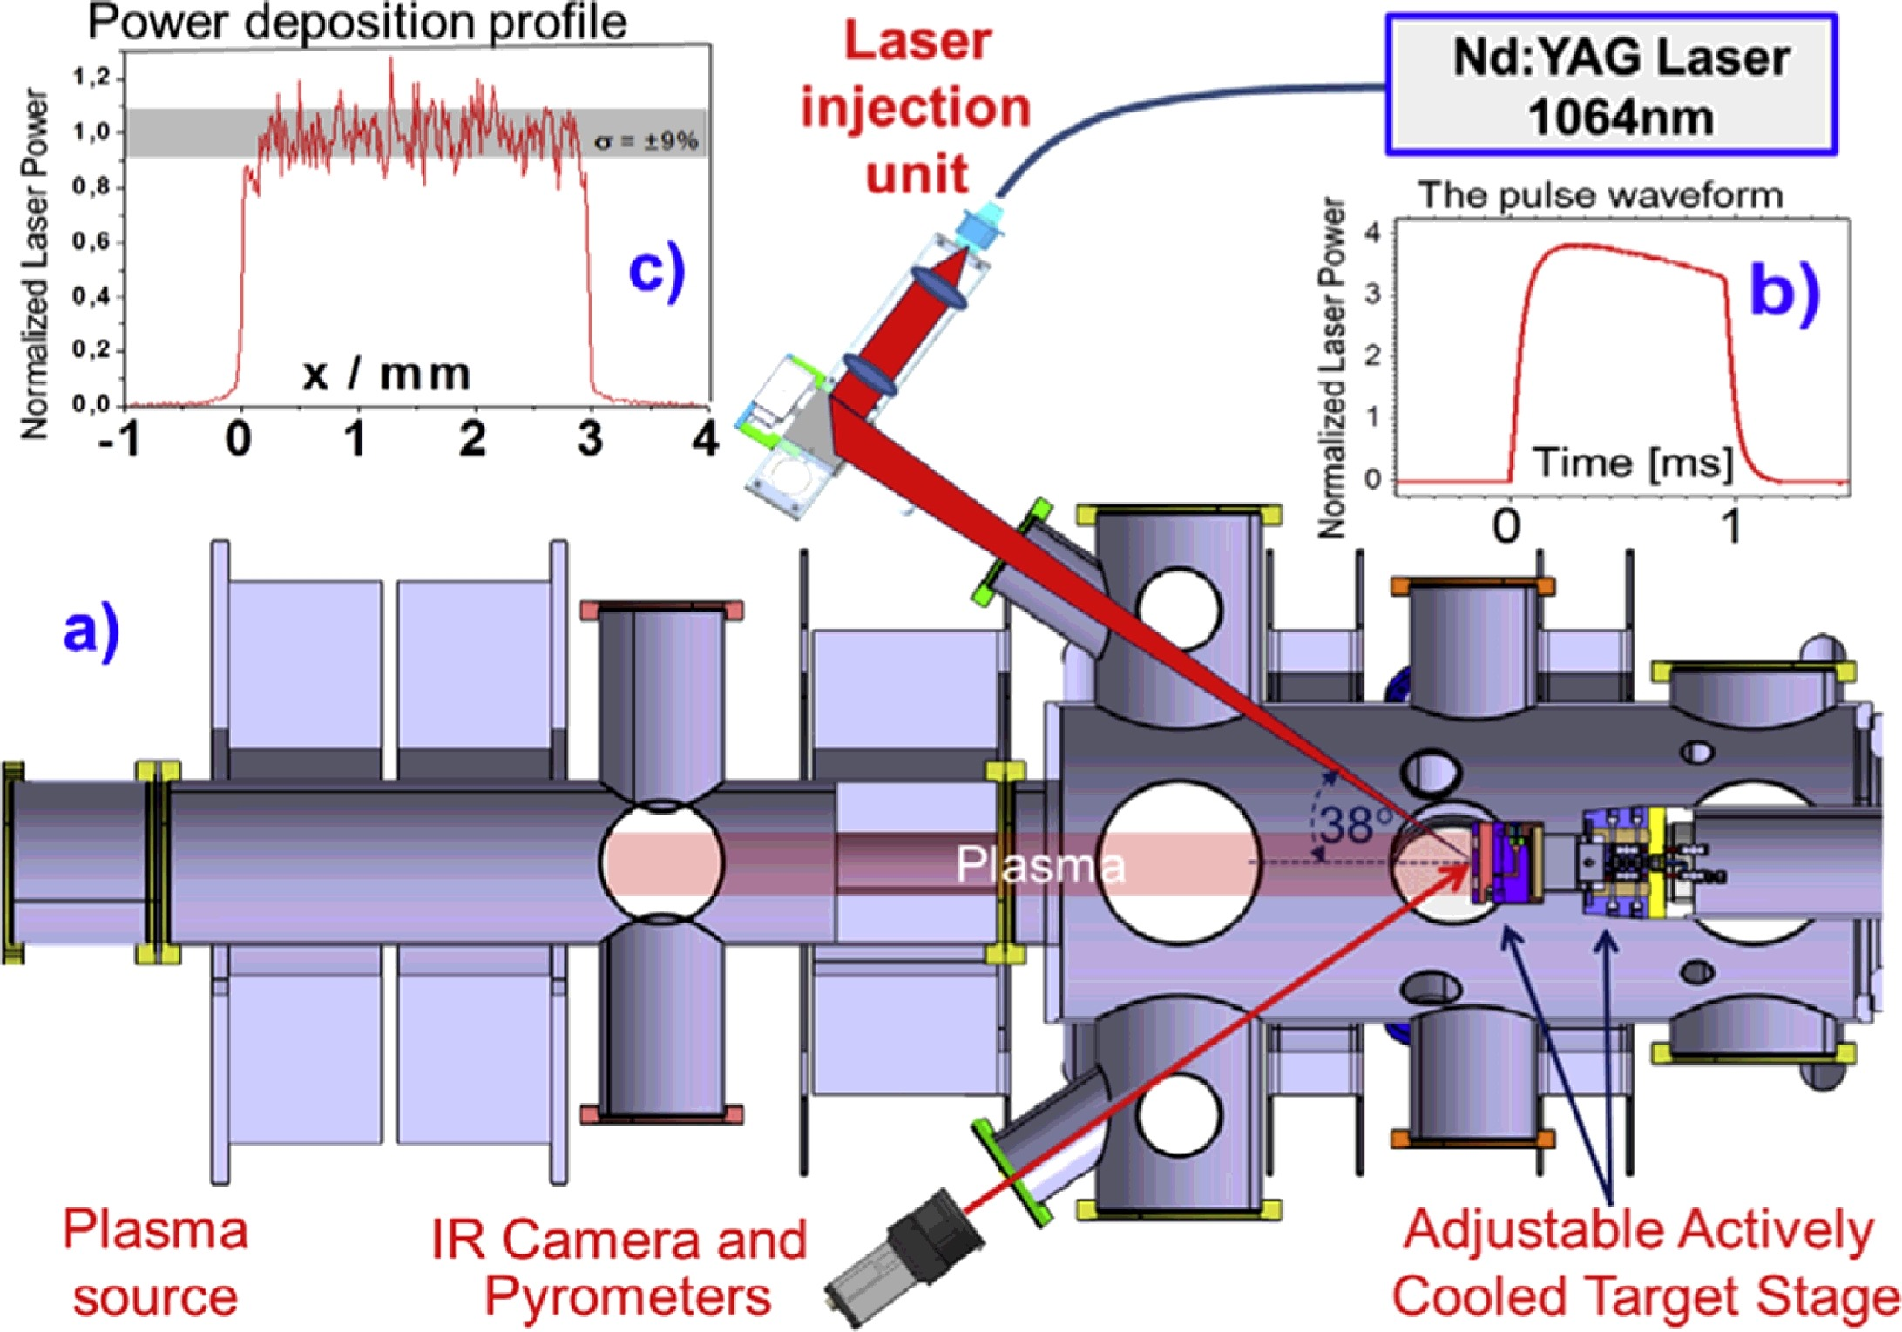
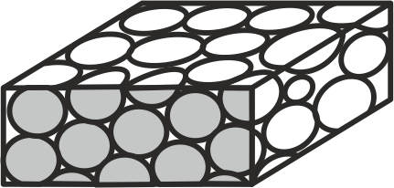
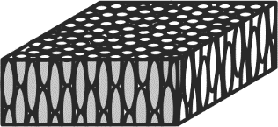
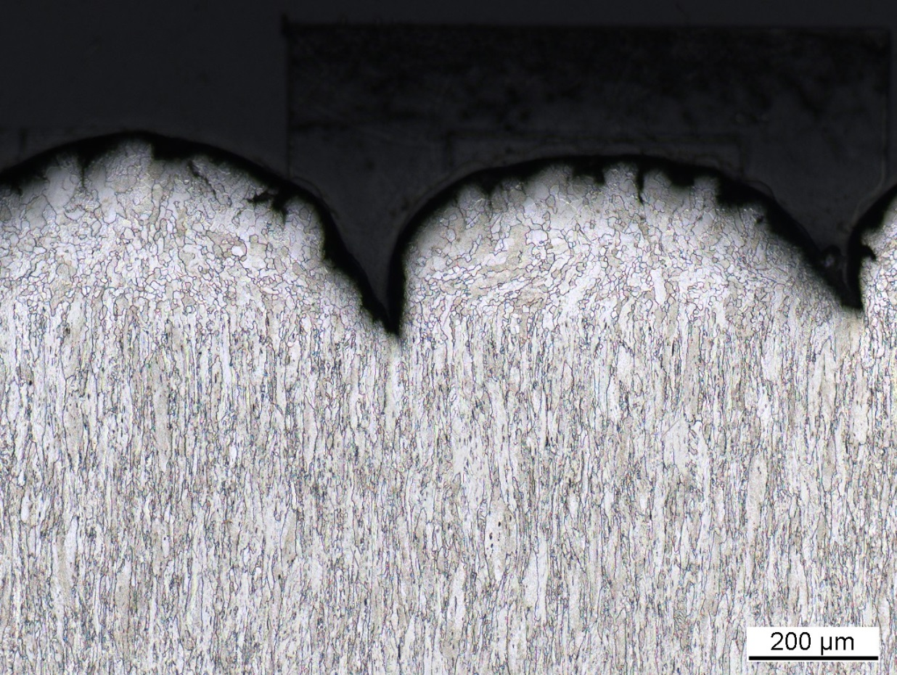
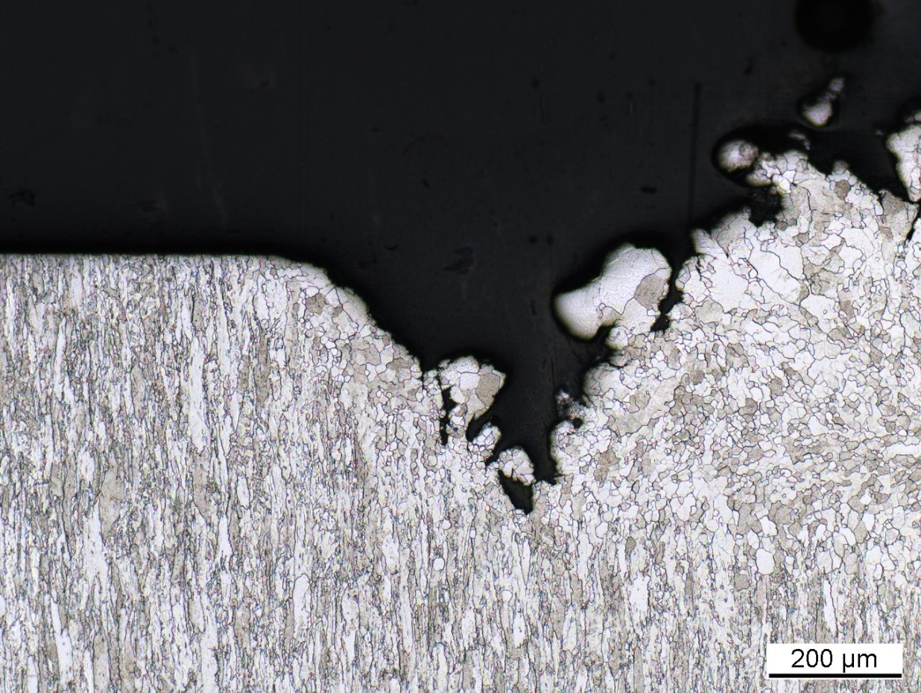
Synergistic effects of fusion relevant plasma and heat loads on tungsten
M. Gago, A. Kreter, B. Unterberg, M. Wirtz
Forschungszentrum Jülich, Institut für Energie- und Klimaforschung, 52425 Jülich, Germany
Introduction
Experimental
Heat loads
in ITER
Linear plasma generator PSI-2
The divertor region in ITER and DEMO will be exposed to intense particle and thermal loads, which will make the material more prone to damage formation due to synergistic effects. Tungsten has been selected as plasma-facing material (PFM) for the divertor in ITER due to its high melting point, its high thermal conductivity, its low tritium retention and its low erosion rate.
The exposure of tungsten to fusion relevant conditions, particularly to loads similar to those during edge-localized modes (ELMs), will help determine its suitability as a PFM, as it will allow the study of its deuterium and helium retention behavior, erosion rate and fatigue performance.
PSI-2 conditions
Base temperature | 700 °C
Pulses | 10⁴-10⁵
Pulse duration | 0.5 ms
Frequency | 10 Hz
Plasma | D/He (6 %)
Plasma flux | 3.3-6.0·10²¹ m⁻²s⁻¹
Plasma fluence | 4-8·10²⁵ m⁻²
Results and discussion
10⁵ thermal shock pulses
3.3·10²¹ m⁻²s⁻¹ flux
As-received
recrystallized
0.21 GW/m²
transversal
10⁵ thermal shock pulses
6.0·10²¹ m⁻²s⁻¹ flux
100 µm
1 µm
0.41 GW/m²
200 µm
200 µm
0.41 GW/m²
transversal
100 µm
1 µm
0.82 GW/m²
100 µm
1 µm
200 µm
200 µm
Two kinds of tungsten samples were compared. One with needle-like grains transversally oriented to the surface. The other was recrystallized and has larger, isotropic grains. The samples were weighed before and after being exposed to heat and particle loads.
Recrystallized samples had a much lower mass loss than transversal samples. A low erosion rate is important, as contamination of the plasma with tungsten would cool the reactor down and might even stop the fusion reaction.
0.82 GW/m²
200 µm
200 µm
Conclusions and outlook
Recrystallized samples appear to have a better resistance to erosion in comparison to transversal samples for higher laser power densities
Deuterium retention tests will be performed (NRA) to determine deuterium retention behavior
Tests with higher flux and pulse numbers (in the 10⁶ range) are planned
Micro- and nanohardness tests will be performed to characterize the deterioration of mechanical properties in the damaged spots
Mauricio Gago | Forschungszentrum Jülich | Institute of Energy and Climate Research (IEK-2) | m.gago@fz-juelich.de

