Slide 1
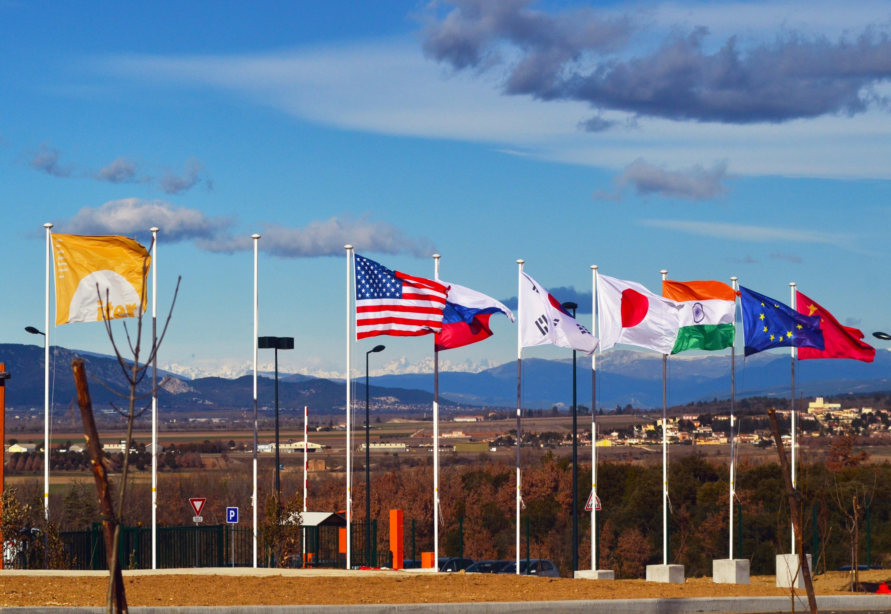
Welcome FuseNet@ITER
Tritium Breeding Technologies and the TBM Program
→ Preparing the NEXT STEP after ITER

Slide 2
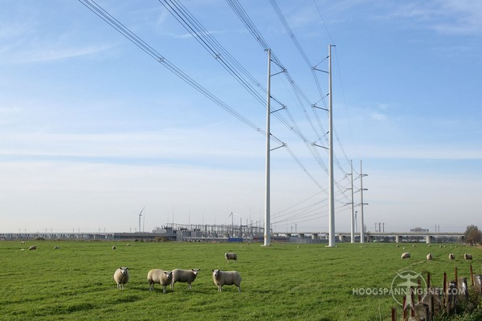
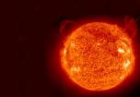
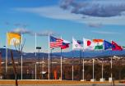


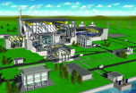
FuseNet@ITER, 181107-9
Outline
Fusion Electricity - next steps after ITER
Tritium Breeding Blankets
Test Blanket Modules Program in ITER
Disclaimer:
The views and opinions expressed today do not necessarily reflect those of the ITER Organization or the ITER Members

Slide 3


Slide 4
ITER
Global challenge, global response
China EU India Japan Korea Russia USA

Slide 5
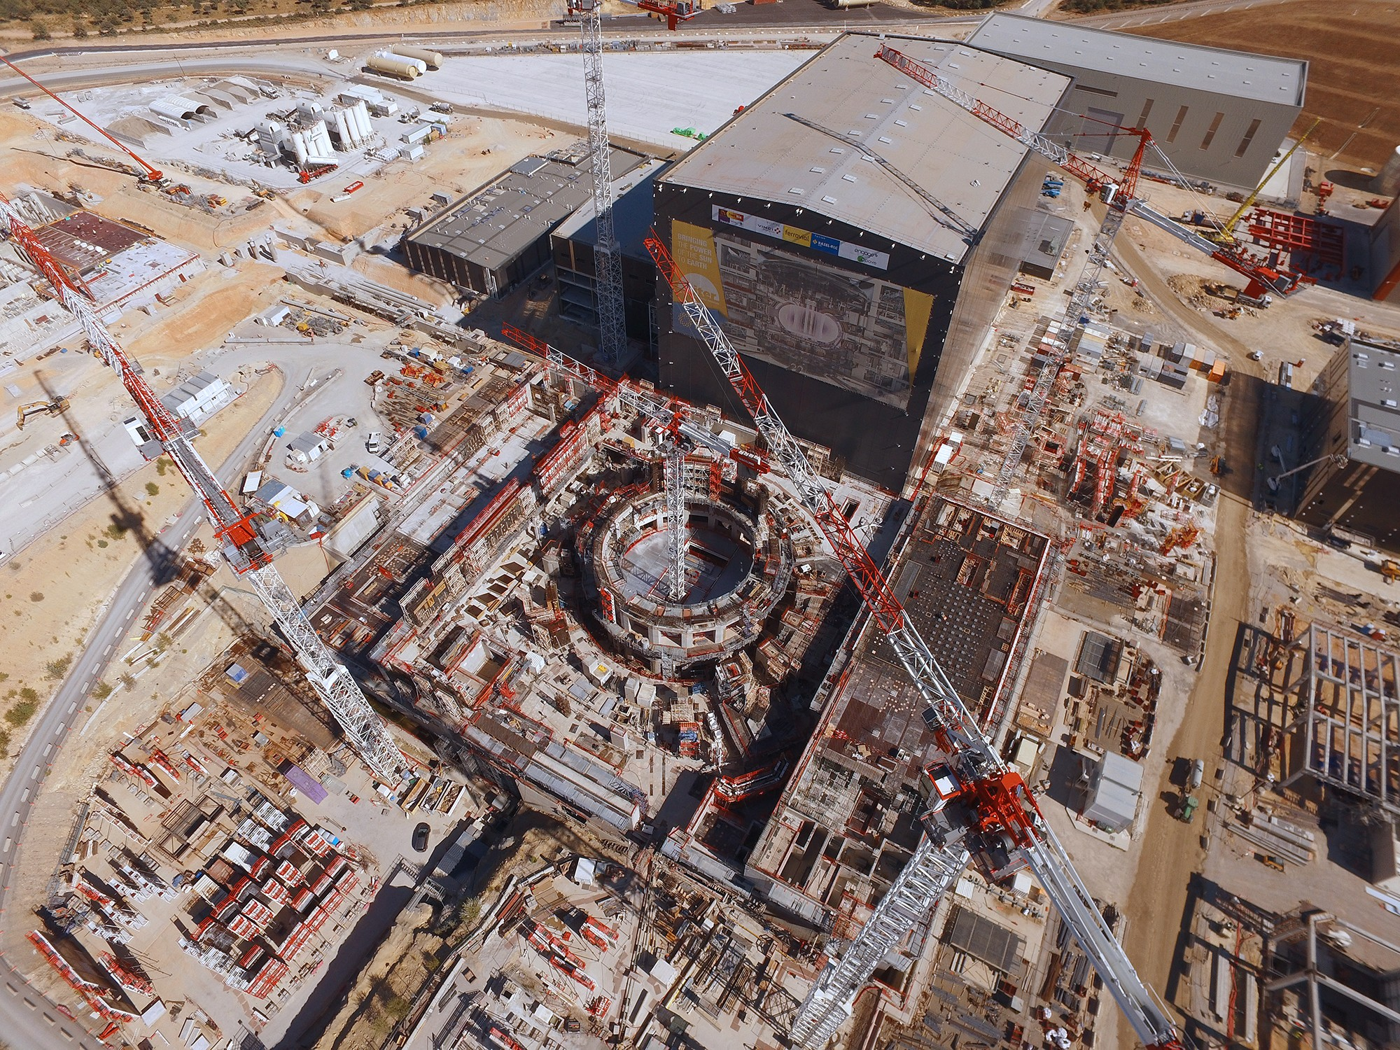
ITER
500 MWth

Slide 6
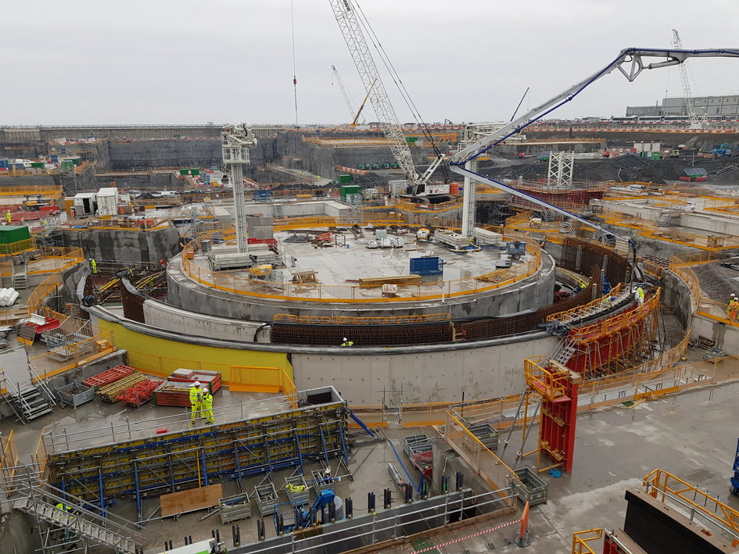
Hinkley Point C
2 x 4524 MWth
2 x 1630 MWe
Picture from French Embassy website

Slide 7
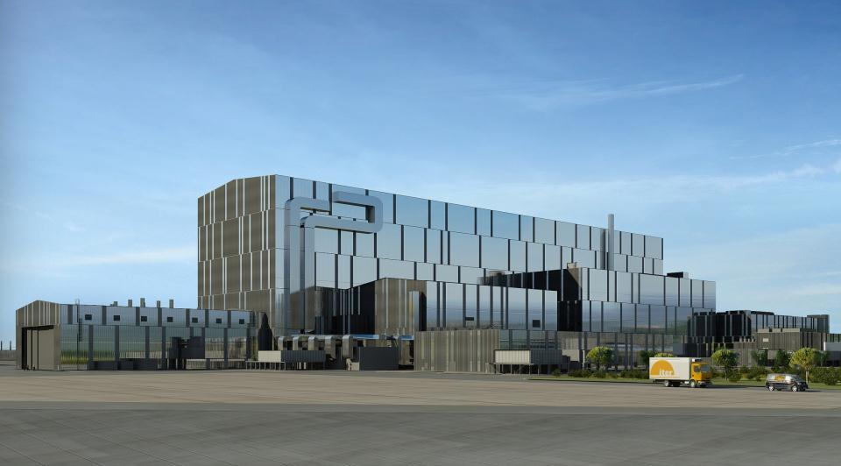
ITER Site 2025
tokamak complex

Slide 8

Fusion Electricity: bringing time forward

Slide 9
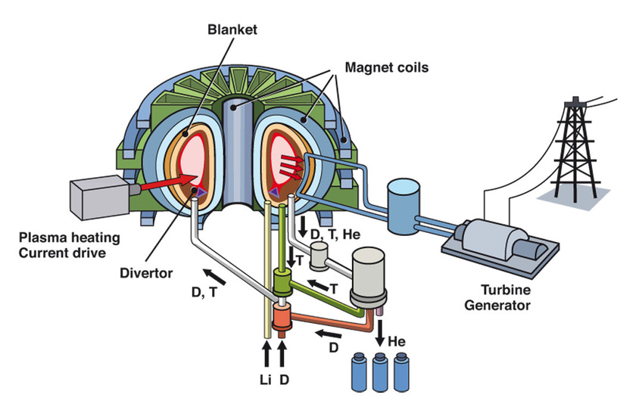
Power Plant Breeding Blanket functions
Three crucial functions:
Convert the neutron energy (80% of the fusion energy) into heat and collect it by mean of an high grade coolant to reach high conversion efficiency (>30%)
In-pile heat exchanger
Produce and recover all Tritium required as fuel for D-T reactors
Tritium breeding self-sufficiency
Contribute to radiation shielding of the superconducting coils
➔ Resistant to high neutron flux and fluence
See talk by R. Raffray

Slide 10
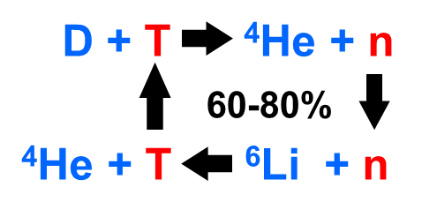
Breeding blankets: Tritium Breeding Self-sufficiency
Tritium breeding self-sufficiency : a necessity
Typical Tritium production rate in heavy water reactor : 1-2 kg T / GW_{th} / y
Typical Tritium burn rate in a fusion reactor : ~ 70 kg T / GW_{th} / fpy (~150 gT/GW_{th}/day)
Need to produce all Tritium and collect it on-line (because of initial inventory and safety)
Tritium Breeding Ratio, TBR = T_{produced} / T_{burnt} > 1 (at least)
Tritium breeding self-sufficiency : a severe constraint
Main Tritium production reaction : ⁶Li + n => T + ⁴He + 4,8 MeV
Neutron Losses
n-leakage through ports,
divertor region, gaps
➔ 10 – 20 %
n-parasitic absorptions on other materials (structures)
➔ 10 – 15 %
blanket n-leakage (< 5%)
Neutronics requirements
minimize n-losses
➔ small gaps and openings,
minimization of structures
and coolant fractions
add a n-multiplier
➔ Pb (n, 2n) or Be (n,2n)
or ⁷Li (n, n’T)
20 to 40 % of neutrons
are not available for
T-production

Slide 11
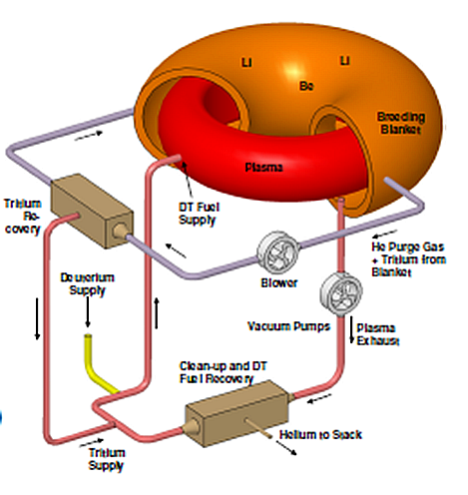
Deuterium-Tritium Fuel Cycle (2/2)
Ingredients for fusion energy systems with Tritium self-sufficiency: add ⁶Li as close as possible around the plasma to capture neutrons*
Main available T-breeders (Li-based compounds):
Solid Li-Ceramics: Li₂O, Li₄SiO₄, Li₂TiO₃
Liquid Lithium (natural 7.5% ⁶Li)
Liquid Eutectic Pb16Li-alloy (T_{melting}: ~ 235°C)
Liquid Molten Salts : FLiBe, FLiNaBe
Neutron multipliers:
Be (n, 2n)
Pb (n, 2n)
⁷Li (n, n’T)
Main Coolants (relevant for plant efficiency)
Pressurized Water (LWR, SCWR)
Gas: Helium, CO₂)
Liquid Metals: Li, LiPb-alloy
Main Structural Materials (BlanketModules)
Ferritic/Martensitic Steels
Vanadium Alloys
Composites SiC/SiC
* In Blue Bold: covered by present ITER TBM Program

Slide 12
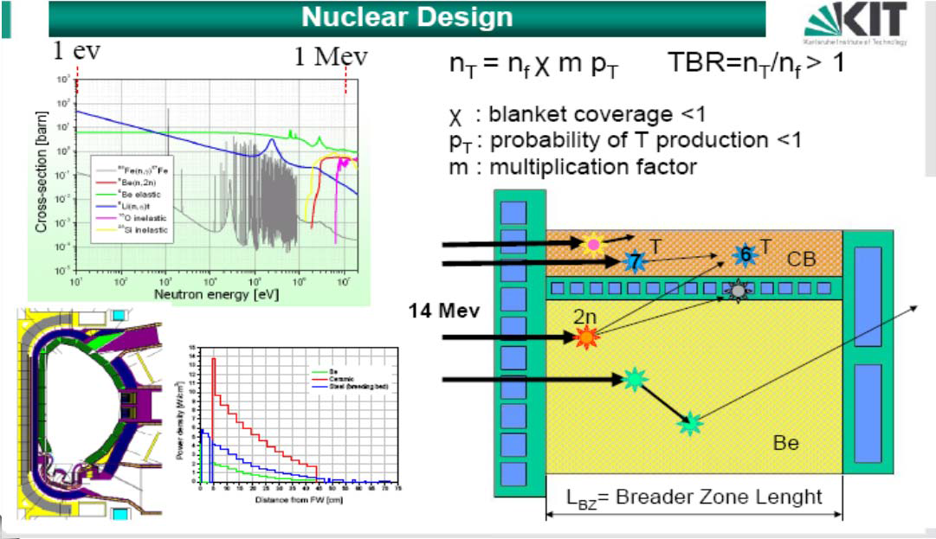
Breeding Blanket Nuclear Design

Slide 13
Material challenges for Gen4 & Fusion
[Based on Zinkle, SMINS, 2007]
DEMO/FPR divertor (consumable)
AGR
ITER

Slide 14
Reduced Activation Ferritic-Martensitic Steels (1/2)
Belongs to the series of 9%Cr F/M Steels used in the tempered martensite microstructure
Reduced Activation:
  Low level waste already after 80-100 years
  Nb and Mo are dominating
Long term irradiation of a DEMO First Wall: 12.5MWa/m²: ~115 dpa
R. Lindau et al., Fusion Eng. and Design 75-79 (2005) 989-996

Slide 15
Reduced Activation Ferritic-Martensitic Steels (2/2)
RAFM Steel compositions presently considered (TBM CD inputs)
 | EU HCLL & HCPB |  | JA WCCB | KO HHCR | CN HCCB |  | IN LLCB
Elements / wt% | GradeX10CrWVTa9-1 (Eurofer97) as in RCC-MRx 2012 | GradeX10CrWVTa9-1 (Aimed for values) | F82H [Target] | ARAA | CLF-1 | CLAM | IN-RAFMS
Ag |  |  |  |  |  | <0.005
Al | < 0.0100 | As low as possible | < 0.1 | ≤ 0.1 | <0.03 | <0.01 | 0.005
As |  |  |  |  |  | <0.005 | 0.01
As+Sn+Sb |  |  |  | ≤ 0.05
As+Sn+Sb+Zr |  | < 0.05 |  |  | <0.005
B | < 0.002 | As low as possible | <0.003 [0.0010] | < 0.002 | <0.005 | <0.002 | 0.001
C | 0.09 to 0.12 | 0.11 | 0.08-0.12 [0.10] | 0.080 – 0.12 | 0.11±0.015 | 0.1±0.02 | 0.12
Co | < 0.0100 | As low as possible | < 0.01 | ≤ 0.1 | <0.01 | <0.01 | 0.005
Cr | 8.5 to 9.5 | 9 | 7.5-8.5 [8.0] | 8.70 – 9.300 | 8.5±0.3 | 9.0±0.5 | 9.2
Cu | < 0.0100 | < 0.0050 | < 0.05 | ≤ 0.1 | <0.01 | <0.01 | 0.002
Fe |  |  |  |  |  |  | 88.1
H |  |  |  | ≤ 0.01
Mn | 0.20 to 0.60 | 0.40 | 0.05-0.5 [0.45] | 0.30 – 0.60 | 0.5±0.2 | 0.45±0.2 | 0.6
Mo | < 0.0050 | As low as possible | < 0.05 | ≤ 0.05 | <0.01 | <0.005 | 0.002
N | 0.015 – 0.045 | 0.03 | < 0.002 | 0.005 – 0.015 | 0.02-0.035 | <0.02 | 0.04
Nb | < 0.0050 | As low as possible | < 0.1 | ≤ 0.05 | <0.01 | <0.005 | 0.001
Ni | < 0.1 | < 0.0050 |  | ≤ 0.1 | <0.01 | <0.01 | 0.005
O | < 0.01 |  | < 0.005 | ≤ 0.1 | <0.005 | <0.01 | 0.01
P | < 0.005 | - | < 0.01 | ≤ 0.05 | <0.005 | <0.005 | 0.002
S | ≤ 0.005 | - | < 0.01 | ≤ 0.05 | <0.005 | <0.005 | 0.002
Sb |  |  |  |  |  | <0.005 | 0.01
Si | < 0.050 | - | < 0.2 | 0.05 – 0.15 | <0.05 | <0.05 | 0.05
Sn |  |  | < 0.004 |  |  | <0.005 | 0.01
Ta | 0.10 – 0.14 |  | 0.01 - 0.1 [0.08] | 0.005 – 0.09 | 0.10±0.03 | 0.15±0.02 | 0.08
Ti | < 0.02 |  | < 0.01 | 0.005 – 0.020 | <0.01 | <0.01 | 0.005
V | 0.15 – 0.25 |  | 0.15-0.25 [0.20] | 0.05 – 0.30 | 0.3±0.1 | 0.2±0.05 | 0.24
W | 1.0 – 1.2 | 1.1 | 1.8-2.2 [2.0] | 1.00 – 1.40 | 1.5±0.2 | 1.5±0.1 | 1.5
Zr |  |  |  | 0.005-0.020

Slide 16
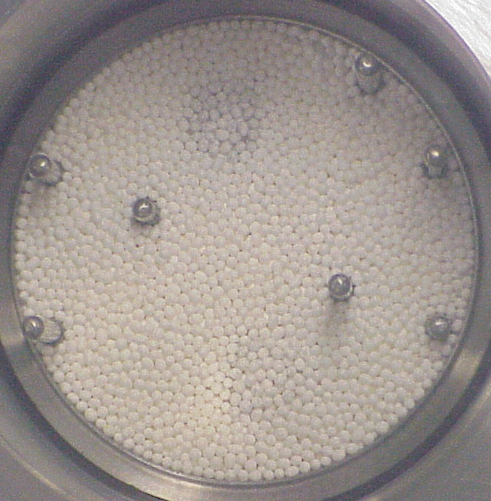
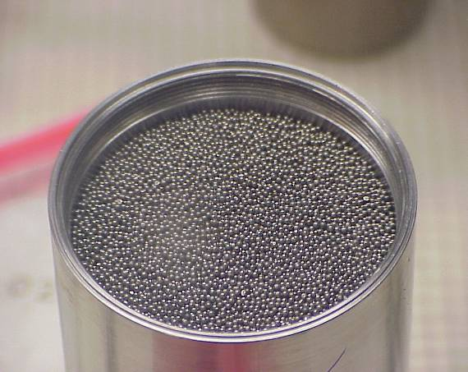
Lithium-ceramics and Beryllium Pebble-Beds
Ceramic Breeder: Ternary Lithium Oxides, based on Li₄SiO₄ and Li₂TiO₃
T-production rate be raised by enrichment in ⁶Li (typically 30–60%).
Neutron multiplier: beryllium, beryllium alloys
Pebble-beds purged with He+H₂ gas for T-extraction
Li₂TiO₃
Be
Technology chosen for pebble production aims at low long term activation and the possibility to recycle (dissolution or remelting) of all the materials

Slide 17
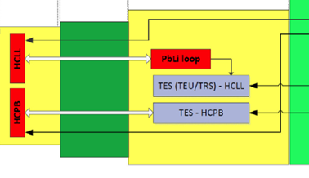
Pb16Li – Lithium Lead eutectic alloy
Pb16Li has melting point at about 235 °C
Always applied as a loop
Tritium extraction is performed outside the VV
⁶Li can be added in the loop
taken from: I. Ricapito et al. / Fusion Engineering and Design 89 (2014) 1469–1475

Slide 18
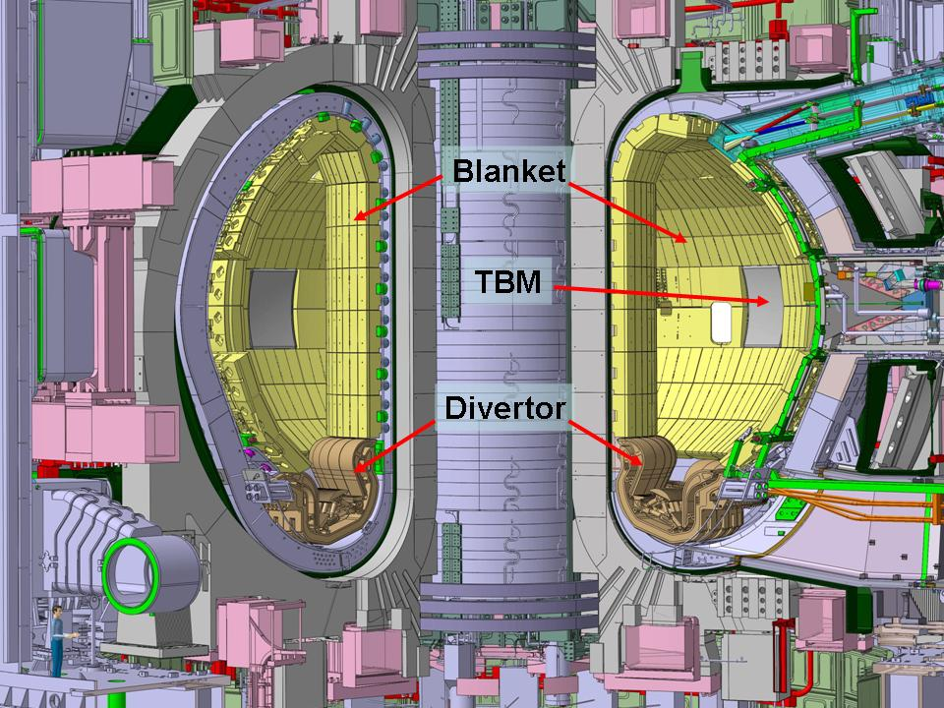
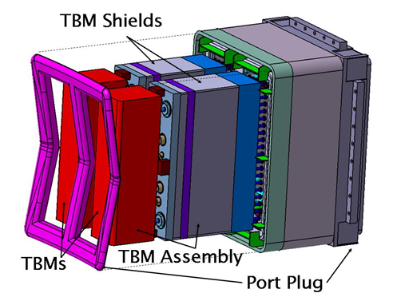

Testing of Tritium Breeding Blankets in ITER
Oone of the ITER missions is the following (cf. Project Specifications): “ITER should test tritium breeding module concepts that would lead in a future reactor to tritium self-sufficiency, the extraction of high grade heat and electricity production.”
All IO-CT & DA activities related to this mission form the “TBM Program”

Slide 19
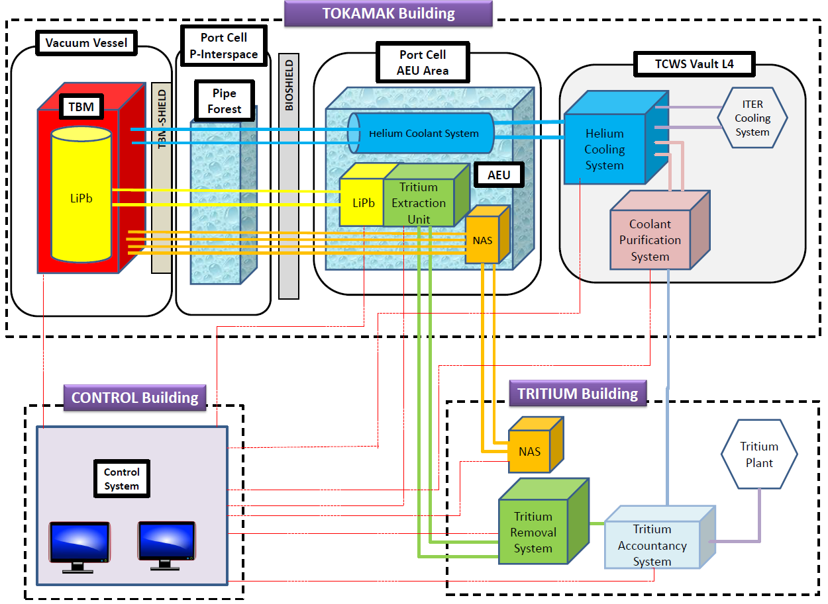
Scheme of a Test Blanket System
Example of the HCLL TBS - Locations in the various ITER buildings

Slide 20
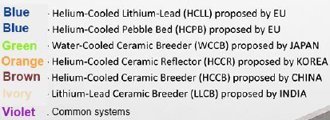
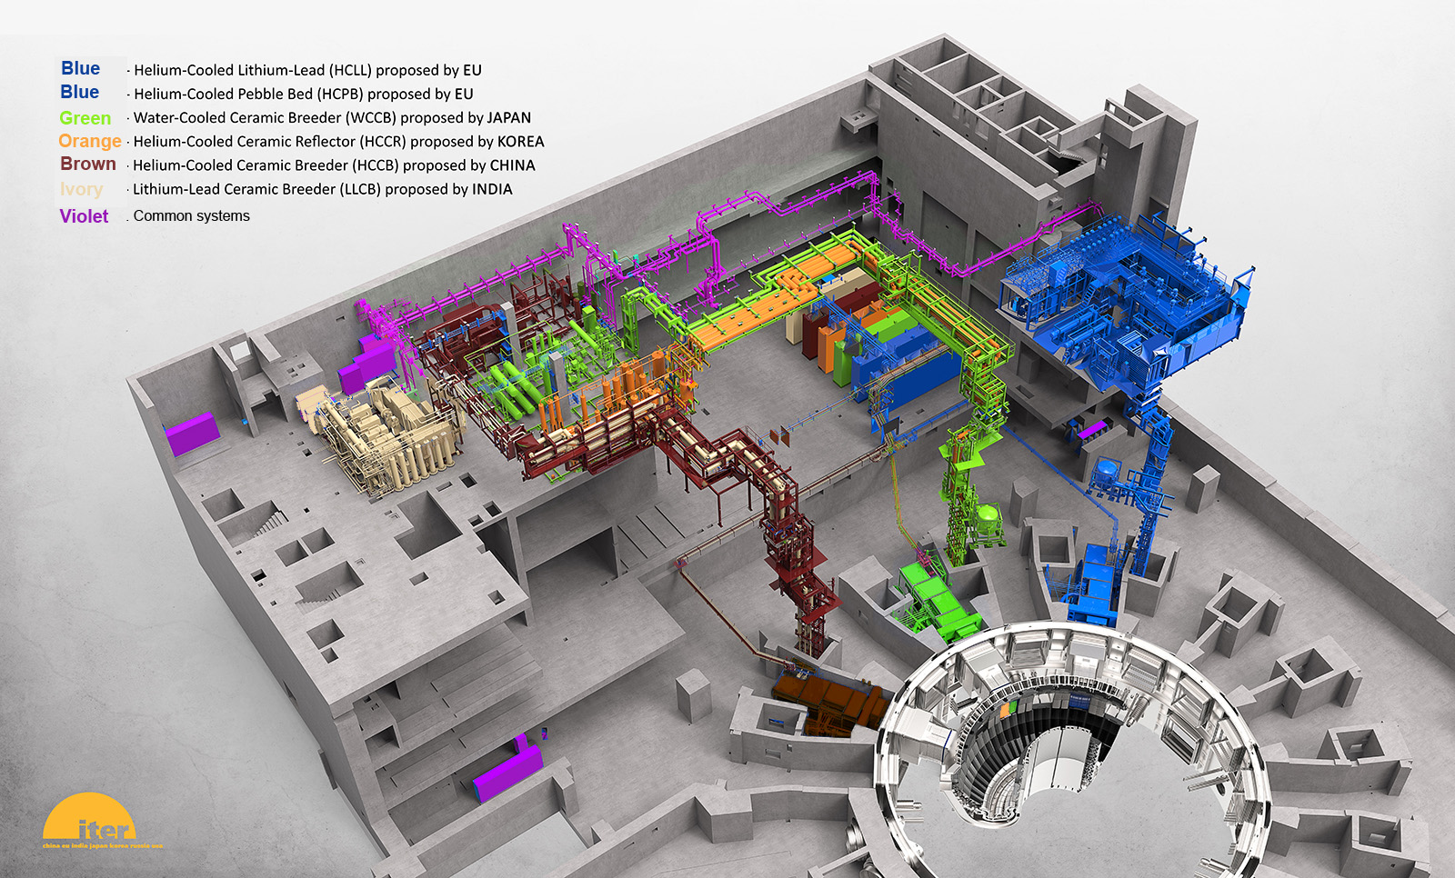
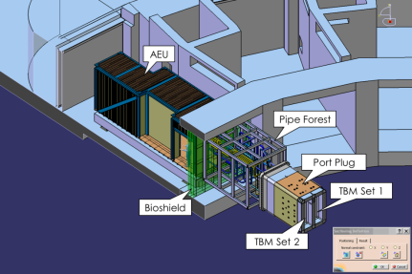
Overall View of the 6 Test Blanket Systems in the Tokamak Complex

Slide 21
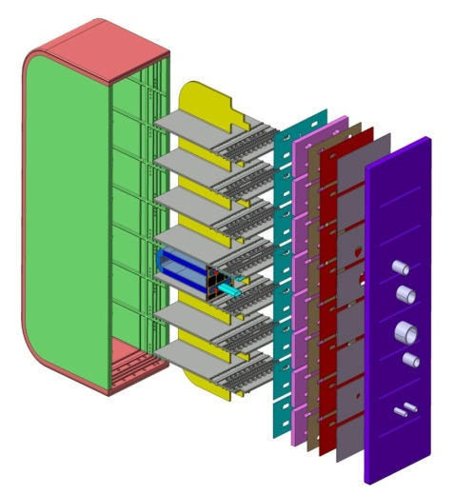
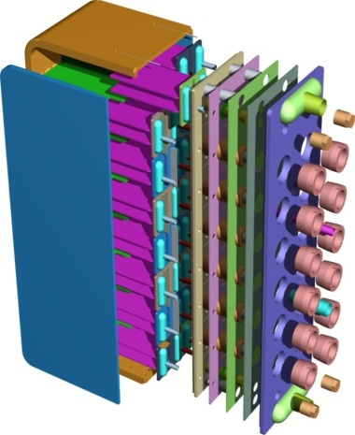
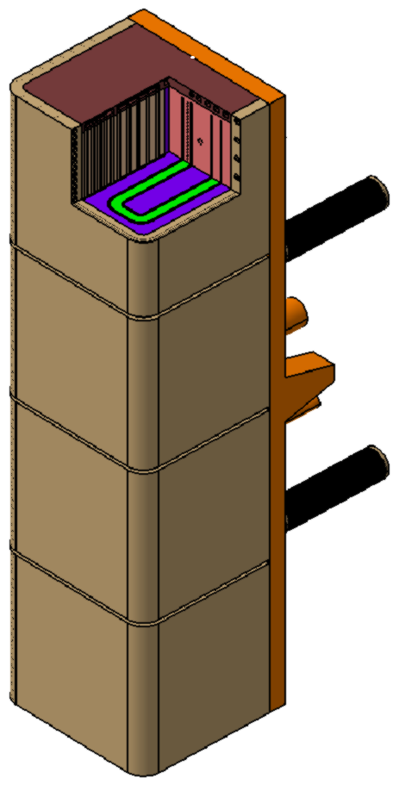
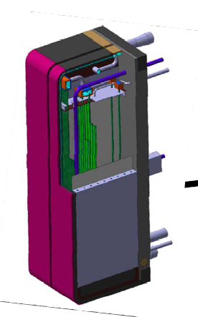
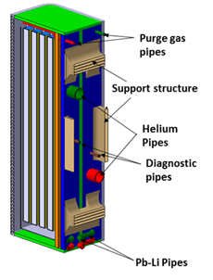
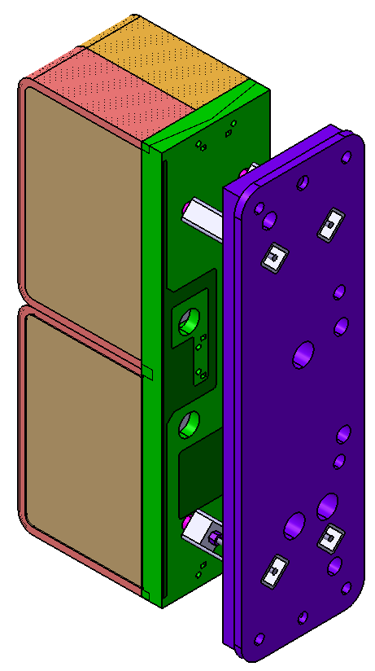
View of the 6 Test Blanket Module Designs
Helium coolant:
80 bar
300 – 550°C
Water coolant:
155 bar
280 – 325 °C
EU-HCPB
EU-HCLL
CN-HCCB
KO-HCCR
JA-WCCB
IN-LLCB

Slide 22
Main Objectives of the TBM Program
Validation of the nuclear response prediction with existing modelling codes and nuclear data
Assessment of the TBMs thermo-mechanical behaviour at relevant temperature and volume heat sources using the specifically developed structural materials
Demonstration of the tritium management, including validation of Tritium extraction techniques and permeation reduction capability; validation of modelling for extrapolation to DEMO
Breeding Blanket performance for an extended period of time in order to obtain initial reliability data
Post-Irradiation Examinations for material/process data

Slide 23
TBM Program Testing Plan - Adopted Strategy
The operation of the TBS must not jeopardize ITER performance, reliability / availability and safety ➔ the TBM testing plan has to be adapted to the ITER operation plan
Up to 4 design versions per each TBM will be tested in order to take into account the various ITER operation conditions
➔ the TBM Port Plugs have to be replaced ~3 times
Typical TBS testing sequence:
TBS learning/validation phase
the Electro Magnetic version (EM-TBM): during the initial H phase and H-He phase
the Thermal/Neutronic version (TN-TBM): during D & initial DT1 phase (low duty)
TBS data acquisition phase
the Neutronic/Tritium & Thermo-Mechanic version (NT/TM-TBM): during final DT1 phase (low duty)
the INTegral TBM (INT-TBM): during DT2 phase (high duty, long pulses)

Slide 24
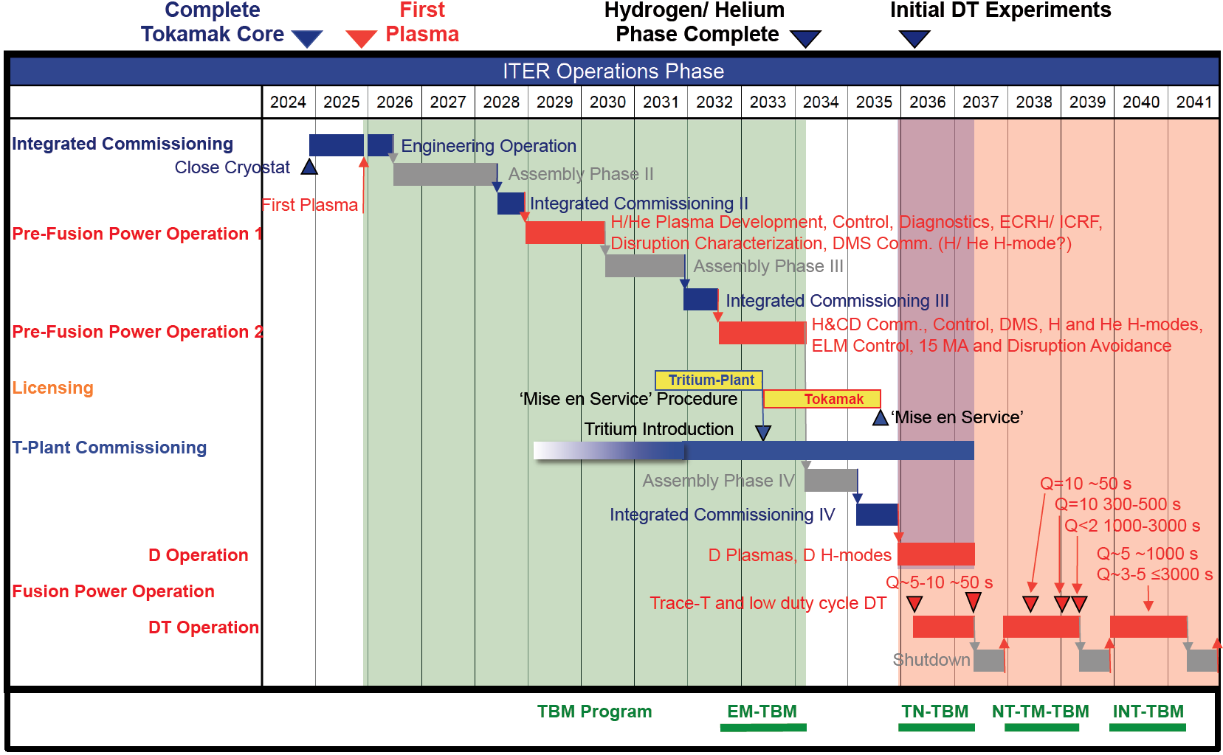
ITER Research Plan & associated TBM Program

Slide 25
Fusion Electricity: bringing time forward

Slide 26
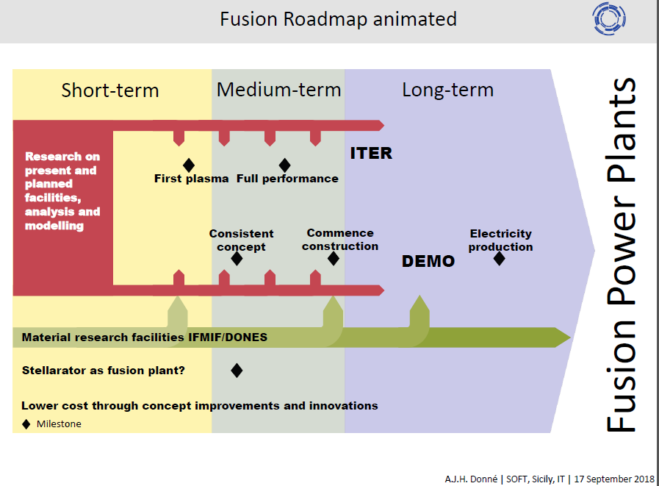

Slide 27
Breeding Blankets Development Timescale
Reactors | JET, TFTR, JT60, Tore Supra Asdex, etc. | one ITER | DEMOs | FOAK Commercial Power Plants
Main | Plasma Physics (control,stability, impurities, shutdown proc., heating, etc.) | Plasma Q=10 Long D-T pulses Systems Integration | Tritium Breeding Self-sufficiency High Safety Standards | Electricity Production at Competitive Cost High Reliability
Goals | Magnetic Field Advanced Systems (e.g., super cond. coils) | Test of DEMO Blanket Mock-ups (Test Module) | Electricity Production (high efficiency, but limited availability) | High Availability Low Level Waste
Operation Years | Since 1980 | ~ 2030 - 2050 | > 2050 ? | > 2070 ?

Slide 28
ITER
Global challenge, global response
China EU India Japan Korea Russia USA

Slide 29
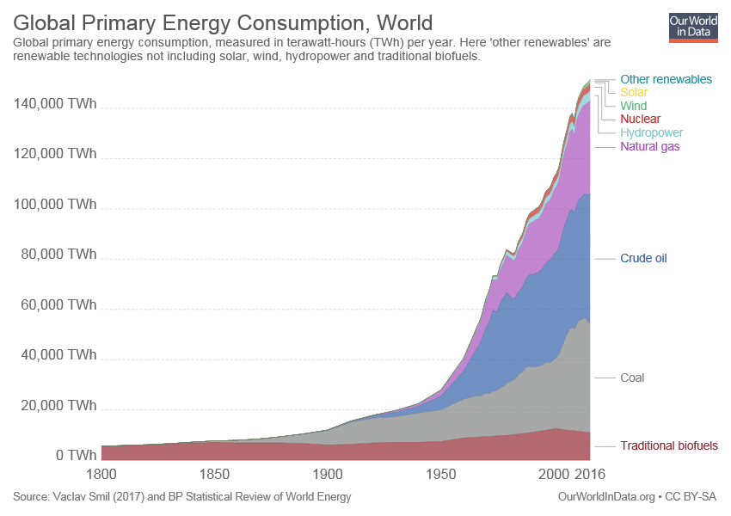
ITER
Global challenge, global response
China EU India Japan Korea Russia USA

Slide 30
Additional Slides

Slide 31
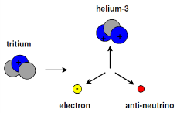
ITER Fuel Cycle
Tritium is a pure β-emitter (E_{max} = 18 keV)
Half life t_{1/2} = 12.323 years
1 gram T = 324 mW decay heat
Main radiological hazard through ingestion
ITER Fueling systems:
Gas Injection
Solid Pellet Injection
Neutral Beam Injection
Plasma T throughput ~ 1 kg/hr
Plasma T inventory ~ 0.2 g
T inventory on-site < 4 kg
Fuel cycle inventory ~ 2 kg
The ITER Tritium–plant is a 7-floor nuclear building: H 35, L 80, W 25 m

Slide 32

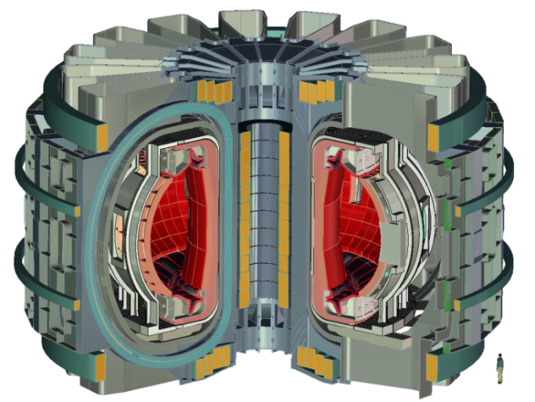
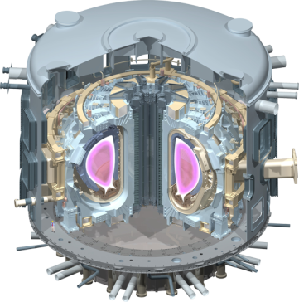
ITER and beyond
ITER
800 m³
~ 500 MW _{th}
DEMO, pre-industrial demonstrator
~ 500 Mw_{e}, 1 200 MW _{th,}

Slide 33


Of bathtubs and laptop batteries…
+
Lithium* contained in the battery of a single laptop computer and deuterium from half a bathtub of water can provide 200,000 kilowatt/hours of electricity.
That's enough to cover for 30 years the energy needs of one person in Western Europe.
* Neutrons impacting Lithium generate Tritium

Slide 34

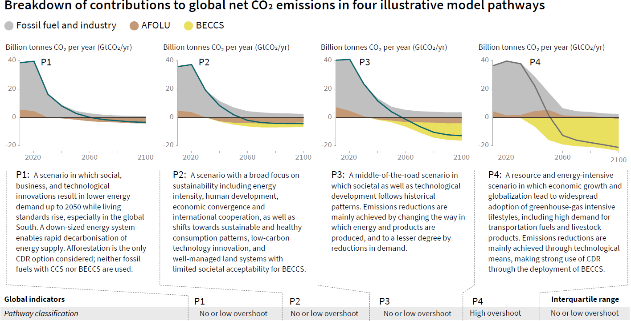
ITER
Global challenge, global response
China EU India Japan Korea Russia USA

Slide 35
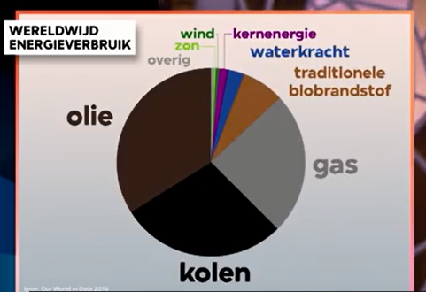
ITER
Global challenge, global response
China EU India Japan Korea Russia USA

