Slide 1
Energy Industry Economics
How fast can fusion grow?
Guido Lange MSc, Researcher at the TU/e, Also on behalf of prof. dr. Niek Lopes Cardozo (TU/e), prof. dr. Gert Jan Kramer (Utrecht University)
Science and Technology of Nuclear Fusion

Slide 2
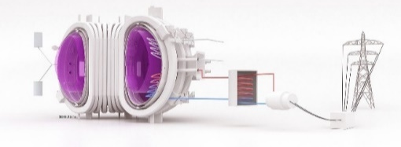
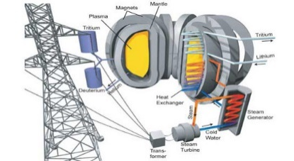
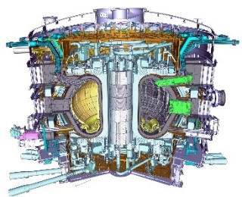
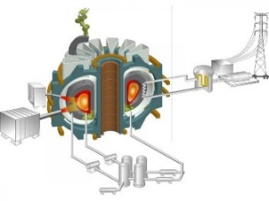
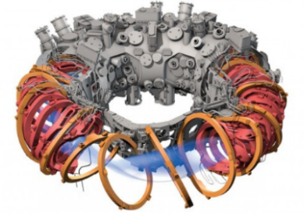
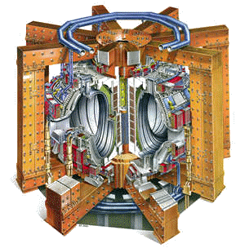
ITER is a long awaited milestone on the journey towards fusion electricity
Commercialisation
Time
Prototyping
?
Burning plasma
You are here!
Basic science
Notes:
ITER is a large success, even before its first plasma. The international collaboration is unprecedented.
However, it is still a step towards the goal: fusion electricity.
We developed a long way through science, and we still do.
What would the (commercial) future of fusion look like?
When will we have fusion electricity? DEMO 2060s

Slide 3
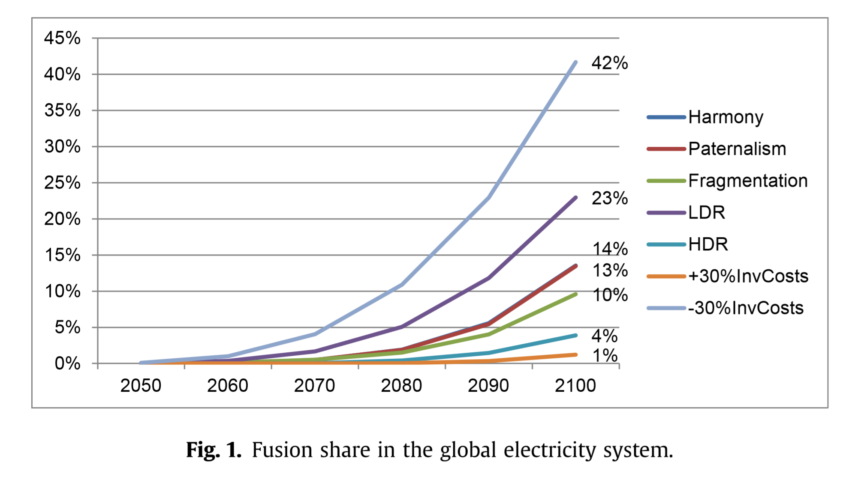
EUROfusion Socio-Economic Studies 2017: 14% Electricity in 2100
Total electricity: 4.4TW
So, 14% = 621 GWe
With capacity factor: 70%, this means almost 900 plants by 2100
2060: 3 2070: 19
2080: 63
2090: 317
2100: 887
For 6-3 $/W!
In the baseline scenario, strong CO2-policies are implemented.
Cabal et. al., Fusion power in a future low carbon global electricity system, Energy Strategy Reviews (2017)
Notes:
Here you see the outcome of a modelling study, the socio-economic studies of EUROfusion.
Baseline scenario: 14% 2100. That is 621 GWe. With a capacity factor of 70% this means 900 plants.
It is a cost optimization, with the assumption that fusion costs 6 $/W in 2050 (and then decreases). Note: “With costs more than 30% surplus, no fusion contribution”

Slide 4
What does it mean, having 900 devices in 2100?
This means building 16 in ‘60-’70, and 44 in ’70-’80, and 254 in ‘80-’90
What if they cost 10 years to build? ITER costs 28 years to DT-operation.
→ And design, licensing, commissioning?
→ Time is needed for concept improvement and prototyping
Fast to build devices are a necessity for a swift innovation cycle.
Can we shape the technology to manage that?
Notes:
What does it mean, following this growth curve?
Innovation cycle needed, therefore fast-to-build
You don’t want to build a generation before you have seen the previous working

Slide 5
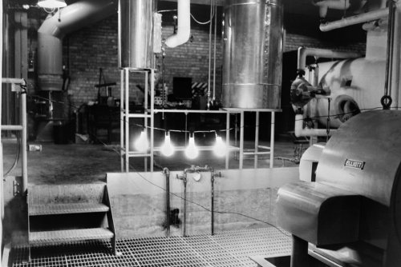
200 units
100 units
The first light bulbs ever lit by electricity generated by nuclear power at EBR-1 at Argonne National Laboratory-West, December 20, 1951.
10 units
1st GW plant
1 unit
1951: Fission demo (100kW)
1954: First grid connection (5MW)
1959: 10 units (500MW)
The initial upscaling of nuclear fission from 1954. Source: IAEA.
Notes:
In 1951, fission demonstrated electricity production: a few lightbulbs.
From 1 to 10 GWe in seven years. In 1960 ten units in operation and a decade later 100.
Fission had the advantage of smaller plant sizes (50-200 MW). In 1973 the first GW-reactor came online.

Slide 6
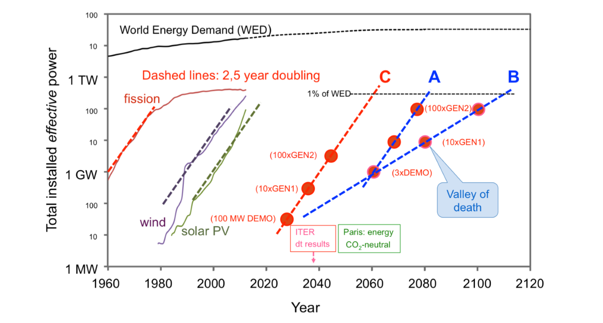
What trajectory could fusion find in the next decades?
N.J. Lopes Cardozo - The prospects of deploying fusion energy, Royal Society (2018)
Notes:
Typically, an energy source maintains doubling for 2.5 year during a few decades. This is the buildup of industrial capacity.
Note: If the energy payback time is longer than the doubling time, it is no net source during the exponential growth phase
Now let’s brainstorm how a fusion trajectory might go.
Could fusion follow the typical curve? Or will the doubling be slower?
Could the fusion community come up with a 100MW DEMO? Starting a growth curve from there?

Slide 7
What trajectory could fusion find in the next decades?
N.J. Lopes Cardozo - The prospects of deploying fusion energy, Royal Society (2018)
Notes:
Typically, an energy source maintains doubling for 2.5 year during a few decades. This is the buildup of industrial capacity.
Note: If the energy payback time is longer than the doubling time, it is no net source during the exponential growth phase
Now let’s brainstorm how a fusion trajectory might go.
Could fusion follow the typical curve? Or will the doubling be slower?
Could the fusion community come up with a 100MW DEMO? Starting a growth curve from there?

Slide 8
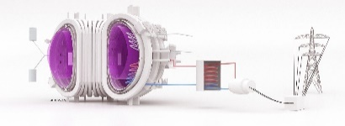
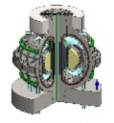
Are we developing the power plant the world is waiting for?
1% of World Energy Demand
1000x
100x
100x
10x
Industry growth
10x
Scale up
Plants, power, investments, workforce
1x
Commercialisation
?
1x
Prototyping
Science
You are here!
Time
Notes:
Currently we are on a track that takes us to 2060 to reach 1GW DEMO
Can we find breakthroughs that allows for a faster route?

Slide 9
What does it mean, building 16 devices for 5 $/W?
With 5$/W, this means 5 $/W *10⁹ W *16 = 80 bn$. → That is what the world needs to invest in fusion in 2050⁺
→ In the next decade: 176 bn$ and the one after that: 762 bn$ (= 80 bn$ per year)
That is the size of the industry.
With 2 $/W, 1GW, Lifetime 40 years, 60% Efficiency, 80% Capacity factor, 7% Discount Rate, 0.1$/kWh selling price: 14 years payback time after machine start. → Investments need to be made before construction starts.
That means getting devices three to four times as cheap at the start of growth. → Can we get the cost here?
Notes:
Now back to the EUROfusion socio-economic study: the costs..
Investments go over a long period. Governments rather than speculants.

Slide 10
A typical energy source Annual investments go up to 300 bn$/yr – after 30 years of exponential growth
New investment in clean energy reached $333.5 billion in 2017 (BNEF)
5 $/W
Net Installed / [10 GW]
3 $/W
Public
Investments
Annual Investments / [G$]
Private Equity
10 $/W
Industry: 75 GW/yr
Assumptions:
2.5 year doubling
30 year lifetime
5$/W at 300GW
Learning rate: 0.3
20 $/W
Notes:
For a typical 10% Energy source. Typical numbers (3yr exp, 30yr life, 5$/W at 300GW, learning 0.3)
When the installed capacity grows exponentially, the annual investments do the same.
The cost of development of a new energy source is an investment.
If the economic payback time is longer than the doubling time: cumulative investments are made during the whole exponential growth phase.
Fusion is not necessarily too expensive. Investments come in bigger steps.

Slide 11
What does it mean, being at the PhD Event in 2018?
YOU are the future of the field. Breakthroughs need to come out of your hands.
Getting machines cheap, fast, tailored: a lot of research and development, which YOU will lead.
That means YOU training the workforce, and making design decisions for commercial concepts.
That also means YOU convincing the world leaders to invest over decades.
Notes:
Finally, what does it mean, being here and now?
We should be developing the power plant the world is waiting for.

Slide 12
Breakthrough areas
High temperature superconductors
Liquid metal wall divertors
Supercomputing
...
Notes:
Let’s start with the potential breakthroughs.
Let’s discuss!
Please come up with ideas to make fusion faster. What suggestion do you have?
You are the future of the field, breakthroughs need to come from your hands

Slide 13
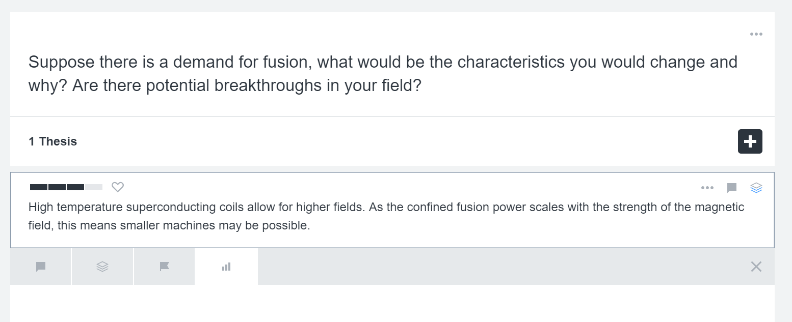
https://www.kialo.com/23314/
Notes:
Let’s structure our discussion via Kialo. Everyone has received a writer’s link to this discussion.
Add a thesis
Vote

Slide 14
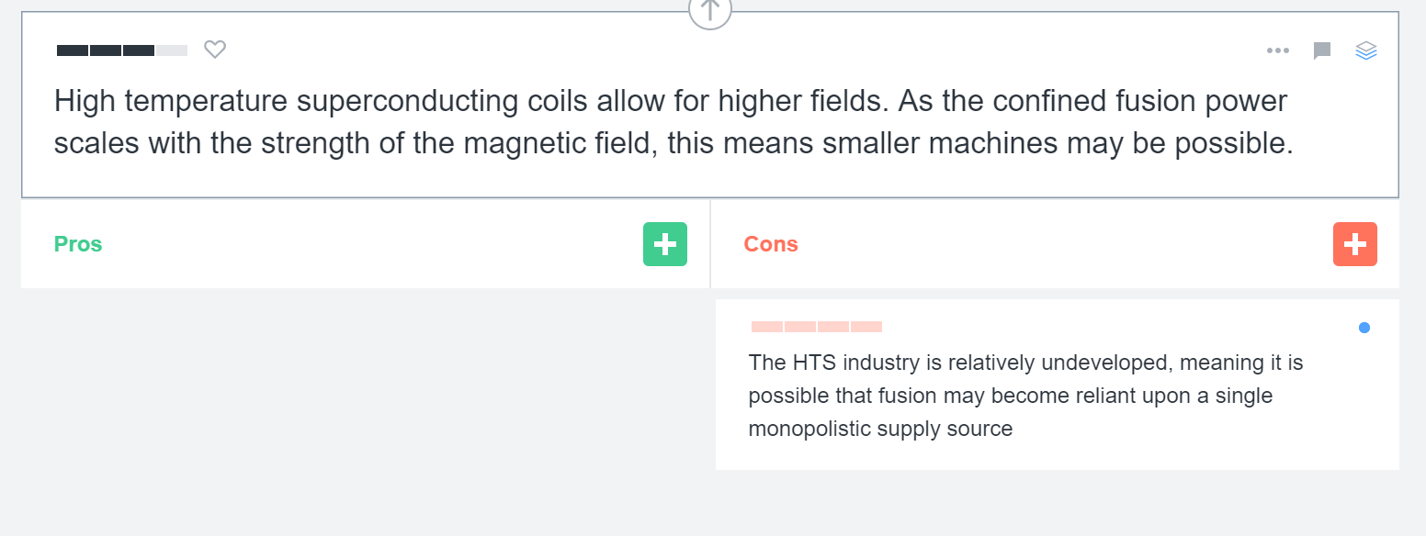
https://www.kialo.com/23314/
Notes:
Make a claim
Respond to a claim (pro/con)

Slide 15
https://www.kialo.com/23314/
Notes:
Everyone has received a writer’s link to this discussion.
Try it, maybe it is a cool thing to keep.
Does anyone have an idea to add?

Slide 16
Shell Sky Scenario: meeting Paris – the world does not wait for fusion
Data: https://www.shell.com/energy-and-innovation/the-energy-future/scenarios/shell-scenario-sky.html

Slide 17
Backup Slides
Energy Industry Economics – How fast can fusion grow?
A.G.G. Lange MSc, Researcher at TU/e
Science and Technology of Nuclear Fusion

Slide 18
What is the global payback period?
Installed capacity sells energy (0.1 $/kWh, capacity 50%)
Doubling 2 yr
Doubling 4 yr
Notes:
When you’d grow the most economical way, the return looks like this
Year 0 is when the growth starts: out of the lab, supplying energy.
The installed capacity sells energy (0.1 $/kWh, cap 50%)

Slide 19
EUROfusion SES Baseline goes with a doubling time of 4.2 years
Data: Cabal et. al. 2017; Model: Lange, The Fusion Deployment Model
Notes:
Now let’s brainstorm how a trajectory might go. Could the fusion community come up with a 100MW DEMO? Starting a growth curve from there?

Slide 20
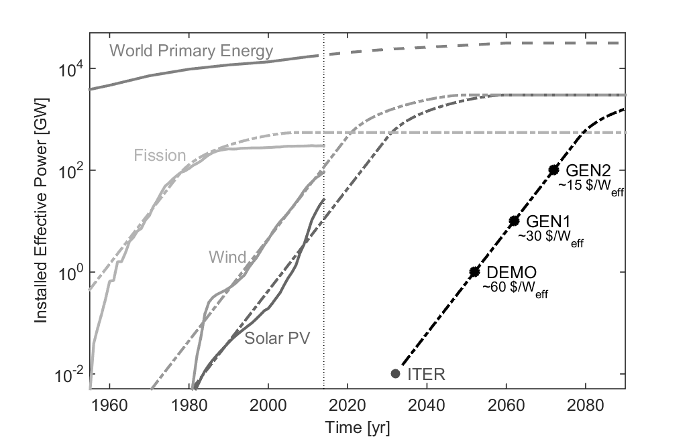
Draw typical energy technology lines for fusion: fusion is not too expensive...
...as long as it gets to a few dollar per Watt around 1% of global energy!
From: N.J.LopesCardozo, A.G.G.Lange, G.J.Kramer, Fusion: expensive and taking forever?, JoFE (2016)
Notes:
Fusion devices mean large steps on a development curve. Hence large upfront investments. But according to our analysis, fusion is not necessarily too expensive.

Slide 21
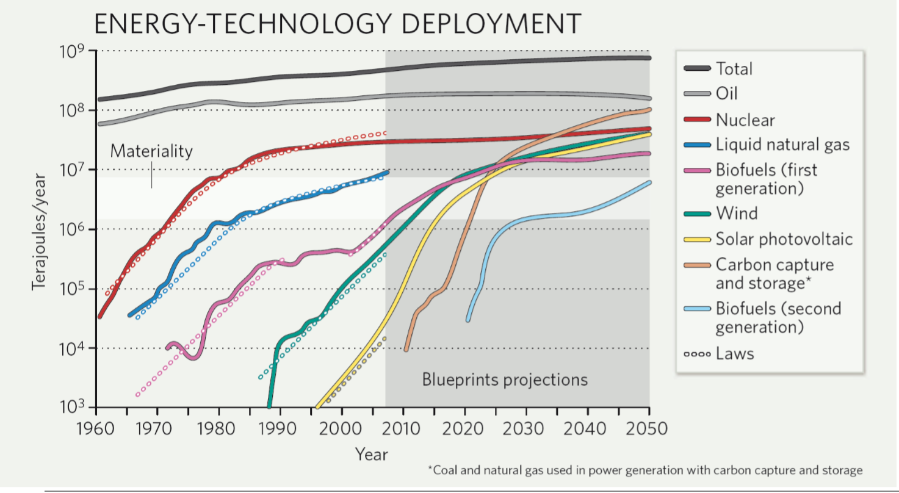
Historical data shows a growth pattern: 2 to 3 decades exponential growth
G-J Kramer and M Haigh, No quick switch to low carbon energy, Nature, Dec 2009
Notes:
History shows exponential phase followed by linear in which 90% of the growth happens.

Slide 22
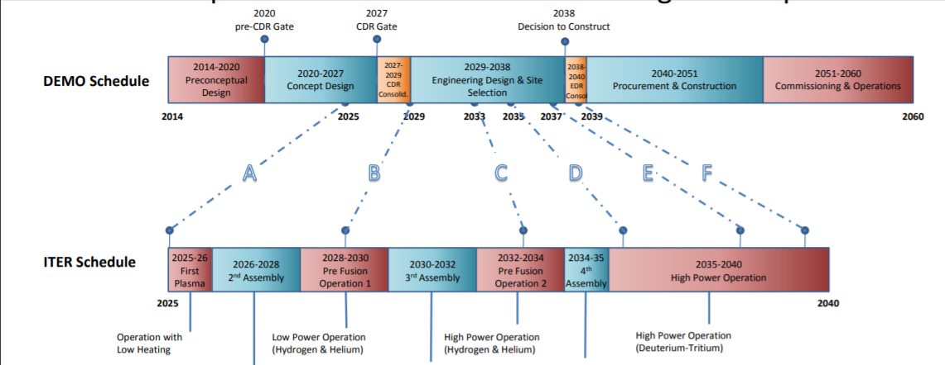
The EUROfusion Roadmap (2018) sketches DEMO in the 2060s
https://www.euro-fusion.org/fileadmin/user_upload/EUROfusion/Documents/180917.Donne.SOFT.Roadmap.v2.pdf

Slide 23
Cost: The EUROfusion Socio-Economic Study
Cabal et. al., Fusion power in a future low carbon global electricity system, Energy Strategy Reviews (2017)
“...an increase in the costs above 30% will result in fusion technologies not entering the system.”
With ITER costing 15bn$ (and counting), the numbers seem rather low: before any industrial learning effect could have taken place already 3-5 $/W.

Slide 24
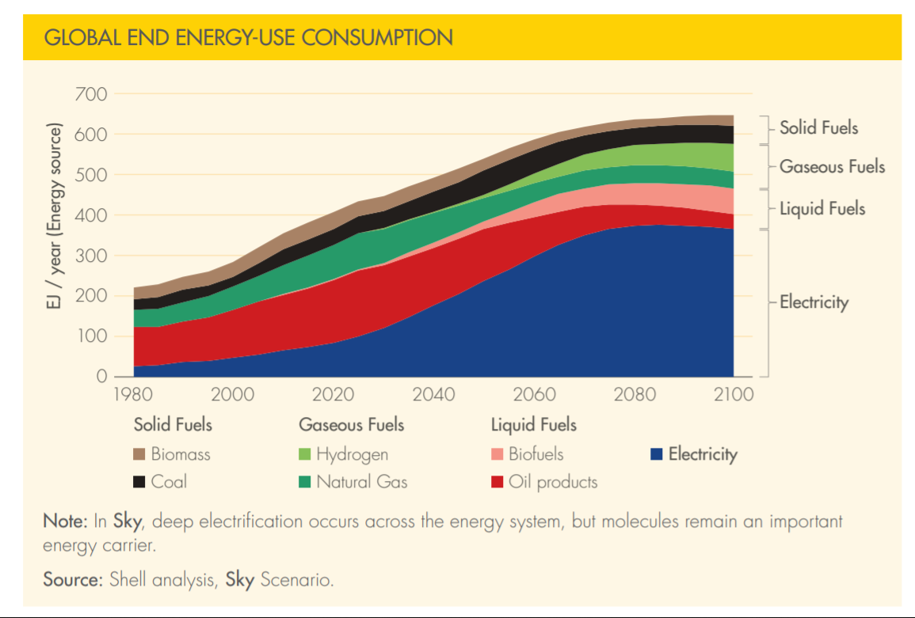
Shell Sky Scenario: meeting Paris – the world does not wait for fusion
Shell Sky Scenario: electricity demand 400EJ/a, fuels some 200 EJ/a
https://www.shell.com/energy-and-innovation/the-energy-future/scenarios/shell-scenario-sky.html

Slide 25
The development of nuclear capacity factors.
Again: how would fusion do?
Remember, the first commercial fission reactor was there in the fifties (this plot starts as 1971)
What will
DEMO have?

Slide 26
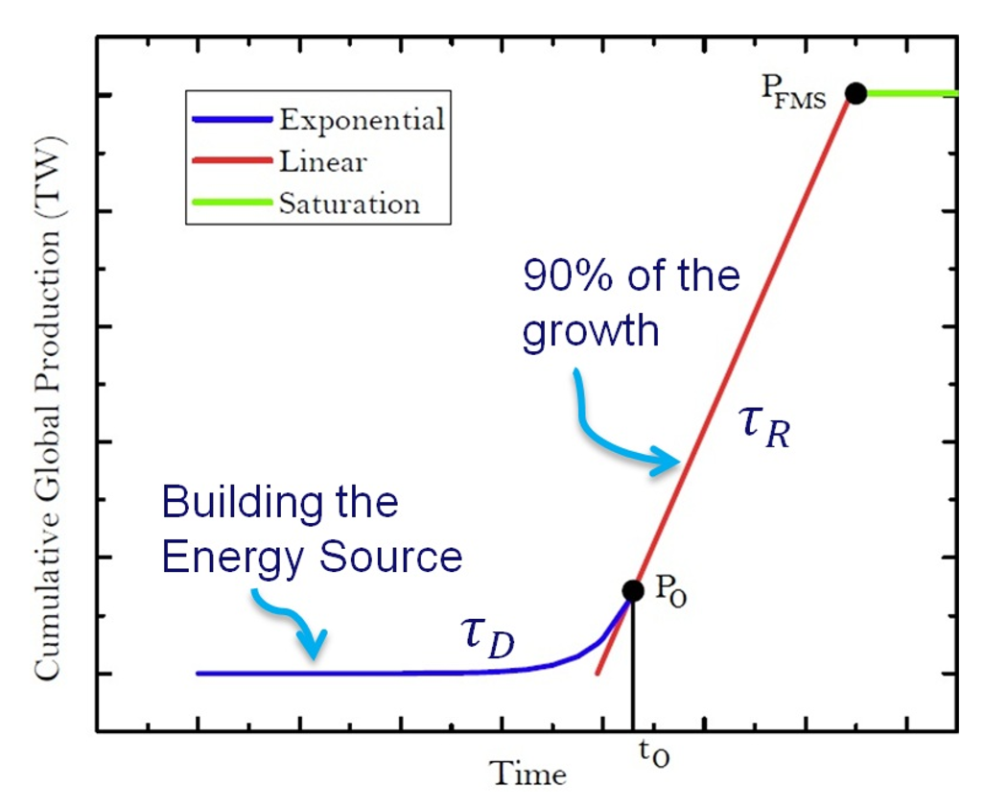
Just three parameters describe the growth of an energy source, and one pinpoint P₀ at time t₀.
τ_{D} typical 2 - 4 years τ_{R} typical 30 - 60 years P_{FMS} say 10% of World Energy, so 2TW
For P holds:
In the exponential phase the capacity scales up. From the point P₀, the linear phase takes over. The built capacity is enough to maintain P = P_{FMS}.
https://research.tue.nl/en/studentTheses/how-much-for-an-energy-source

Slide 27
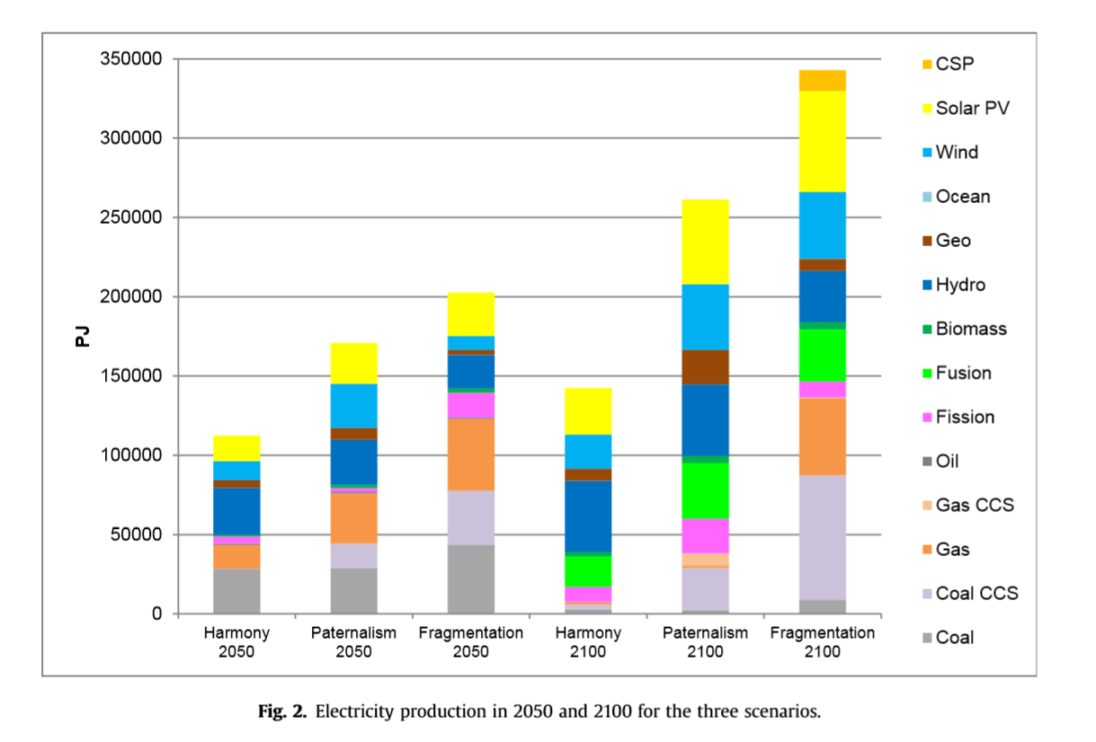
EUROfusion SES 2016: Electricity production
Harmony: 4.4TW
Paternalism: 8.3TW
Cabal et. al., Fusion power in a future low carbon global electricity system, Energy Strategy Reviews (2017)

Slide 28
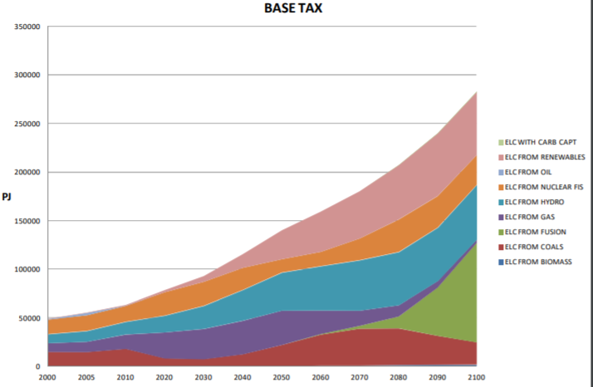
Socio Economic Studies – Cabal et. al. – EFDA TIMES 2012
125000 – 25000 = 100000 PJ = 3.16 TW 50000/4 = 12500 PJ = 0.39 TW With capacity factors 80% in 2100 and 60% in 2080, this is 3300 GW machines in 20 years. And 660 by 2080.
- How long does it take to build a plant? - Who is going to invest the money?
H. Cabal, et.al., Analysing the role of fusion power in the future global energy system, EPJ Conf (2012)
Notes:
But how fast can we grow?

Slide 29
How will fusion do?
Following this line of argument:
We need to build DEMO, results come a career length from now.
Therefore, we might need to think of different concepts that are faster
We perhaps need to prioritize in the optimization parameters (the current design challenges for fusion power plants). Breakthroughs are needed in various fields
Investment in an energy source takes a few decades and grows exponentially. Then you reap the benefits.
What does the world really need? Available, acceptable and affordable (AAA) energy.
Are we on track saving the world?
Society, who makes this all possible (even this event) must be advised on the investments it needs to make in order to solve a problem.
Notes:
Now my friends, go out and get fusion there.
What are potential breakthroughs?
What are potential fabrication fasteners?
The world needs you, as thinkers, because it has problems to solve
A tokamak or a stellarator? And how compact? REF: ARC.
Solar fuels and the intermittency solution.

Slide 30
Outline
Baseline scenario 14% = 4.4TW => 621 GWe ➔ 700 devices in 2100.
What does that mean? 4, 18, ## per decade: can we do that?
Industrial capacity of building 18 machines, ##, ## -> that needs to grow.
It means YOU training the workforce, having made design decisions.
Cost optimization: 6-3 $/W. For 1 GW machine: 6bn$. (ITER 15bn$ to date)
Costs: +30%: no fusion technology
It means getting fusion devices three to four times as cheap for the first buyers.
That means a lot of research and development that you are gonna lead.
GW machines = billions investment: 5$/W * 1 GW * 10 devices = 50 bn$. financial risk. 20yrs upfront. But the industry starts up.
This means that governments need to fund the initial upscaling by ordering projects: industry can develop
The sooner you find a business case per plant, the better
Innovation versus scale-up: construction time
How fast a technology could innovate critically depends on the time to realise a project
Fusion too late? Fusion too slow? Fusion too expensive?
We need breakthroughs: smaller, cheaper, faster are advantageous for take off
Are we developing the power plant the world is waiting for?
We need YOU to come up with clever ideas. You are the future!

Slide 31
End of Document
Contact:
Guido Lange – a.g.g.lange@tue.nl

