Slide 1
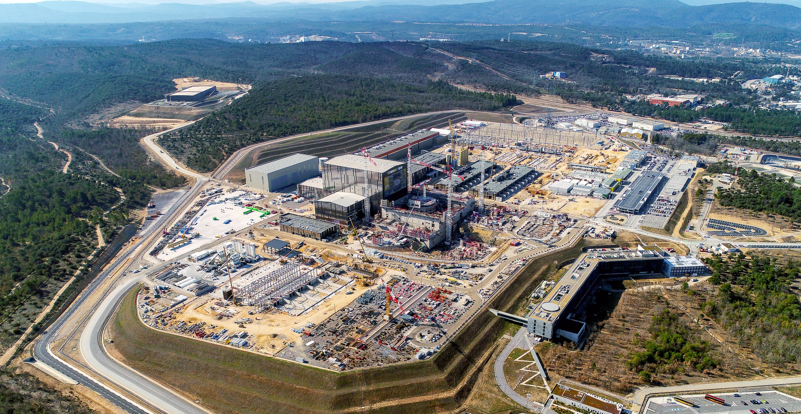
ITER
The way to a new, clean, safe and nearly unlimited energy
Bernard BIGOT, Director-General, ITER Organization

Slide 2
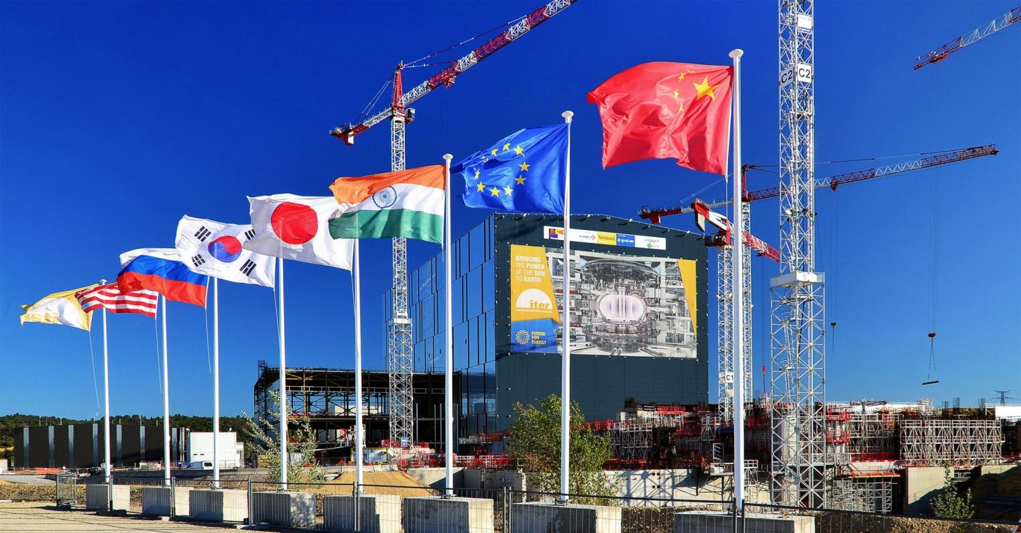
ITER
A multinational scientific collaboration without equivalent in history
A large-scale experiment to demonstrate the feasibility
of fusion energy

Slide 3
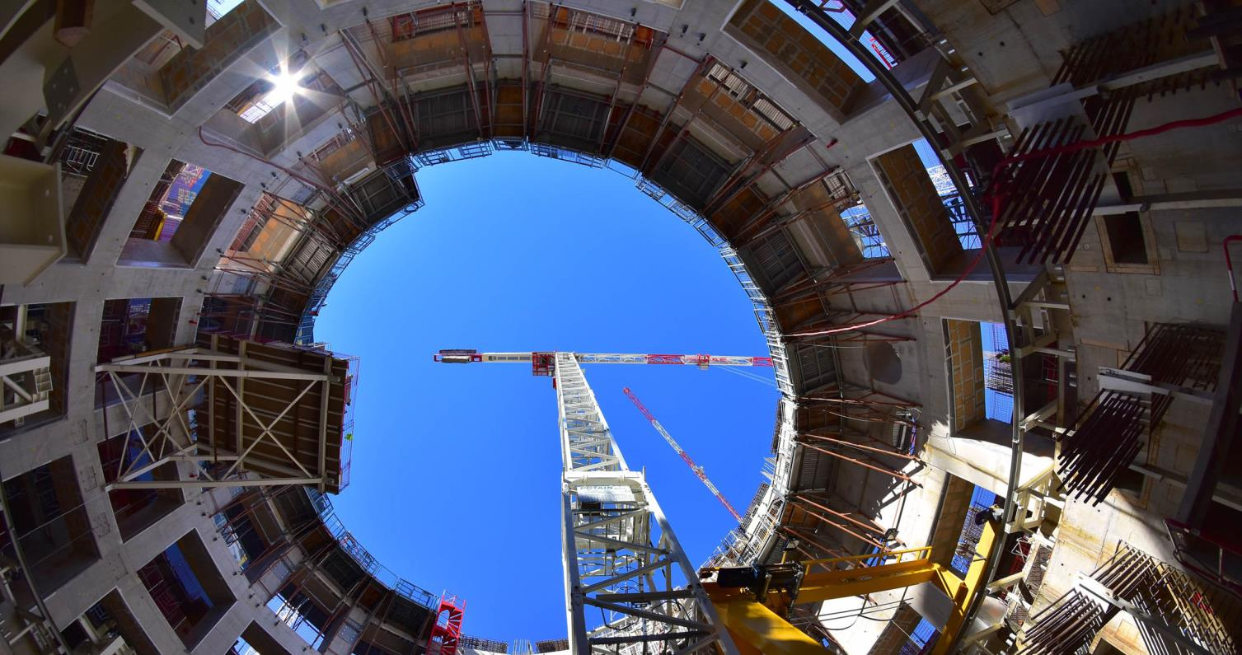
One of the biggest challenges
for our civilization

Slide 4
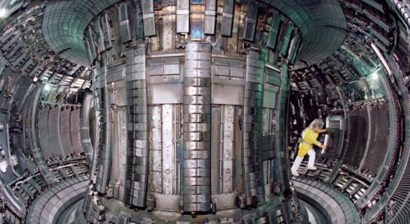
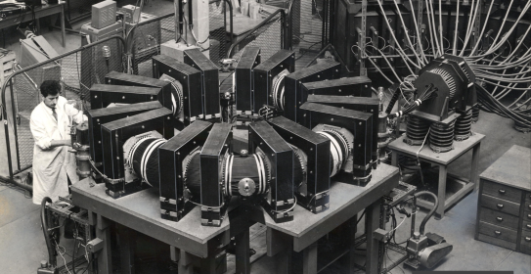
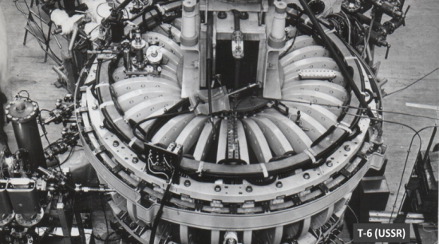
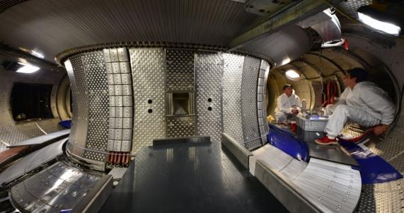
60 years of constant progress
TA-2000,
France, 1957
JET, EU
1984 to present (ITER-like wall) & divertor)
T-6, USSR,
1965
WEST, CEA-Euratom, 1988, now a testbed for ITER

Slide 5
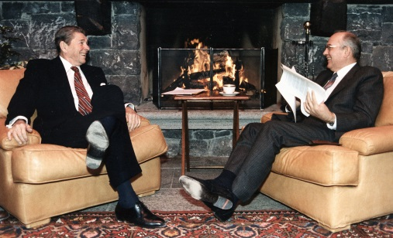
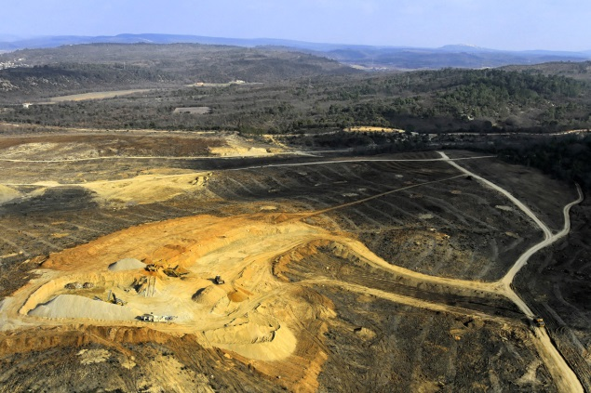
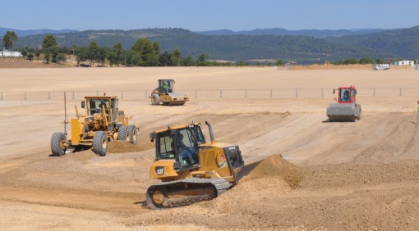
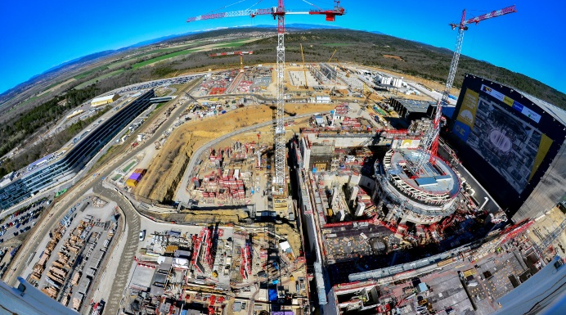
ITER: from paper project
to steel-and-concrete reality
November 1985
At the Geneva Summit President Reagan and General Secretary Gorbachev give a decisive political push to an international collaboration on fusion “for the benefit of all mankind”…
January 2007
Preparation works by France (clearing, levelling, etc.) begins on the 42-hectare ITER Platform.
Today
Construction on the ITER site and components manufacturing by the ITER Members are progressing in accordance with the 2016 baseline.
August 2010
Construction works begin in earnest.

Slide 6
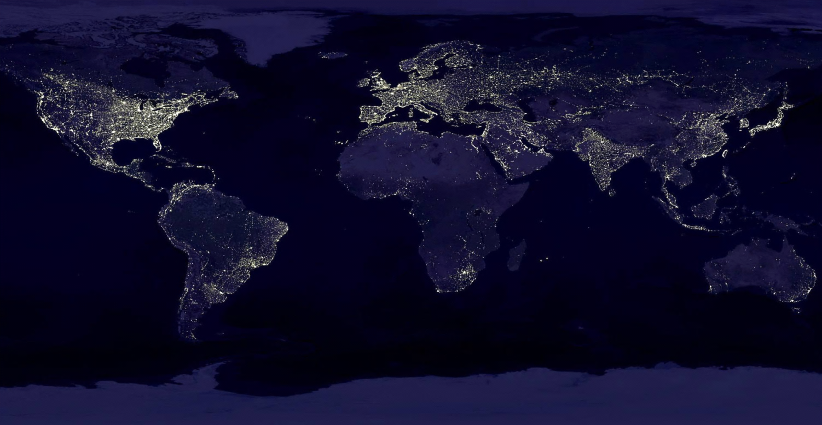
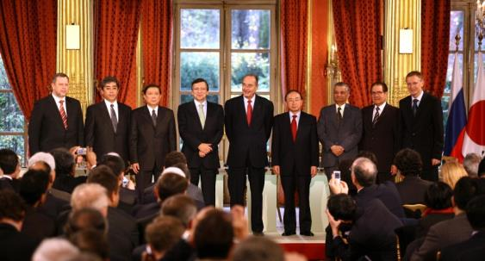
Global challenge,
global response
28 June 2005: The ITER Members unanimously agreed to build ITER on the site proposed by Europe
21 November 2006: The ITER Agreement was signed at the Élysée Palace, in Paris.
The seven ITER Members represent more than 50% of the world’s population and about 85% of the global GDP
China EU India Japan Korea Russia USA
Notes:
KD: “represent” KD: Remove “on” from dates

Slide 7
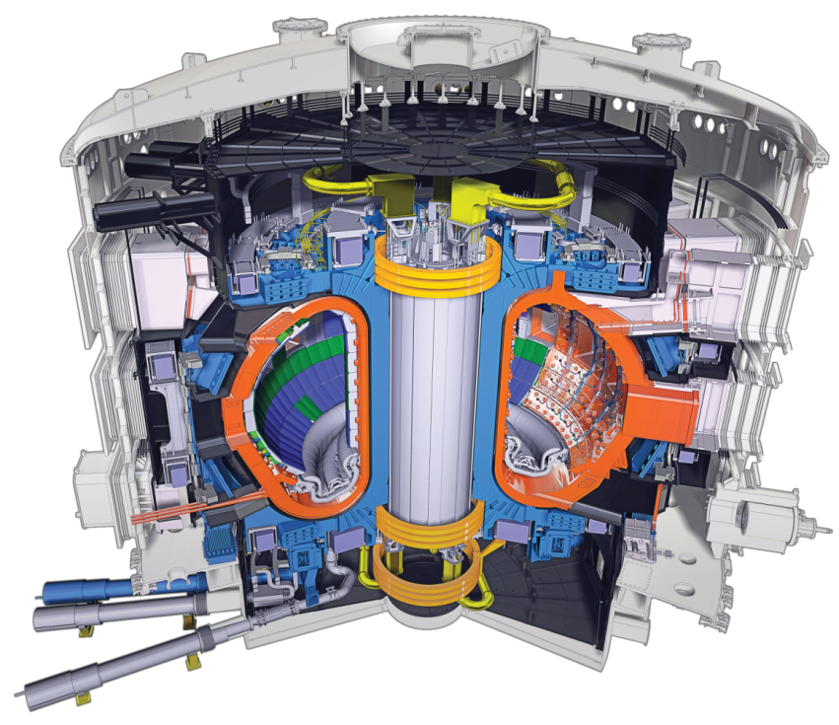
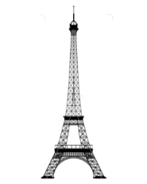
The ITER Tokamak
Vacuum Vessel: ~ 8 000 t.
TF Coils: ~ 18 x 360 t.
Central solenoid: ~ 1 000 t.
Etc.
Total ~ 23 000 t.
R=6.2 m, a=2.0 m, I_{p}=15 MA, B_{T}=5.3 T, 23,000 tonnes
3,5 times the weight of the Eiffel Tower!

Slide 8
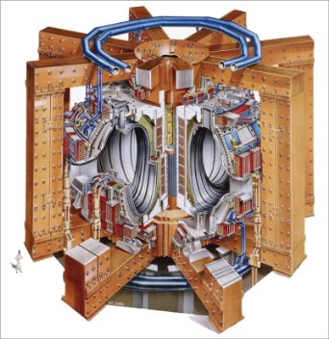
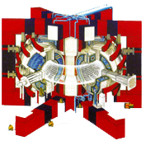
Size matters
Tore Supra-WEST (France-CEA)
V_{plasma} 25 m³
P_{fusion} ~0
P_{chauffage} ~15 MW
T_{plasma} ~400 s
I_{plasma} ~ 1.7 MA
JET (Europe)
V_{plasma} 80 m³
P_{fusion} ~16 MW
P_{chauffage}~23 MW
T_{plasma} ~30 s
I_{plasma} ~ 5-7 MA
ITER (35 countries)
V_{plasma} 830 m³
P_{fusion} ~500 MW
P_{chauffage} ~ 50 MW
T_{plasma} > 400 s

Slide 9
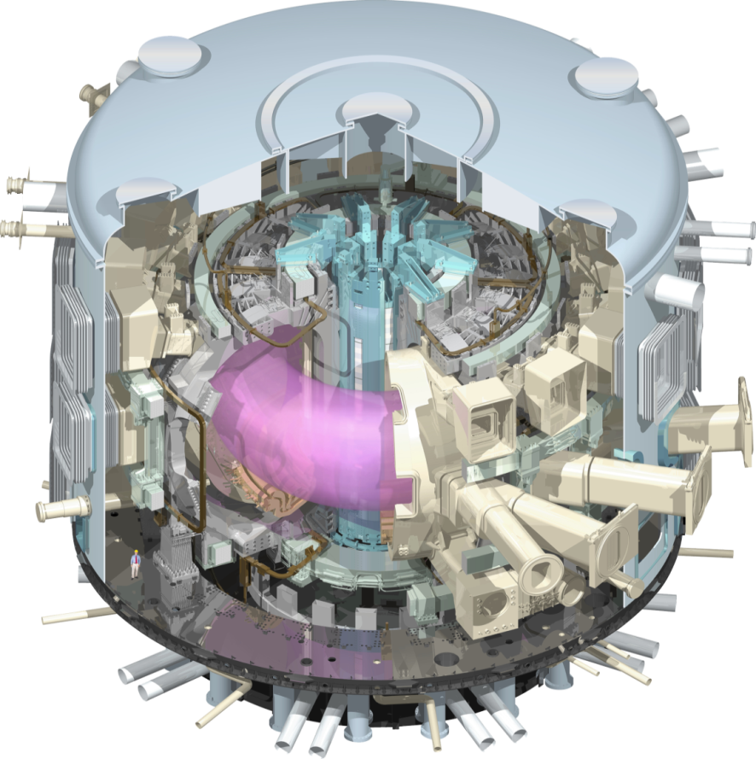
ITER mission
To demonstrate the scientific and technological feasibility of fusion power for peaceful purposes
ITER is the only magnetic fusion device under construction aimed to produce a burning plasma.
Input (heating power): 50 MW
Output (fusion power): 500 MW

Slide 10
An integrated project:
Central Team & Seven Domestic Agencies
IO
The 7 ITER Members make cash and in-kind contributions (90%) to the ITER Project. They have established Domestic Agencies to handle the contracts to industry.
The ITER Organization Central Team manages the ITER Project in close collaboration with the 7 Domestic Agencies.
The ITER Members share all intellectual Property generated by the Project.
CN
US
ITER Project
RF
EU
KO
IN
JA

Slide 11
A unique formula
ITER is being built through the in-kind contributions
of the seven Members of the ITER Organization.
400
China, India, Japan, Korea, Russia and the United States each have responsibility for ~ 9% of procurement packages.
Europe’s share, as Host Member, is ~ 45% (construction and manufacturing).
300
200
100
Machine Core
0
Internal Auxiliary
External Auxiliary
EU
CN
Heating, Diagnostics, Control
CN
IN
IN
JA
KO
RF
Buildings
US
IO

Slide 12
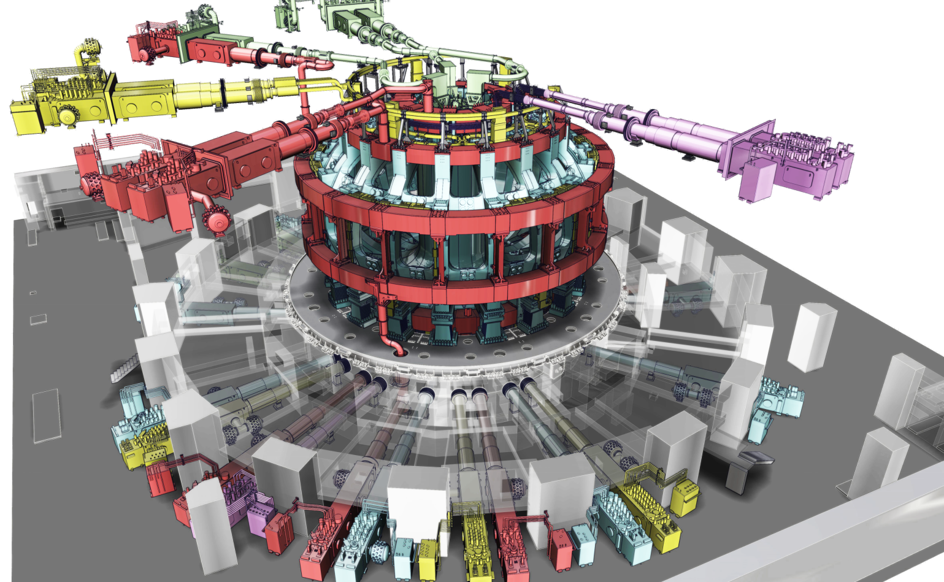
10,000 tons of superconducting magnets...
Manufactured from niobium-tin (Nb3Sn) or niobium-titanium (Nb-Ti), the magnets become superconducting when cooled with supercritical helium in the range of 4 K (– 269 °C).
10,000 tons of magnets, with a combined stored magnetic energy of 51 Gigajoules (GJ), produce the magnetic fields that initiates, confines, shapes and controls the ITER plasma.

Slide 13
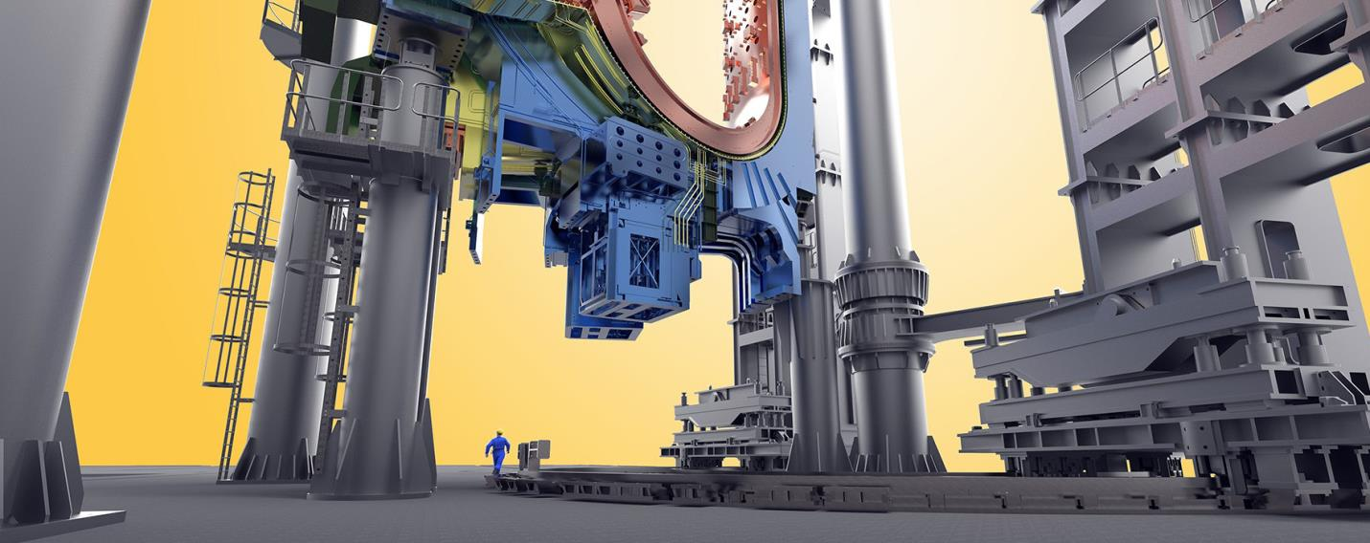
Naval construction-size components…
Inside the Assembly Hall, giant tools (procured by Korea) will handle loads up to 1,500 tons

Slide 14
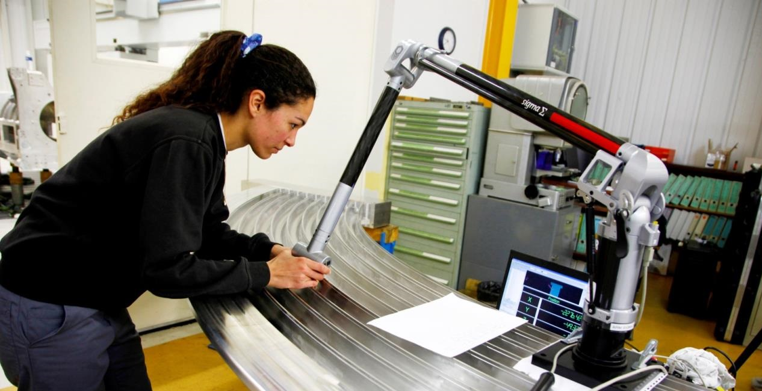
…watch-like precision
Laser measurements of grooves in TF Coil radial plates. Tolerances are in the 1/10th millimetre range.

Slide 15
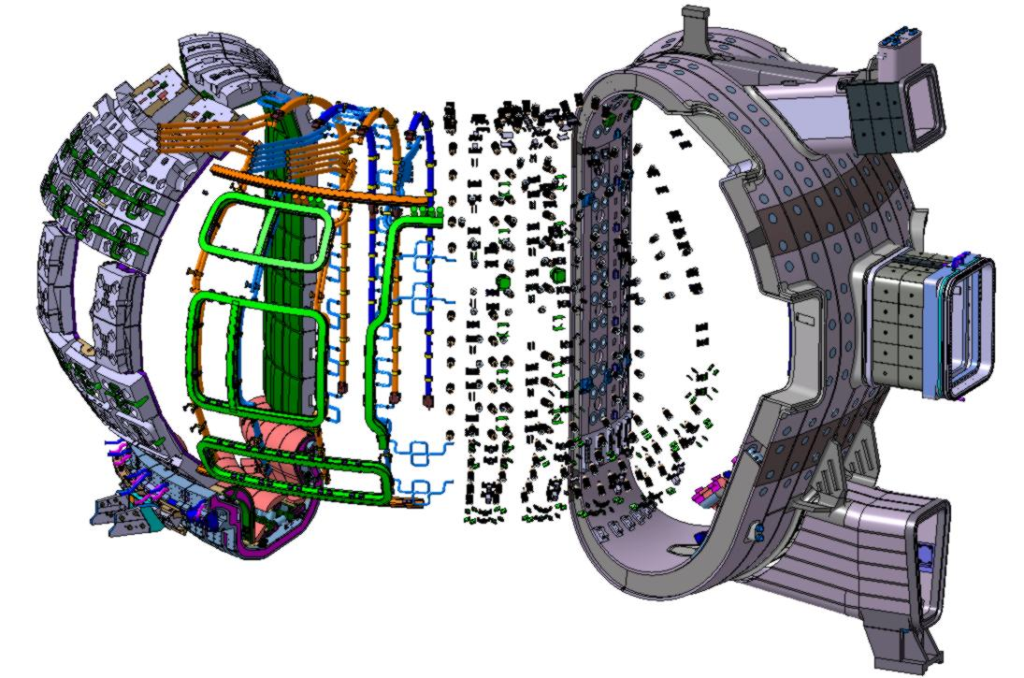
The integration challenge
BLANKET MODULES
MANIFOLD
DIVERTOR
INTERNAL COILS
INTERFACES

Slide 16
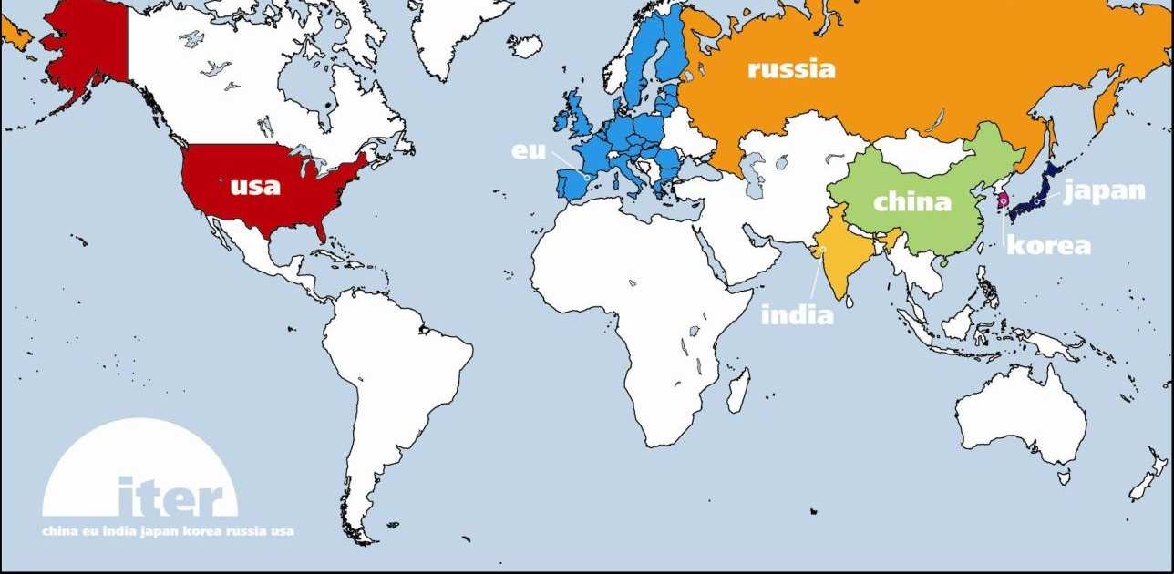
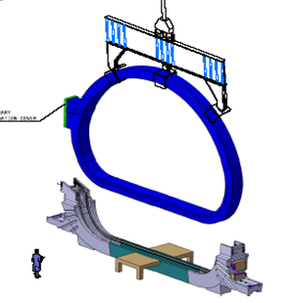
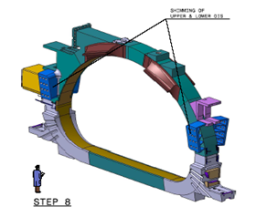
Managing collaboration
(The TF Coils example)
TF Coil
TF coil cases
Conductor
Japan
Japan
China
Russia
Europe
South Korea
United States
Japan
Europe

Slide 17
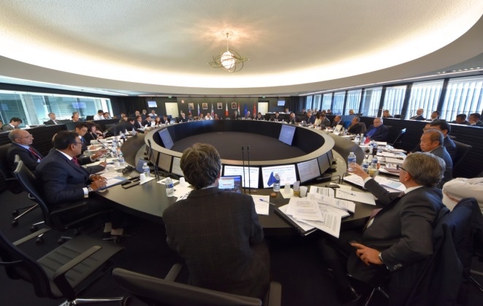
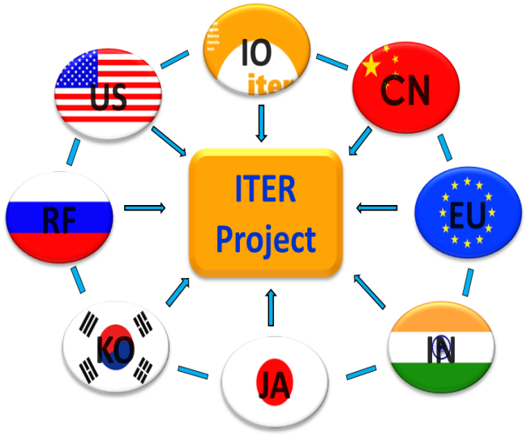
A culture of continous improvement
2015-17: successful organizational reform
Clear decision-making processes
Profound integration of work
Comprehensive technological understanding
Reliable, challenging schedule
Best principles of International Project Management
Systems engineering, configuration management
Risk analysis, risk and opportunity management
Freezing of design interfaces
Rigorous self-examination and transparency
Promotion of ITER-wide project culture

Slide 18
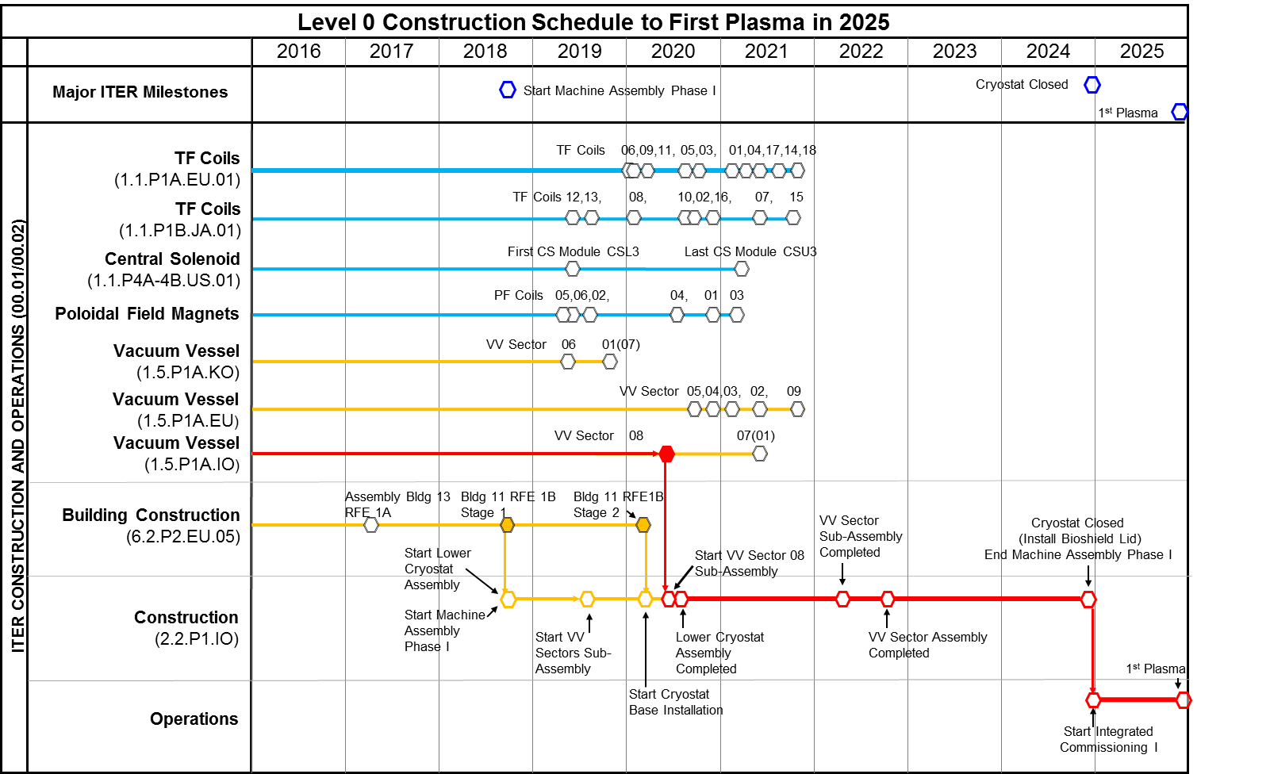
Major assembly milestones

Slide 19
A staged approach to DT plasma
Extensive interactions among IO and DAs to finalize revised baseline schedule proposal
Schedule and resource estimates through First Plasma (2025) consistent with Members’ budget constraints
Proposed use of 4-stage approach through Deuterium-Tritium (2035) consistent with Members’ financial and technical constraints

Slide 20
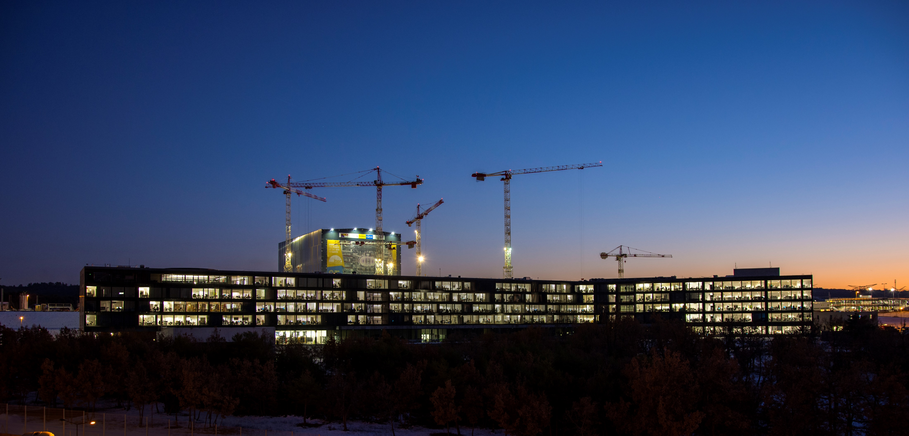
Halfway to First Plasma
According to the stringent metrics that measure project performance, 50 percent of the "total construction work scope through First Plasma" was completed as of November 2017. Media throughout the world hailed the accomplishment. The current progression rate is in the order of 0.7 percent.
[Sept. 2018: ~58,3 percent]
Etc.

Slide 21
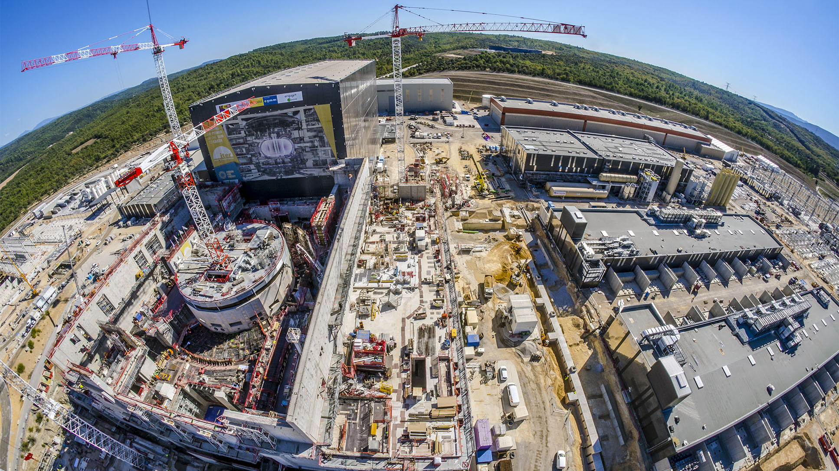
Worksite progress
Assembly Hall
Cryostat Workshop
PF Coil Winding Facility
Radiofrequency Heating
Cryoplant
Service Bldg.
Cooling System
400 kV Switchyard
~ Machine axis
Tritium Bdg.
Diagnostics Bdg.
Bioshield
Magnet Power Conversions Bdgs.
Tokamak Bdg.
4 October 2018

Slide 22
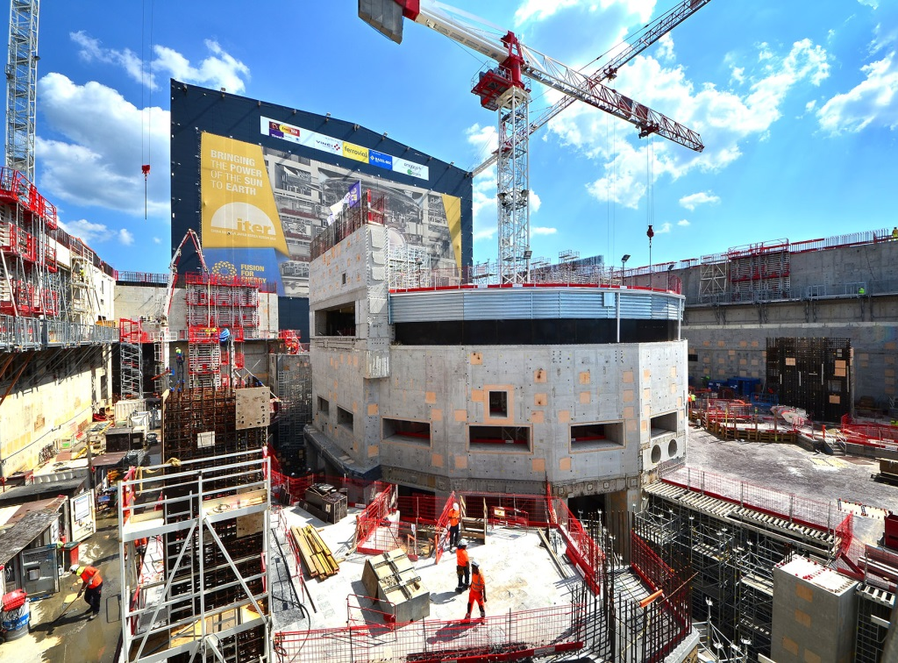
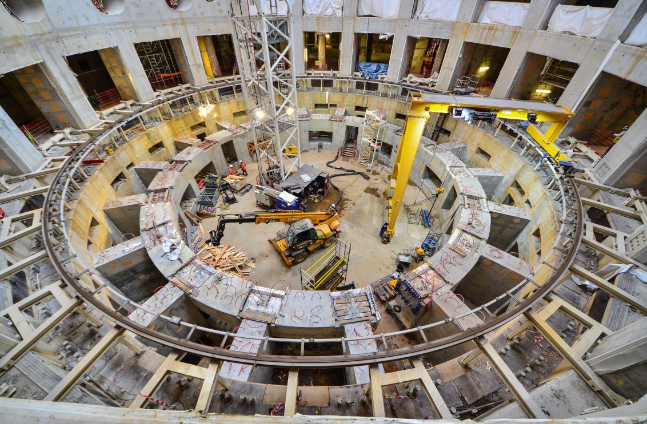
Tokamak Complex
The bioshield is now finalized. Openings in the wall are for the cryostat bellows connecting the machine to the port cells designed to give access to systems such as remote handling, heating and diagnostics. The high-resistance concrete-and-steel structure (the “Crown”) that will support the combined mass of tokamak + cryostat (23 000 tonnes) is now finalized.

Slide 23
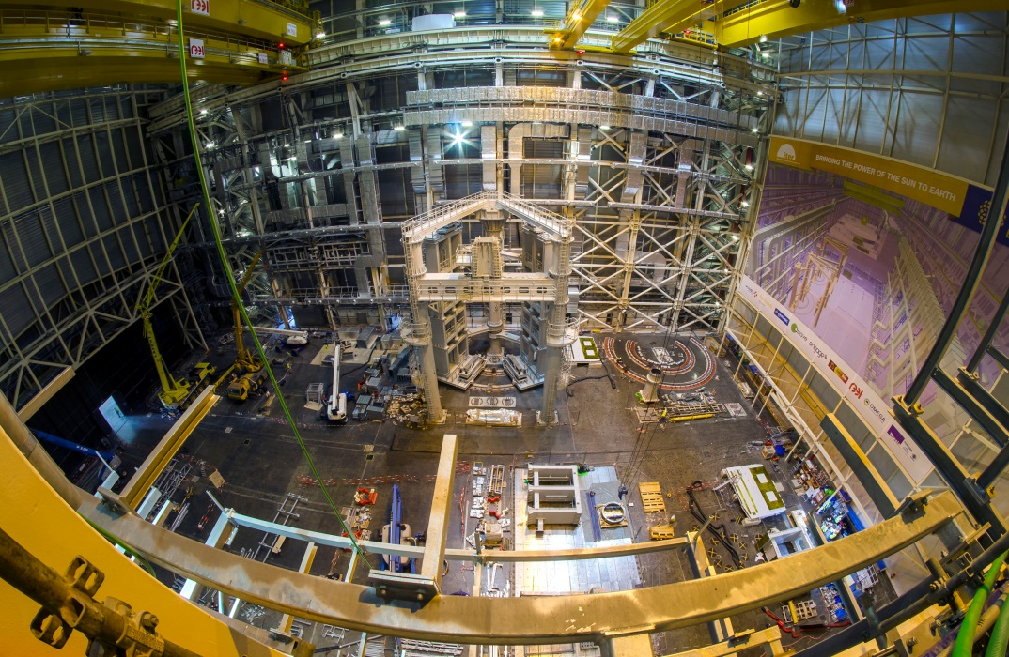
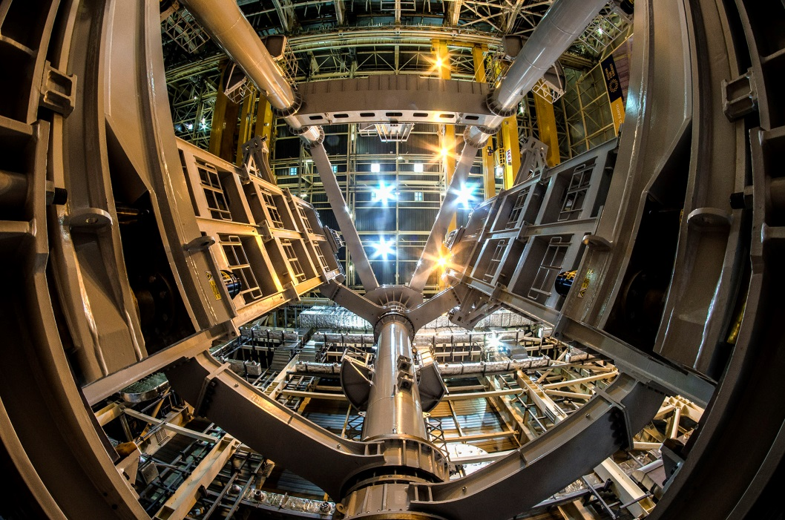
Assembly Hall
Before being integrated in the machine, the components will be prepared and pre-assembled in this 6,000 m2, 60-metre high building. The Assembly Hall is equipped with a double overhead travelling crane with a total lifting capacity of 1,500 tons.
All mechanical elements of sub-assembly tool # 1 (SSAT-1) are assembled. Work is beginning on the installation of SSAT-2.

Slide 24
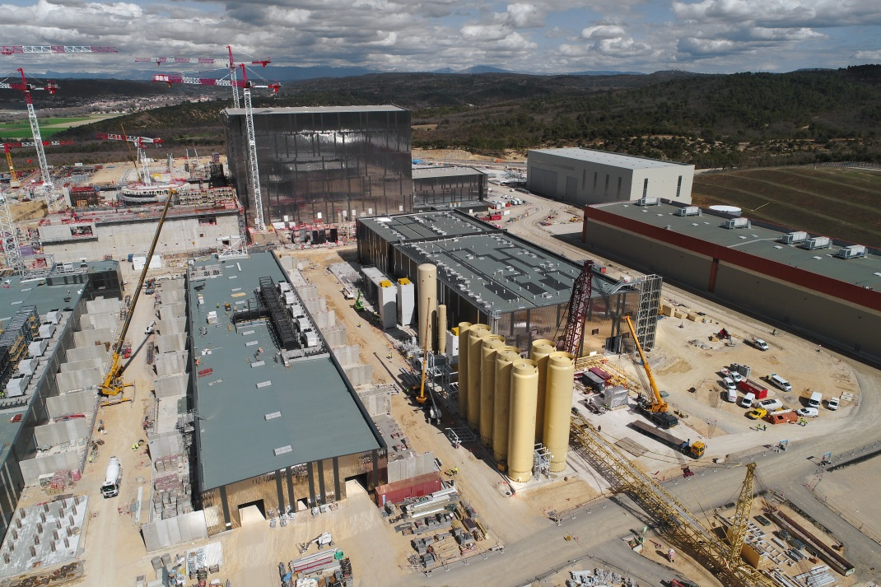
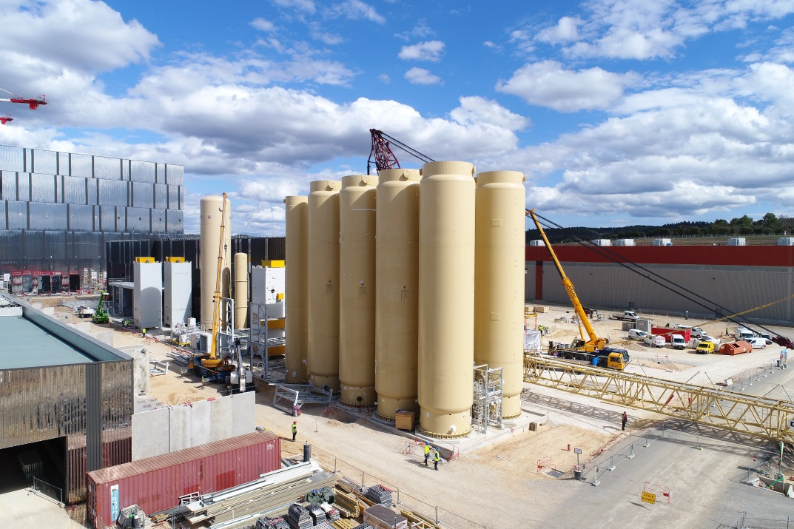
Cryoplant (overview)
The ITER Cryoplant will be the largest single platform cryofacility in the world. It will distribute liquid helium to various machine components (superconducting magnets, thermal shield, cryopumps, etc.).

Slide 25
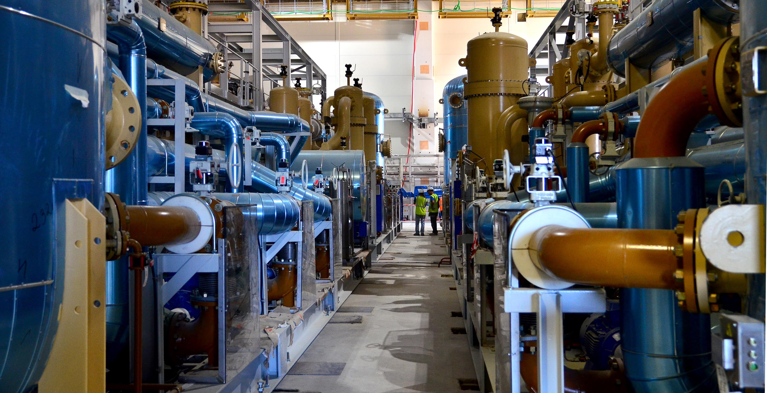
Cryoplant (inside view)
Equipment installation for what will be the largest cryogenic unit in the world is nearing completion

Slide 26
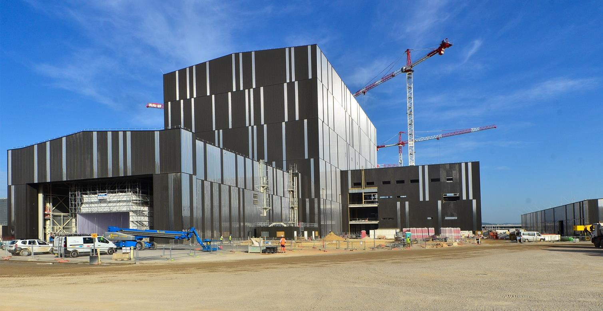
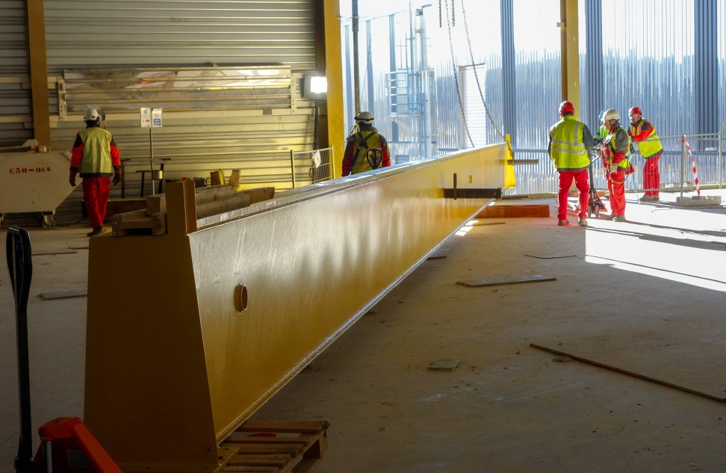
Radiofrequency heating
Adjacent to the Assembly Hall, the building that will house the plasma heating systems (microwave and radio frequency) is ready to be equipped.
This girder is part of the gantry crane that will be used to install radio frequency and microwave heating components. It was installed in December 2017.

Slide 27
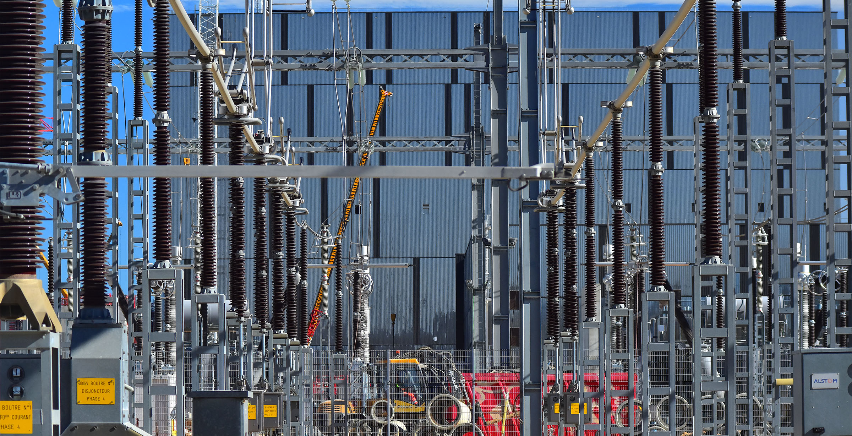
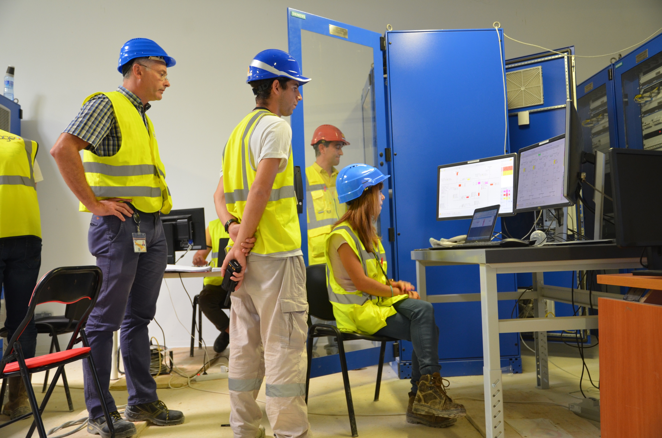
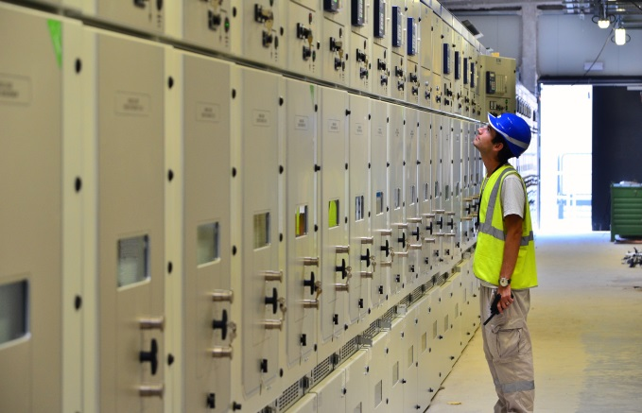
Electrical network
The connection of the 400 kV switchyard to the French grid was successfully established on 17-18 Sept. 2018

Slide 28
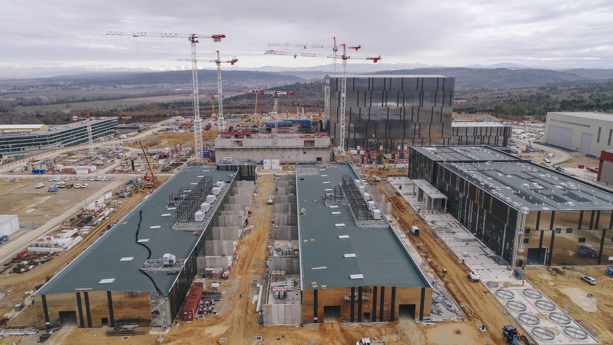
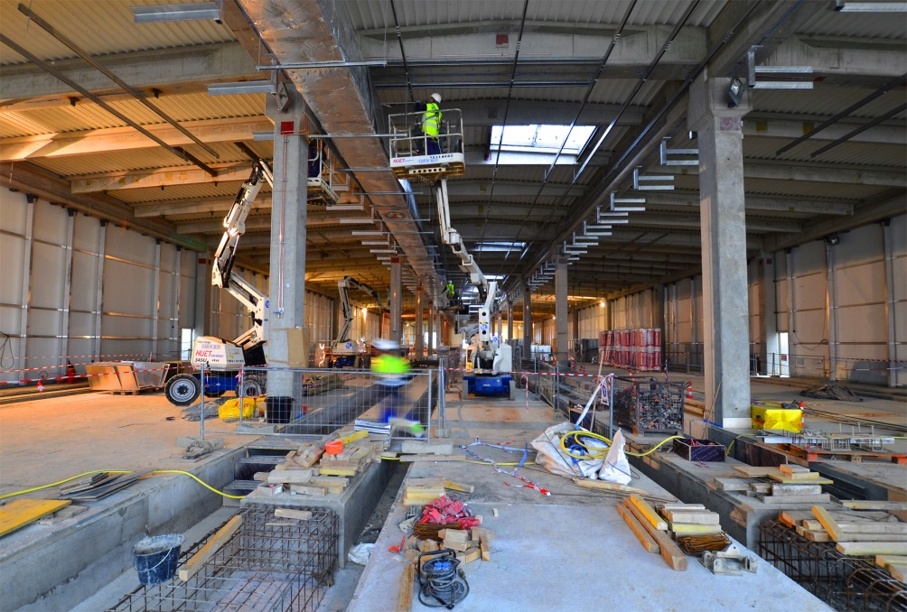
Electrical conversion
Two large Magnet Power Conversion buildings will host the transformers and converters ( AC ► DC) feeding power to the ITER magnets.
The twin buildings are now ready for equipment. Electrical components from China, Korea and Russia will be progressively installed inside of the building as well as in the exterior bays.

Slide 29
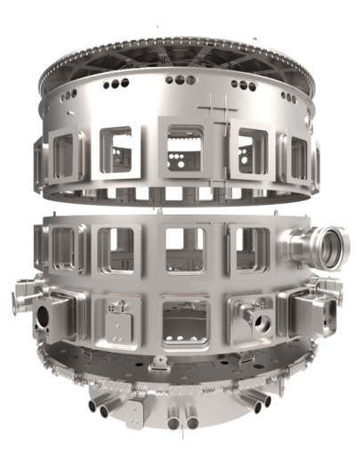
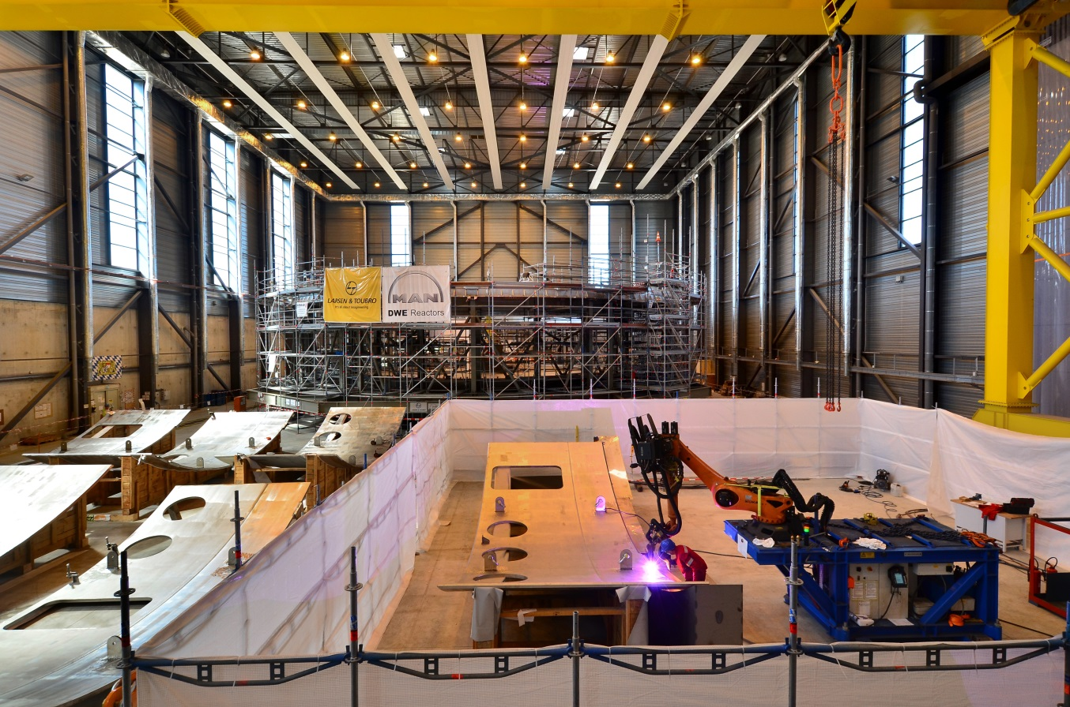
Cryostat workshop
Lid
Upper cylinder
Lower cylinder
Base section
Manufactured in India, the 30 m x 30 m cryostat (the insulating vacuum vessel that encloses the machine) is being assembled and welded on site.

Slide 30
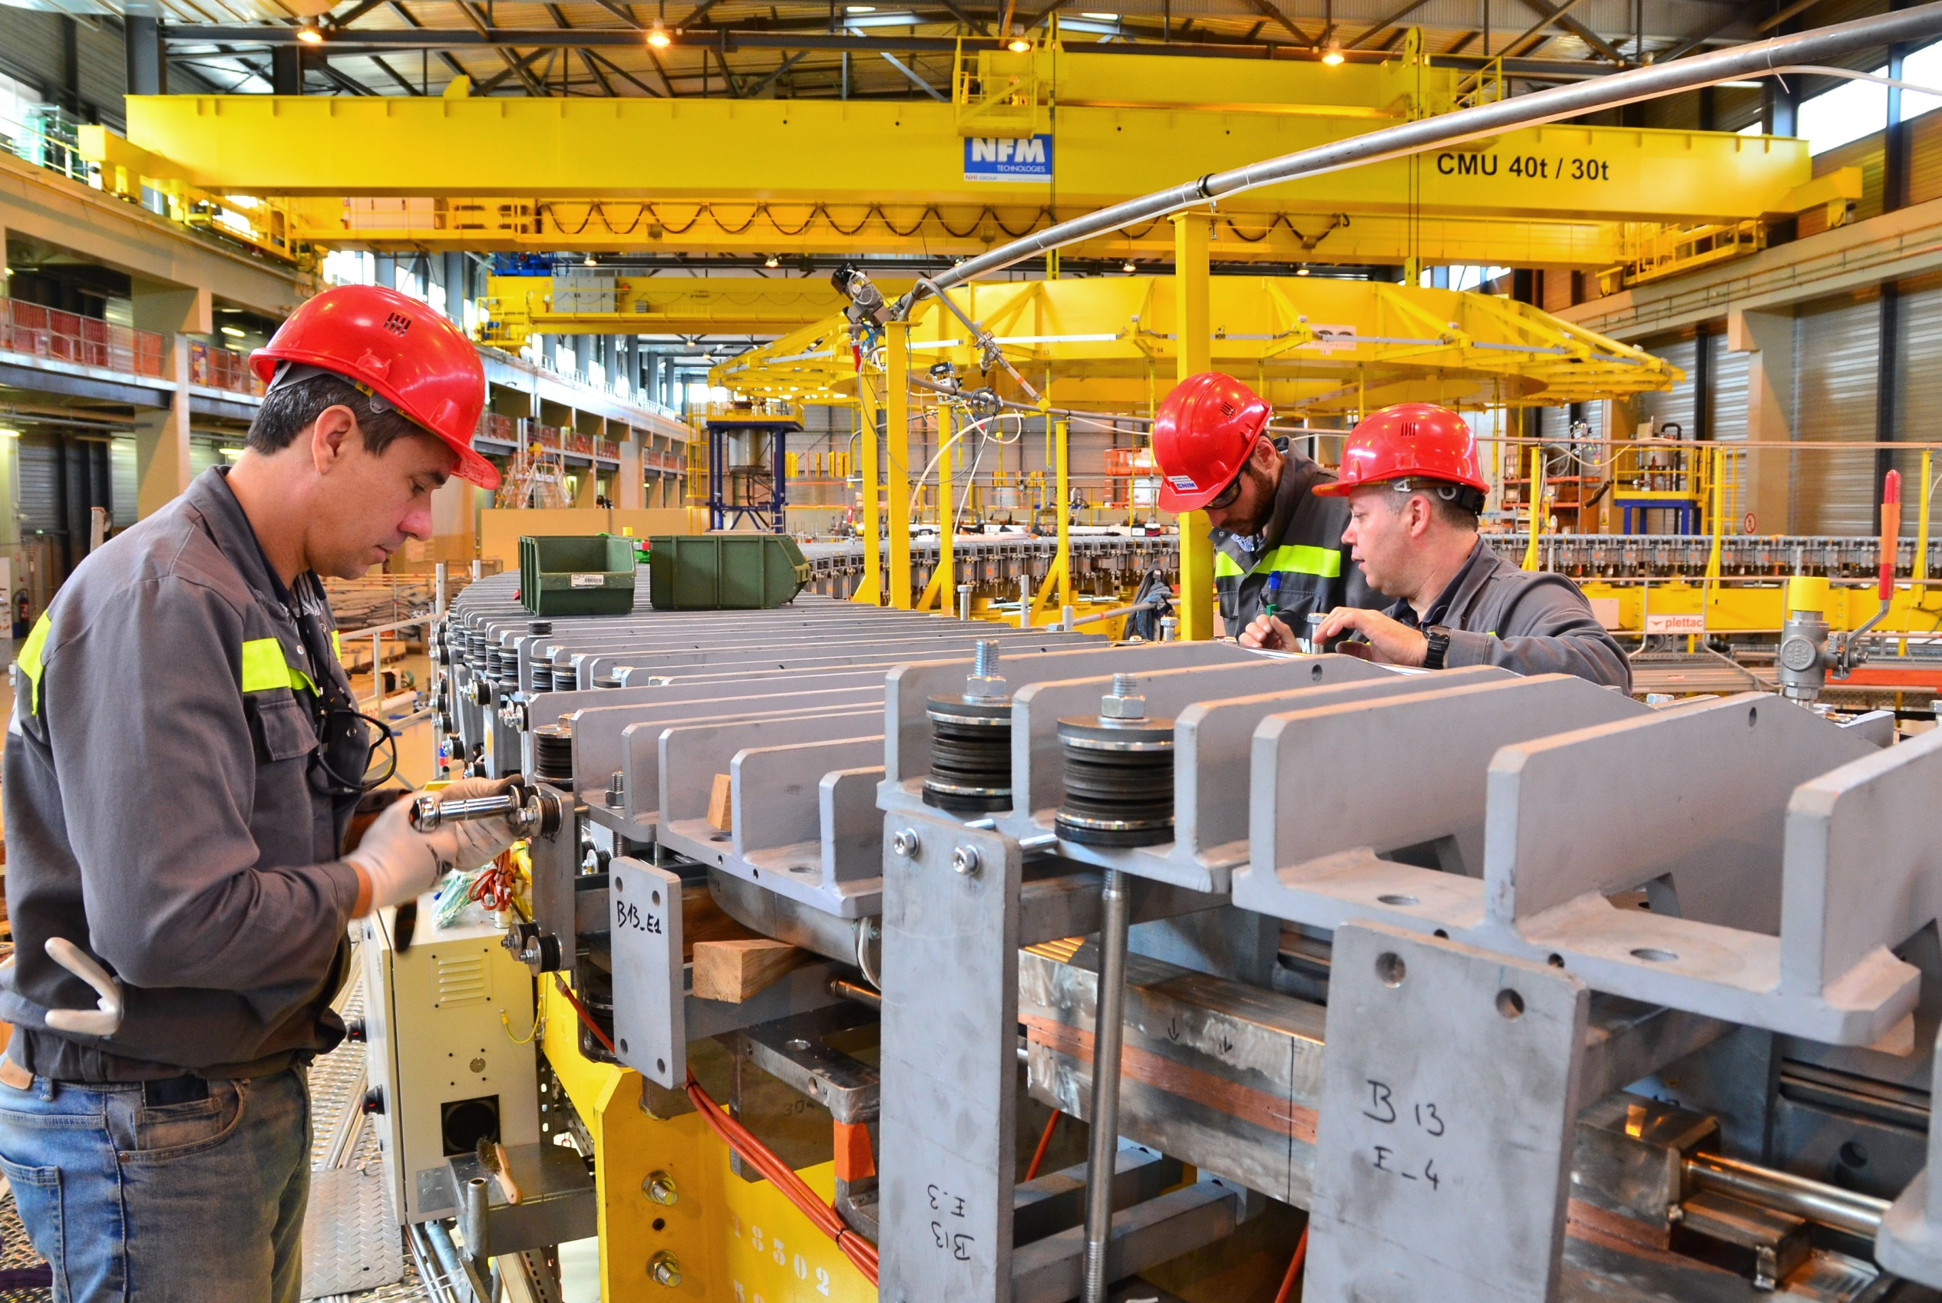
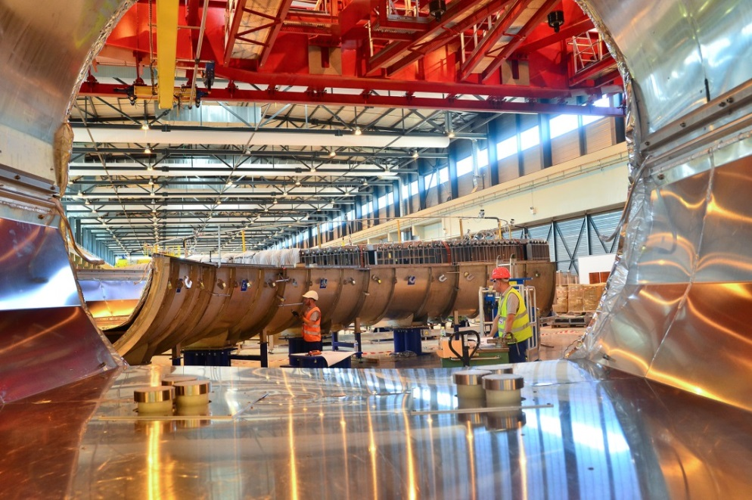
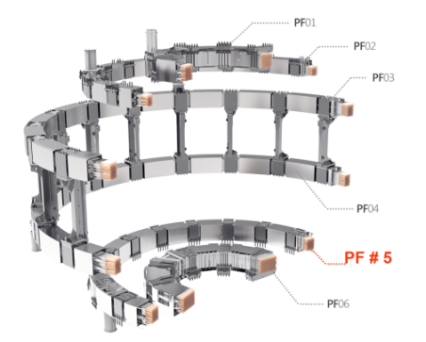
PF Coil winding facility
Too large to be transported by road, four of ITER’s six ring-shaped magnets (the poloidal field coils, 17 to 24 m, in diametre) will be assembled on site by Europe in this 12,000 m² facility. Resin impregnation operations have begun for PF Coil # 5 (17 m. diametre, ~ 350 tonnes).

Slide 31
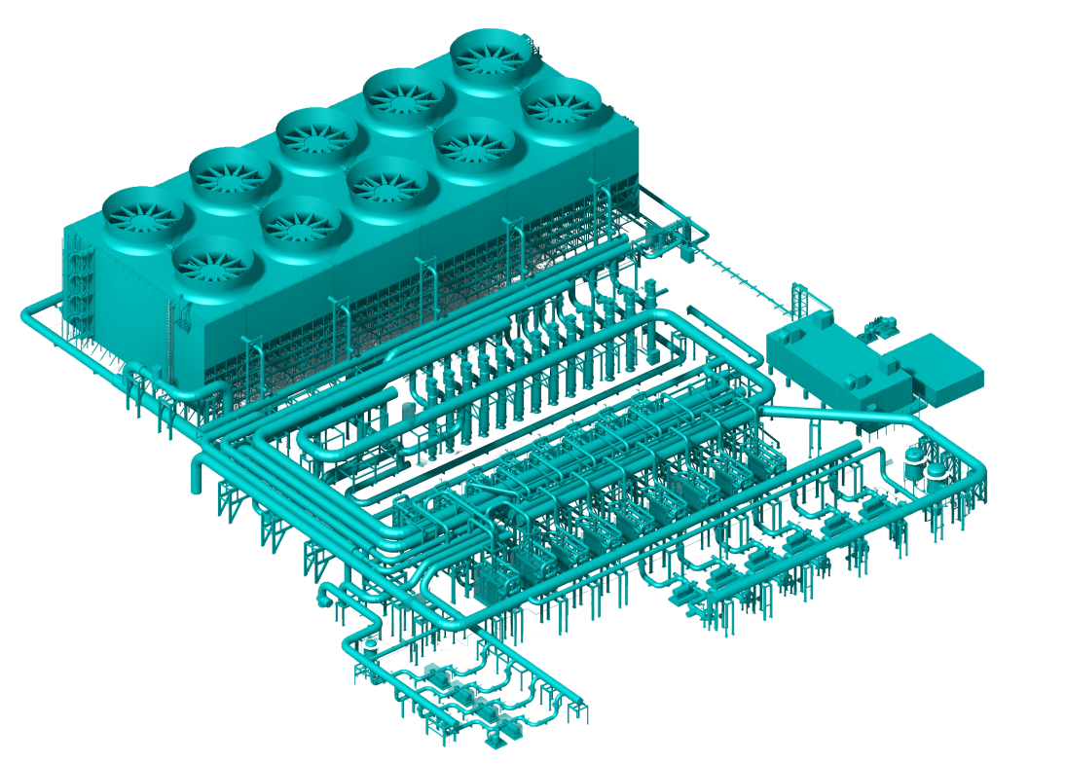
Cooling water systems
ITER power will be partly evacuated by cooling towers (procured by India).

Slide 32
Into the industrial phase
with highly challenging specifications
Manufacturing of ITER components is taking place at the cutting edge of technology:
Geometrical tolerances measured in millimetres for steel pieces up to 17 m tall weighing several hundred tons
Superconducting power lines cooled to minus 270 degrees Celsius
Plasma facing components to withstand heat flux as large as 20 MW per m²
Cryoplant cooling capacity up to 110 kW at 4.5 K; maximum cumulated liquefaction rate of 12,300 l/hr
Etc.

Slide 33
Who manufactures what? The ITER Members share all intellectual property
Cryostat
Feeders (31)
Thermal shield
Toroidal Field coils (18)
Vacuum vessel
Poloidal field coils (6)
Blanket modules
Correction coils (18)
Central solenoid (6)
Divertor

Slide 34
Manufacturing progress
Manufacturing of PF Coil # 6 (8.5 m. in diametre, ~400 tonnes) under a contract with Europe.
Welding operations for tier 2 of the cryostat’s lower cylinder are being finalized on site by German contractor MAN Diesel & Turbo.
Two out of ten toroidal field coils to be procured by Europe are finalized.
Fabrication of Japan’s share of superconducting cables (43 km, 745 t.) is finalized.

Slide 35
Manufacturing progress
4 out of 9 segments for the vacuum vessel are being manufactured at Hyundai Heavy Industries shipyard in Ulsan.
In San Diego, General Atomics has completed the high-temperature treatment for the first of six Central Solenoid modules.
Electrical equipment prototypes were tested and qualified at the Efremov Institute in Saint Petersburg.
The fitting test for the first Toroidal Field Coil Structure, manufactured partly in Korea, partly in Japan, was completed at Hyundai Heavy Industry in Ulsan. Tolerance requirements of 0.5mm +- 0.25mm were successfully met!

Slide 36
Manufacturing progress
Thermal Shield, Cryostat, Port Plugs, Cases, Electrical & Cooling Systems

Slide 37
Door-to-door delivery
65 Highly Exceptional loads (HEL) delivered as of July 2018
~ 100 expected before 2025 - ~ 10 expected after 2025
Unloaded at Marseille harbour, components are ferried through the inland sea Etang de Berre on a specially designed barge and delivered to ITER by way of the 104-km long “ITER Itinerary”. The journey to the ITER site takes 3 to 4 nights.

Slide 38
The ITER Itinerary
The 104-km long ITER Itinerary between Berre-l’Etang and the ITER site is part of France’s contribution to the ITER project.

Slide 39
Economic benefits
More than 8,5 billion euros in contracts for construction and fabrication
ITER

Slide 40
The ITER worksite
2,300 workers, technicians and engineers today, up to 3,000 in the coming years;
ITER construction represents 18 million working hours (2010-2020).

Slide 41
Who works for ITER?

Slide 42
Who works for ITER?
Distribution by Member
Septembre 2018
The international staff of the ITER Organization (Central Team) comprises ~ 850 persons (35 countries).
An equivalent number of contractors and experts are directly working for ITER in Saint-Paul-lez-Durance.
More than 3,000 specialists work for ITER throughout the world.

Slide 43
Challenges ahead
ITER Organization, Domestic Agencies and suppliers working as “One-ITER Team” with a strong project culture;
Strict respect by suppliers for quality and safety requirements;
Strict respect by all stakeholders for the schedule requirements, in particular for the required delivery dates for materials and equipment on the ITER site;
Reliable and fully integrated assembly/construction sequences on ITER site;
Contracting with high performing and experienced companies for the assembly activities in the Tokamak Complex;
Setting in place a well-suited organization in charge of commissioning;
Setting in place a well-suited organization to conceive and execute the progressive take-over of the machine, ultimately for its operation and maintenance;
Timely, reliable availability of the planned and committed resources from the seven ITER Members.

Slide 44
ITER and beyond
ITER
800 m³
~ 500 MW _{th}
DEMO, pre-industrial demonstrator
~ 500 Mw_{e}, 1 200 MW _{th,}

Slide 45
ITER is moving forward!
April 2015

Slide 46
ITER is moving forward!
http://www.iter.org

