Slide 1
Plasma Meets Wall
Steven Lisgo¹
G. De Temmerman¹ (knowledge diffusion)
engineering support:
F. Escourbiac¹, T. Hirai¹, R. Mitteau²
¹ITER CT, ²CEA/IRFM
FuseNet PhD Event, Provence 6-8/11/2018
The views and opinions expressed herein do not necessarily reflect
those of the ITER Organization

Slide 2
…
Overview
PREFACE | ITER PFCs | HIGH-DUTY CYCLE | SUMMARY

Slide 3
PREFACE | ITER PFCs | HIGH-DUTY CYCLE | SUMMARY
Perspective – The importance of a balanced Inside/Outside-View
[Delusion and Deception in Large Infrastructure Projects, Flyvberg et al.]

Slide 4
PREFACE | ITER PFCs | HIGH-DUTY CYCLE | SUMMARY
The Fusion Wheel of Pain – All aspects must be fully addressed
[EPRI Report, 1994, short]

Slide 5
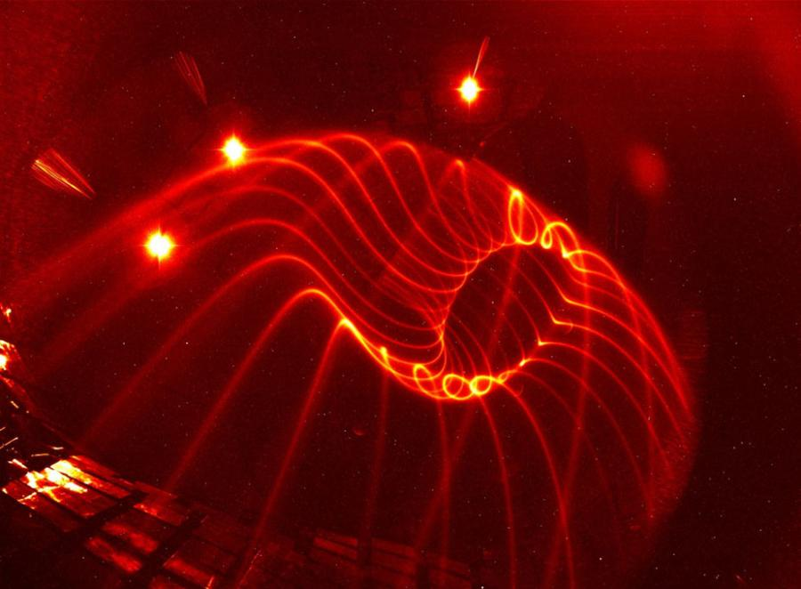
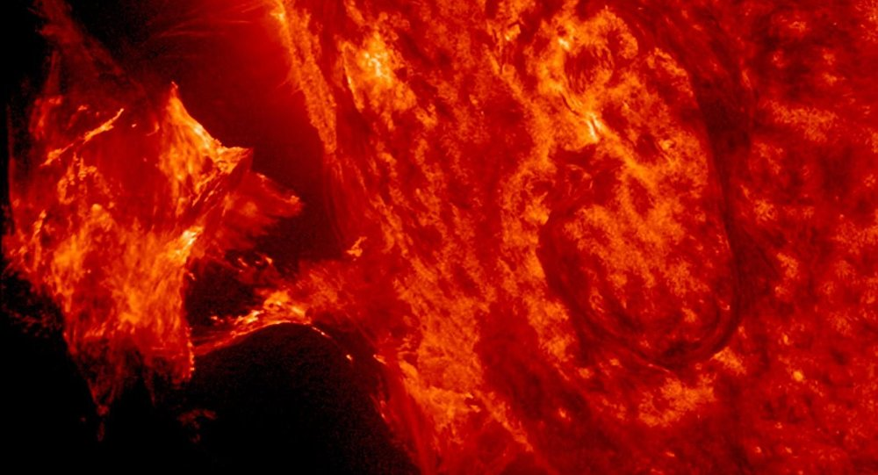
PREFACE | ITER PFCs | HIGH-DUTY CYCLE | SUMMARY
Physics – Pretty cool

Slide 6
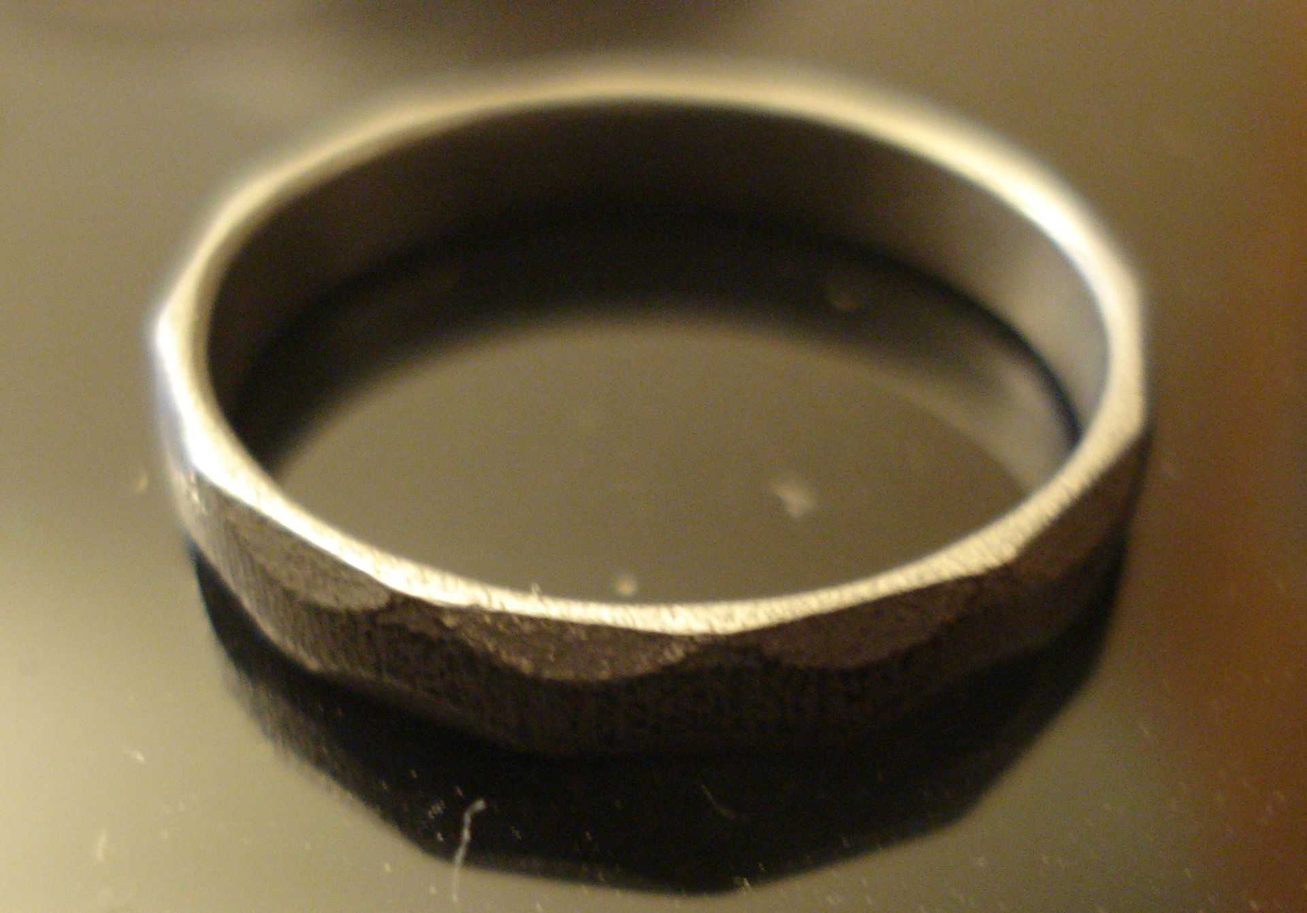
PREFACE | ITER PFCs | HIGH-DUTY CYCLE | SUMMARY
Engineering – A craft, and the burden of being real life
Fusion research can probably learn from systems engineering.
[GFI]
[The Iron Ring]

Slide 7
PREFACE | ITER PFCs | HIGH-DUTY CYCLE | SUMMARY
Sociology – A big challenge
For me, the sociology is harder than the physics.

Slide 8
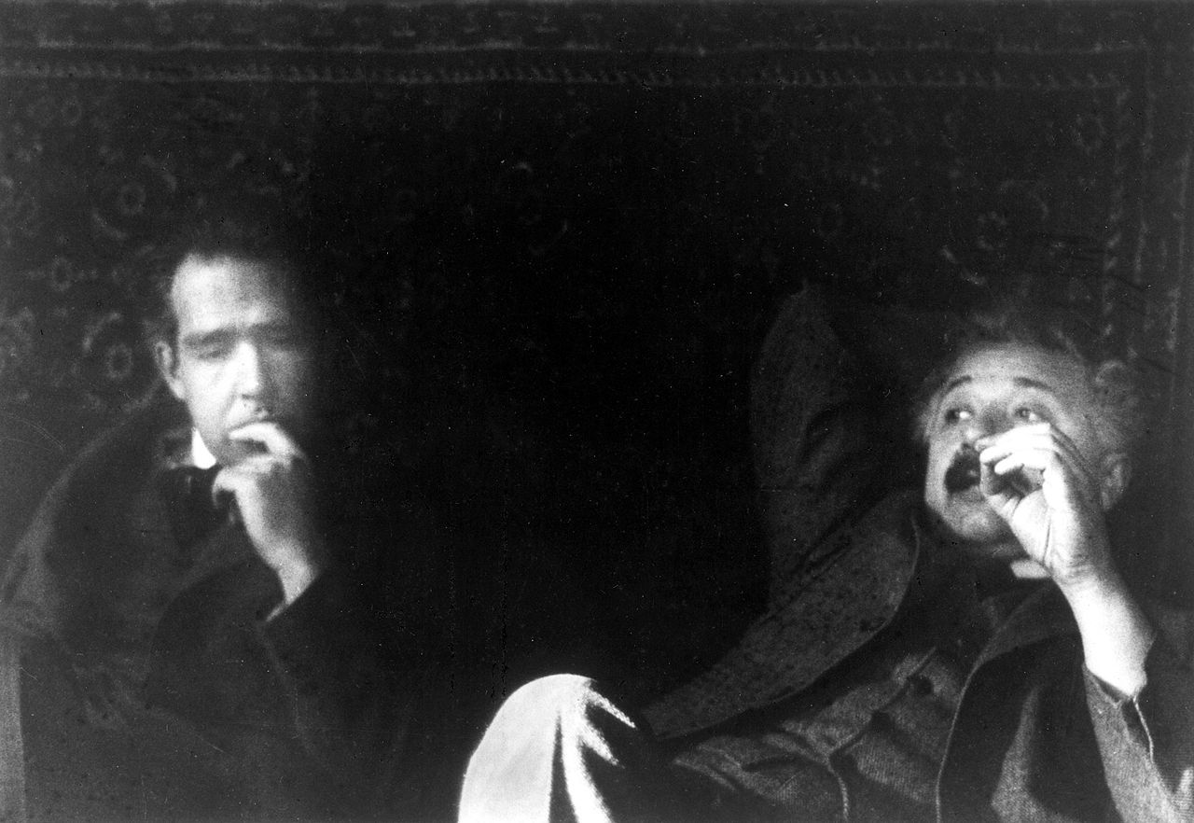
PREFACE | ITER PFCs | HIGH-DUTY CYCLE | SUMMARY
The challenge of complexity
“ We can not solve our problems with the same level of thinking that created them. ” – Einstein
Complex problems need to be solved on many levels at the same time.

Slide 9
…
Overview
PREFACE | ITER PFCs | HIGH-DUTY CYCLE | SUMMARY

Slide 10
PREFACE | ITER PFCs | HIGH-DUTY CYCLE | SUMMARY
ITER Plasma Facing Components (PFCs), vacuum vessel

Slide 11
PREFACE | ITER PFCs | HIGH-DUTY CYCLE | SUMMARY
ITER Plasma Facing Components (PFCs), water manifolds

Slide 12
PREFACE | ITER PFCs | HIGH-DUTY CYCLE | SUMMARY
ITER Plasma Facing Components (PFCs), shield blocks

Slide 13
PREFACE | ITER PFCs | HIGH-DUTY CYCLE | SUMMARY
ITER Plasma Facing Components (PFCs), First Wall Panels (FWPs)

Slide 14
PREFACE | ITER PFCs | HIGH-DUTY CYCLE | SUMMARY
ITER Plasma Facing Components (PFCs), The Divertor

Slide 15
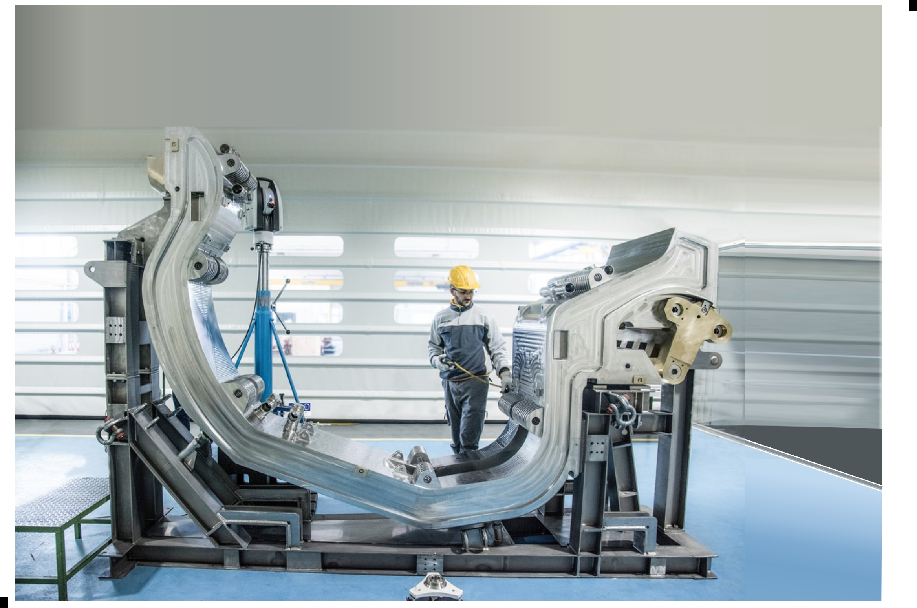
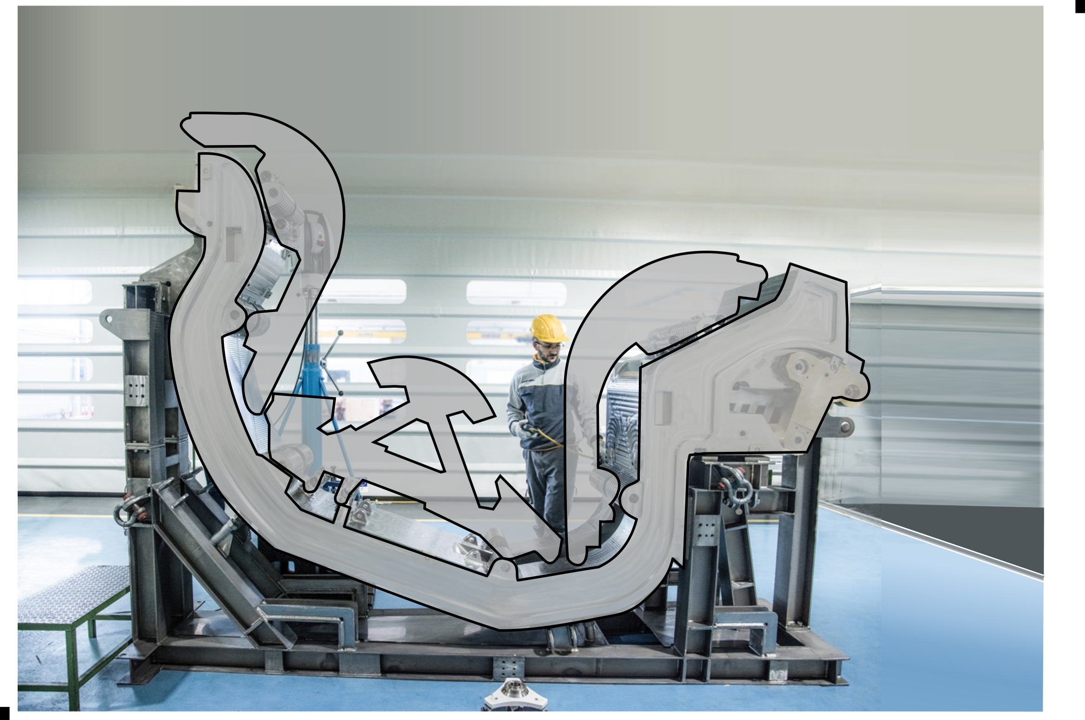
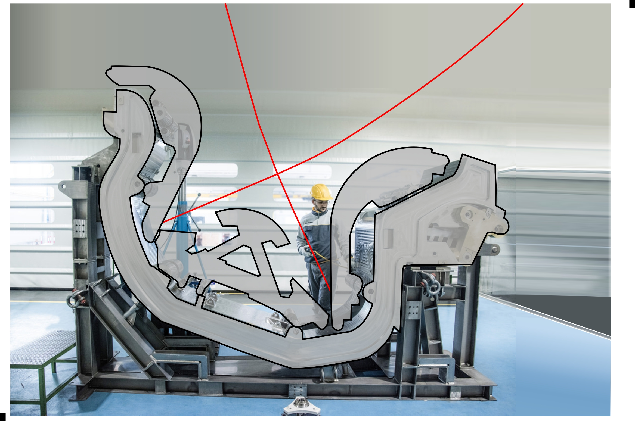
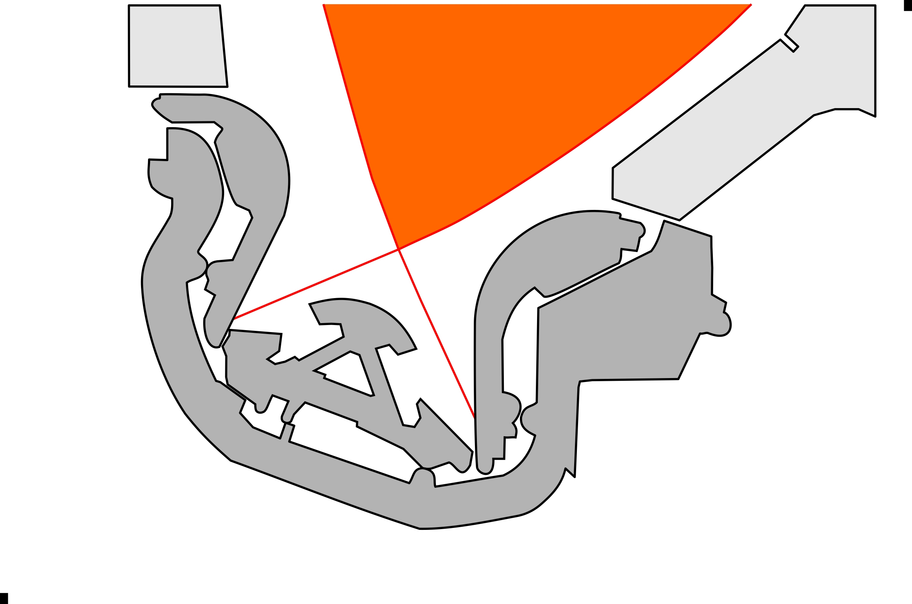
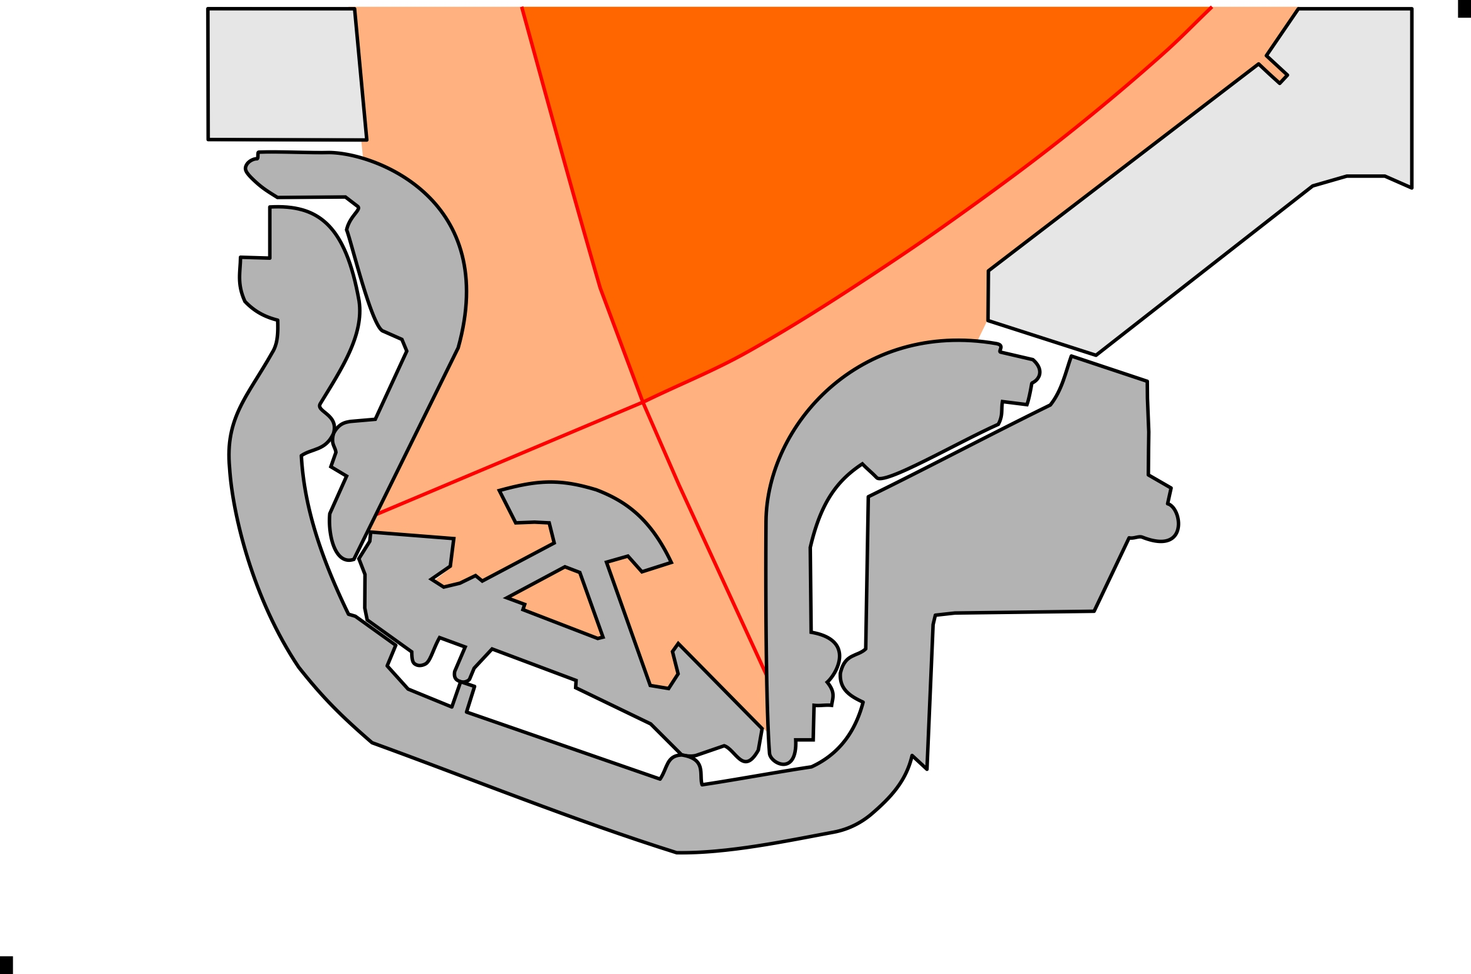
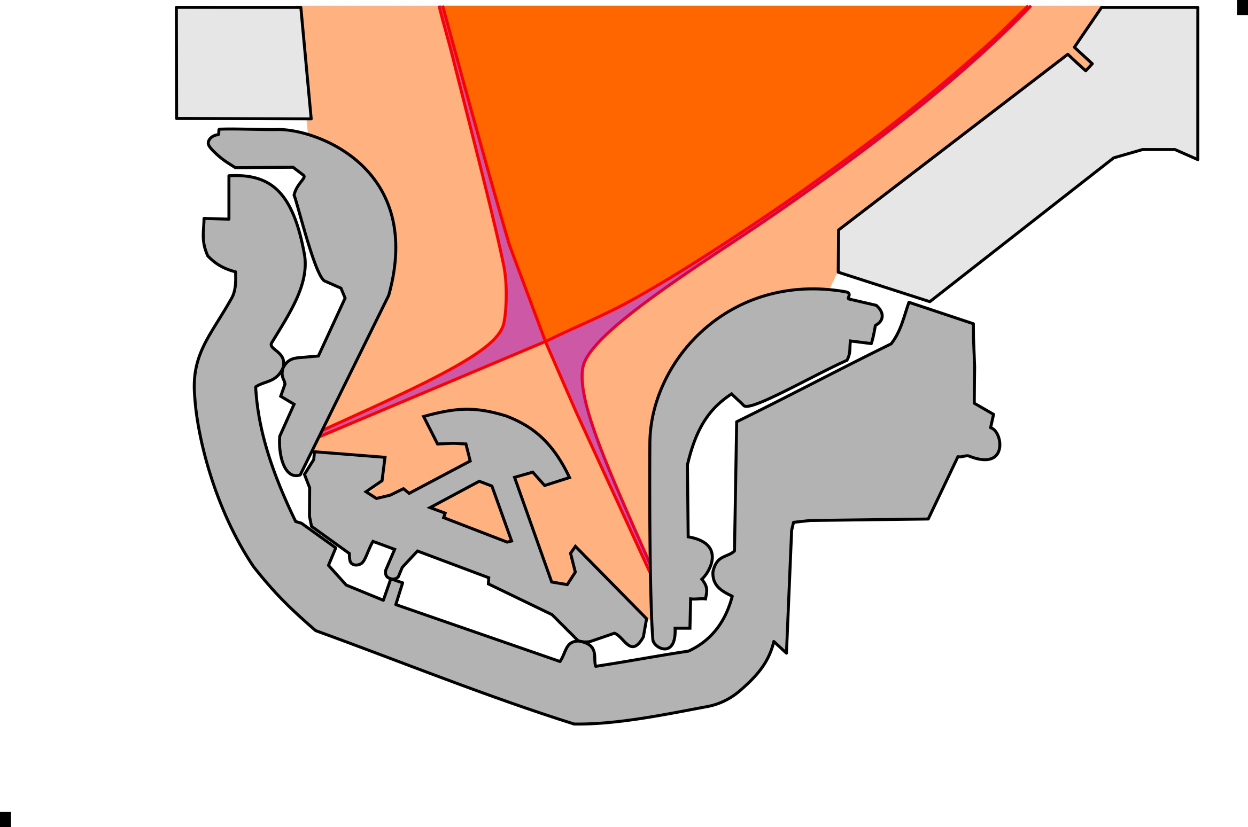
PREFACE | ITER PFCs | HIGH-DUTY CYCLE | SUMMARY
The Divertor
100 MW
INNER
VERTICAL TARGET, IVT (EU)
OUTER
VERTICAL TARGET, OVT (JA)
-70%
BODY (EU)
DOME
(RF)
For the engineering design, a 5 mm radial exponential decay length at the outer mid-plane was assumed for the power channel.

Slide 16
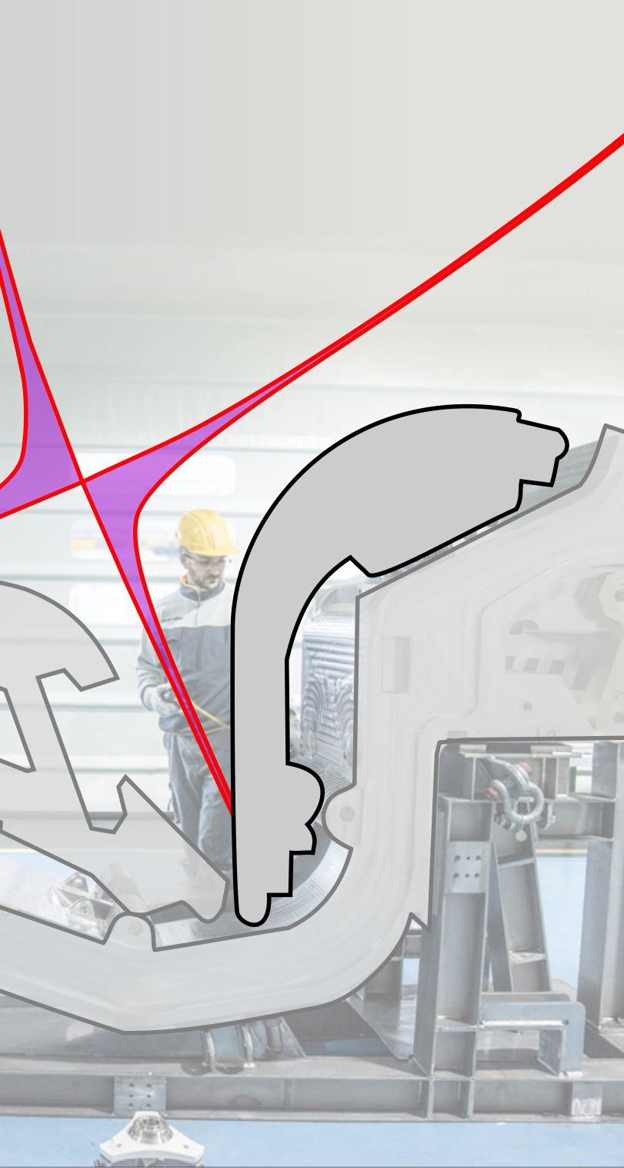
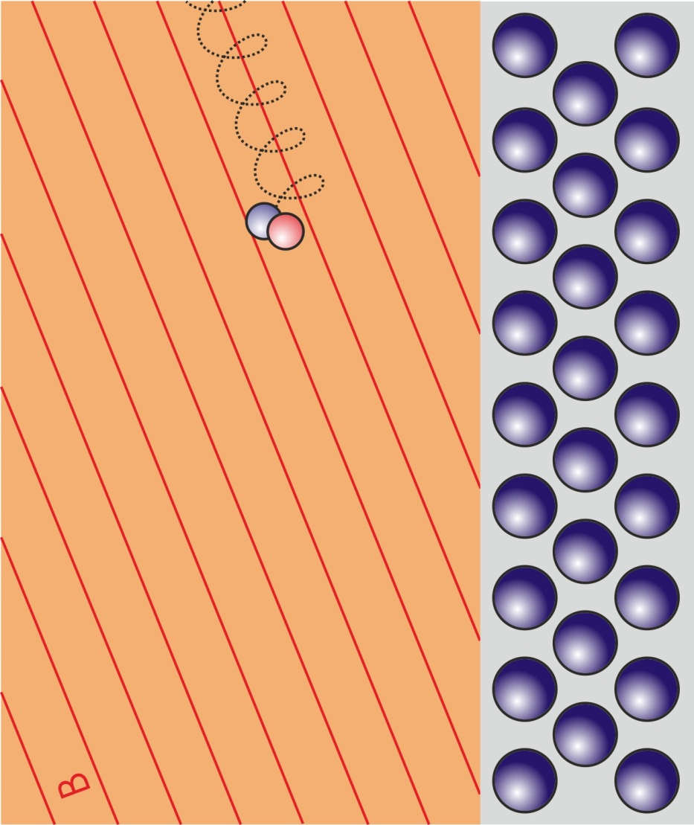
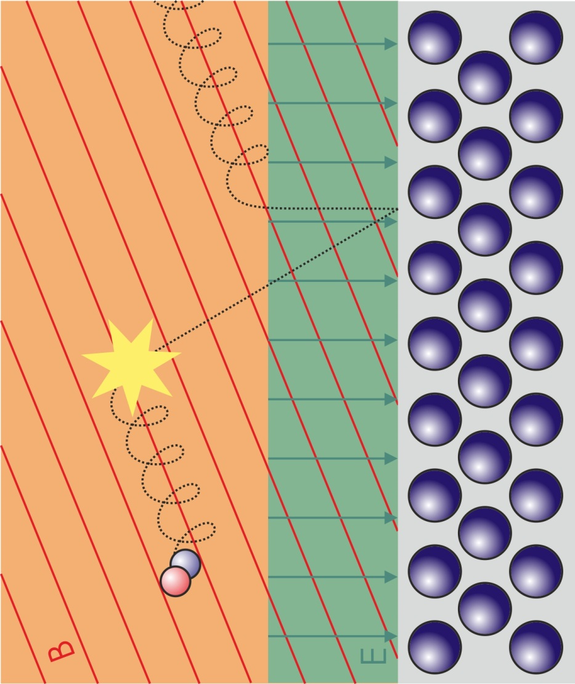
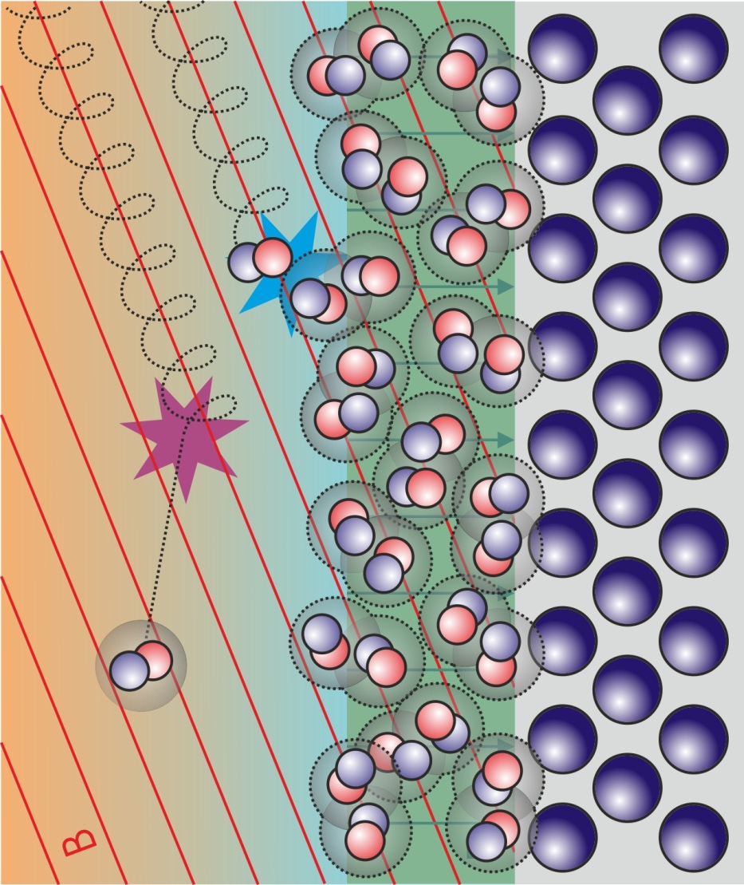
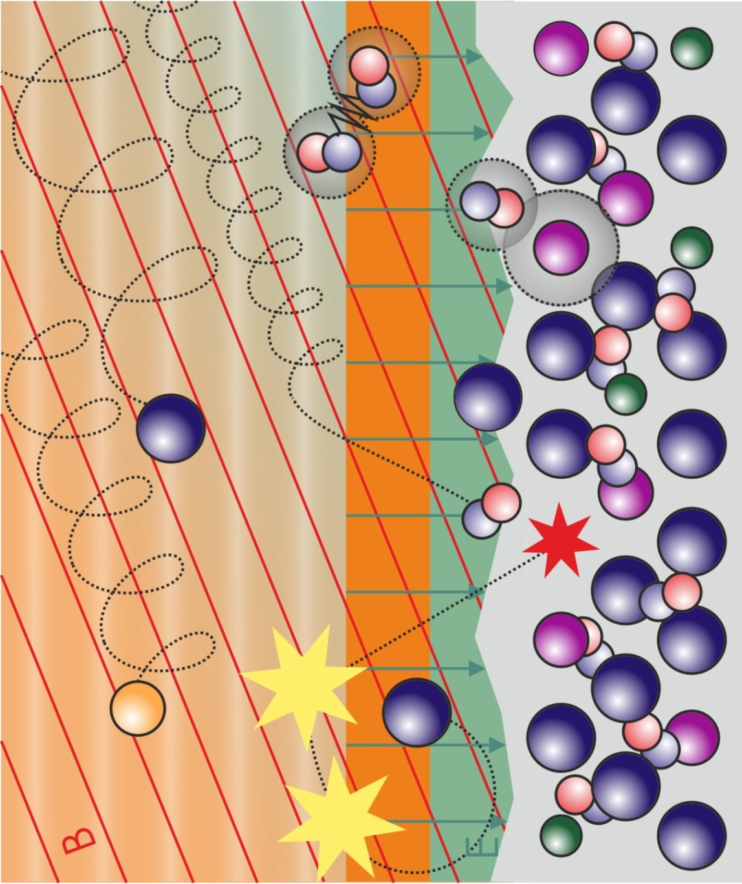
…
– Plasma detachment
PREFACE | ITER PFCs | HIGH-DUTY CYCLE | SUMMARY
The Divertor
B
E

Slide 17
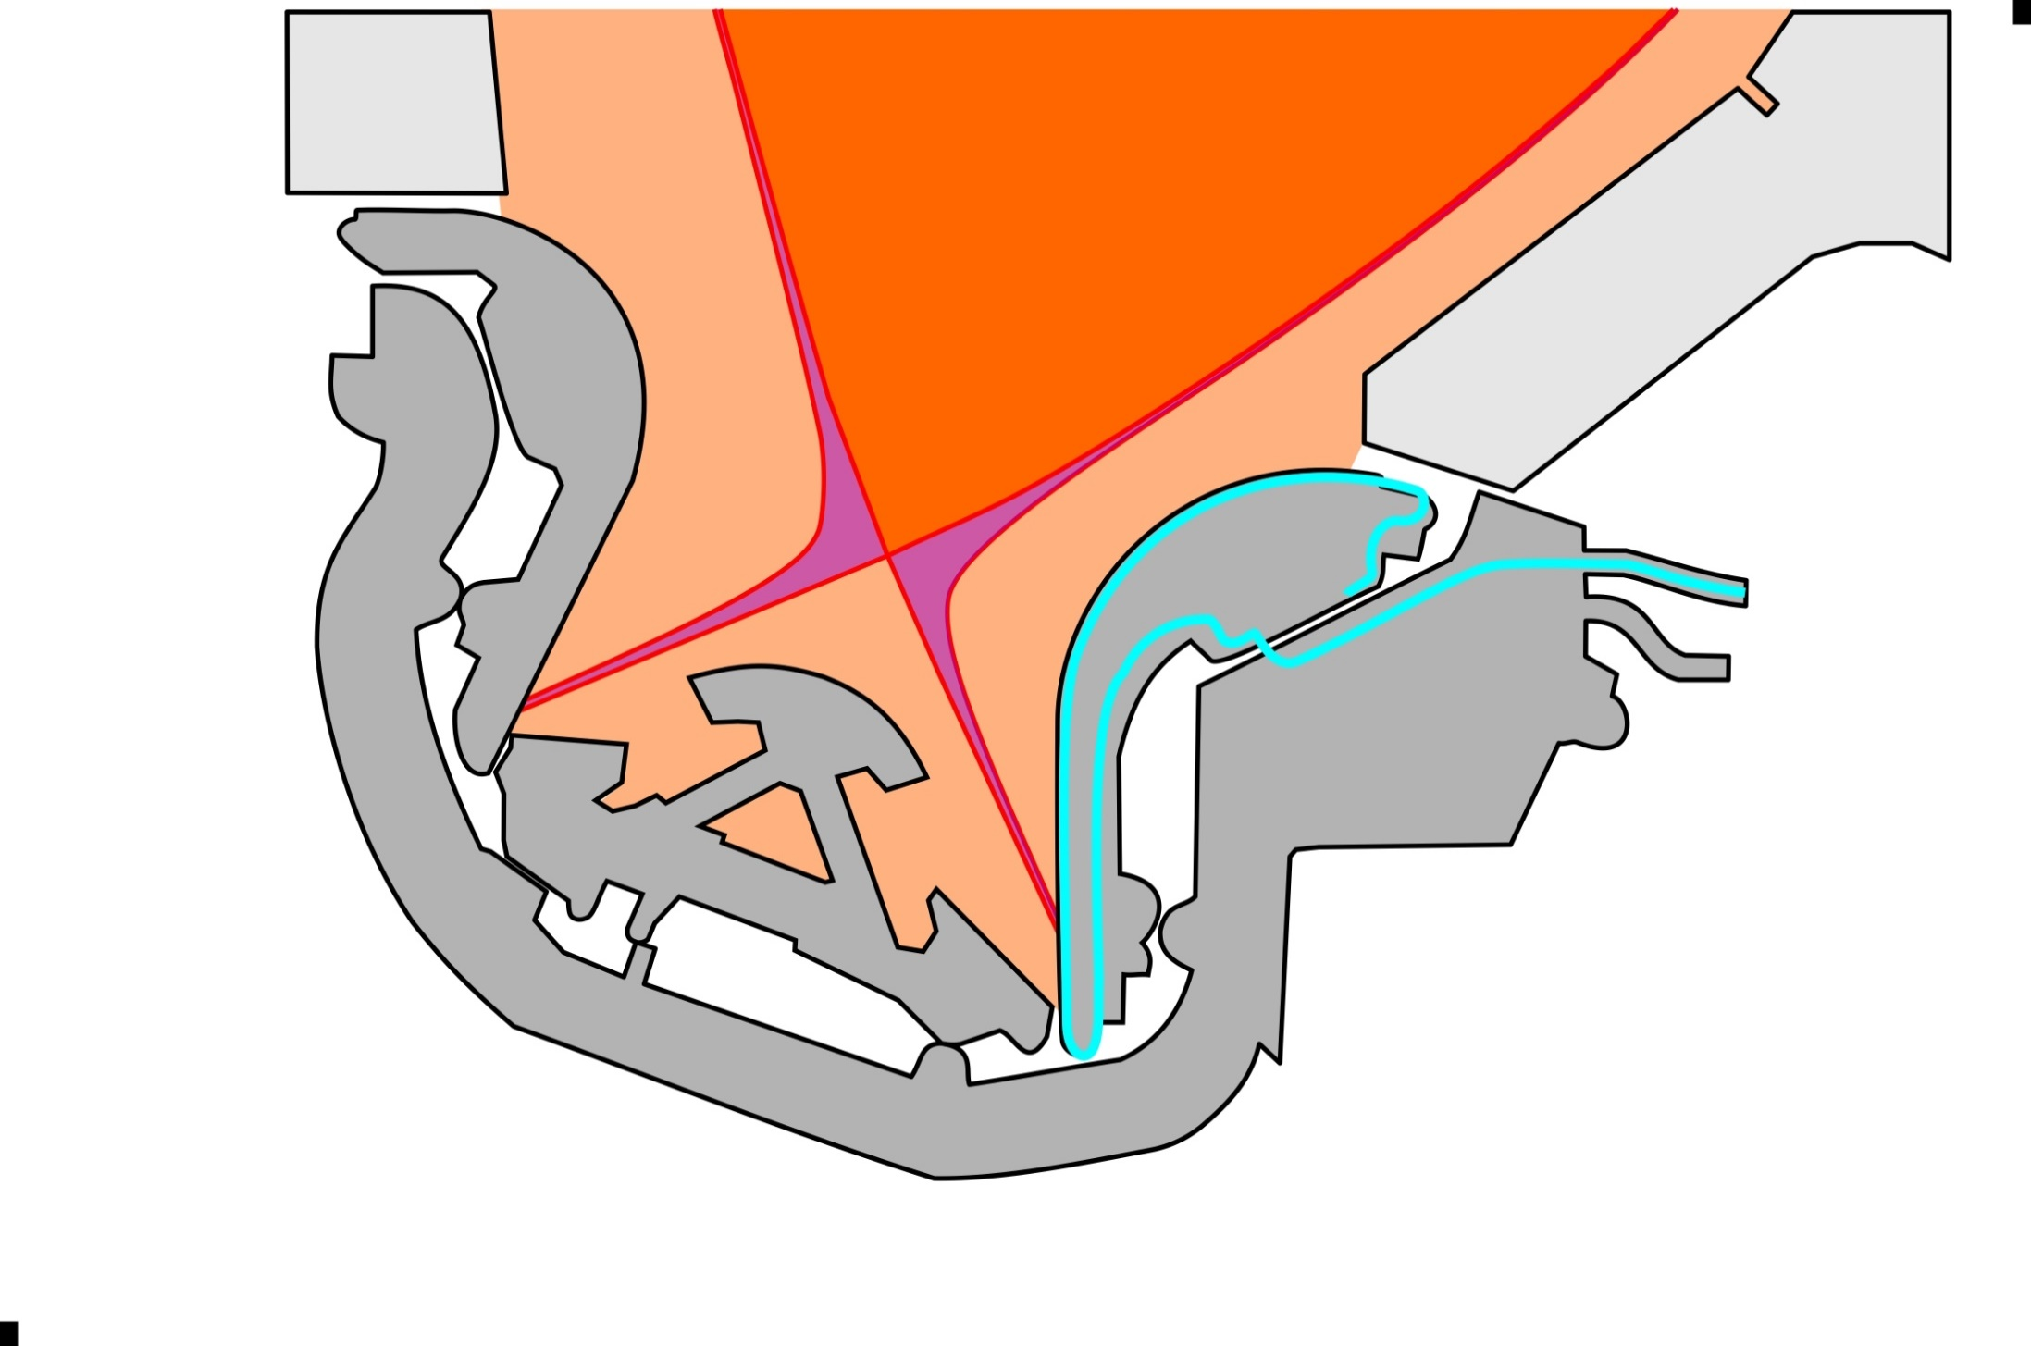
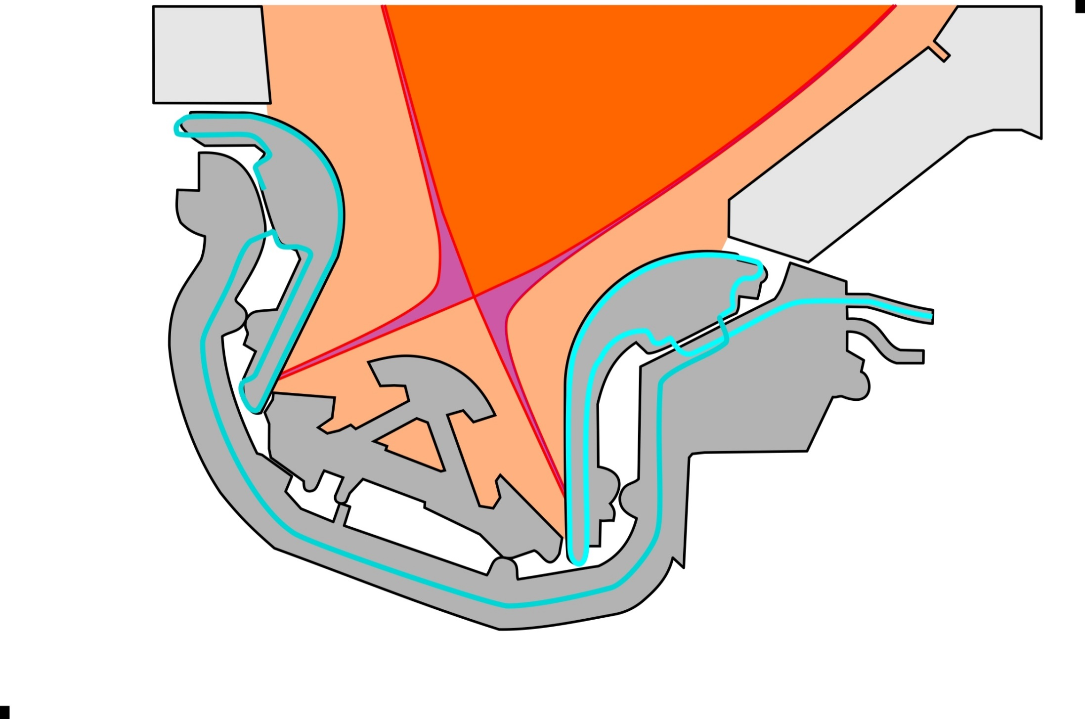
PREFACE | ITER PFCs | HIGH-DUTY CYCLE | SUMMARY
The Divertor – Active cooling

Slide 18
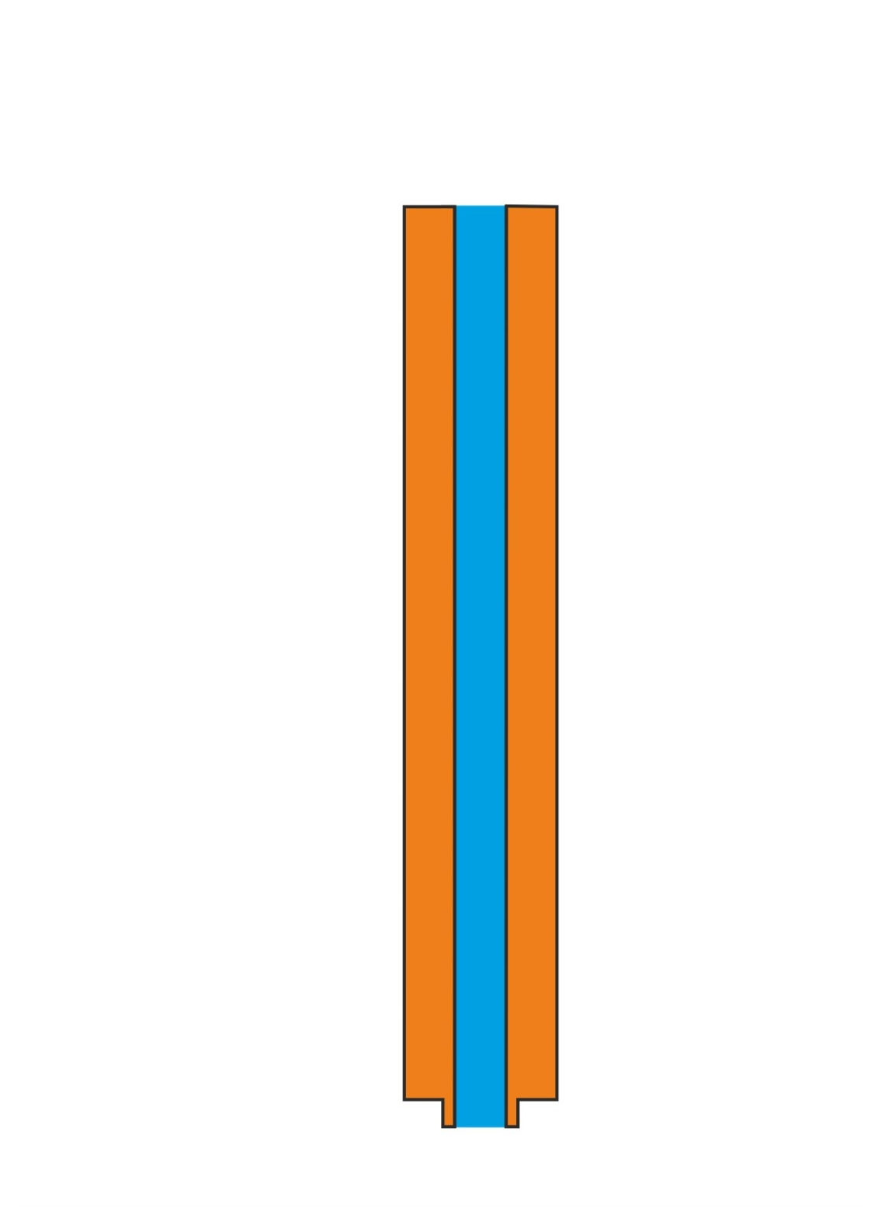
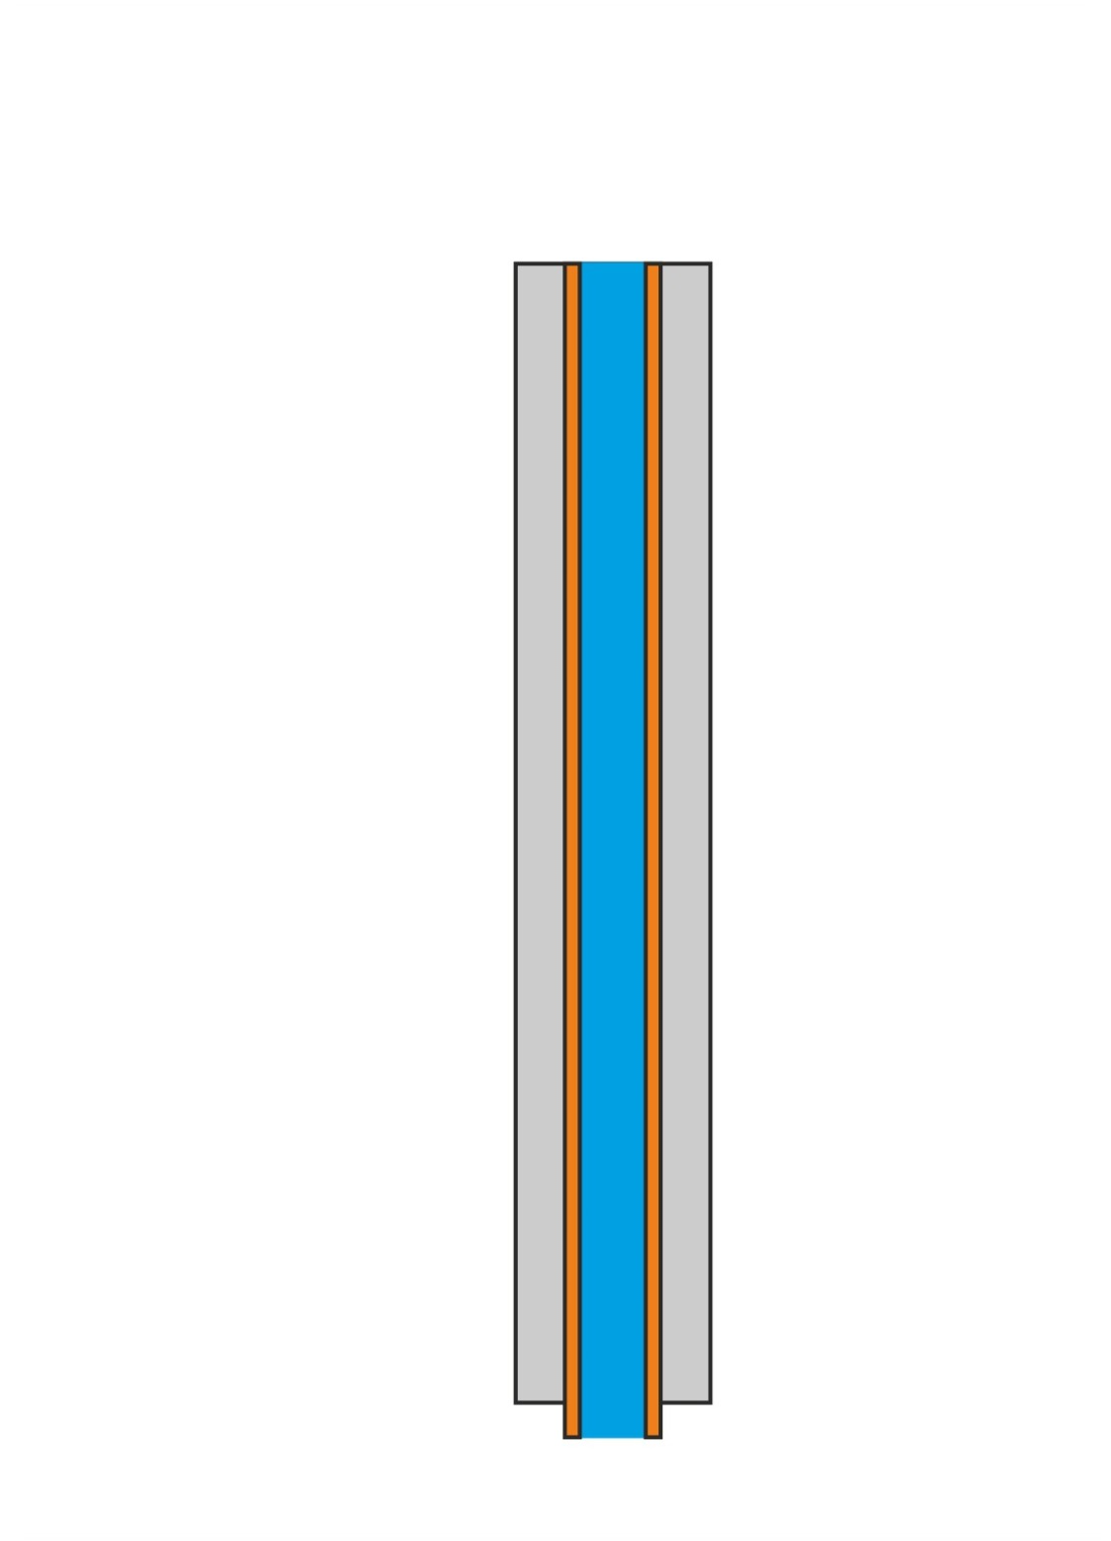
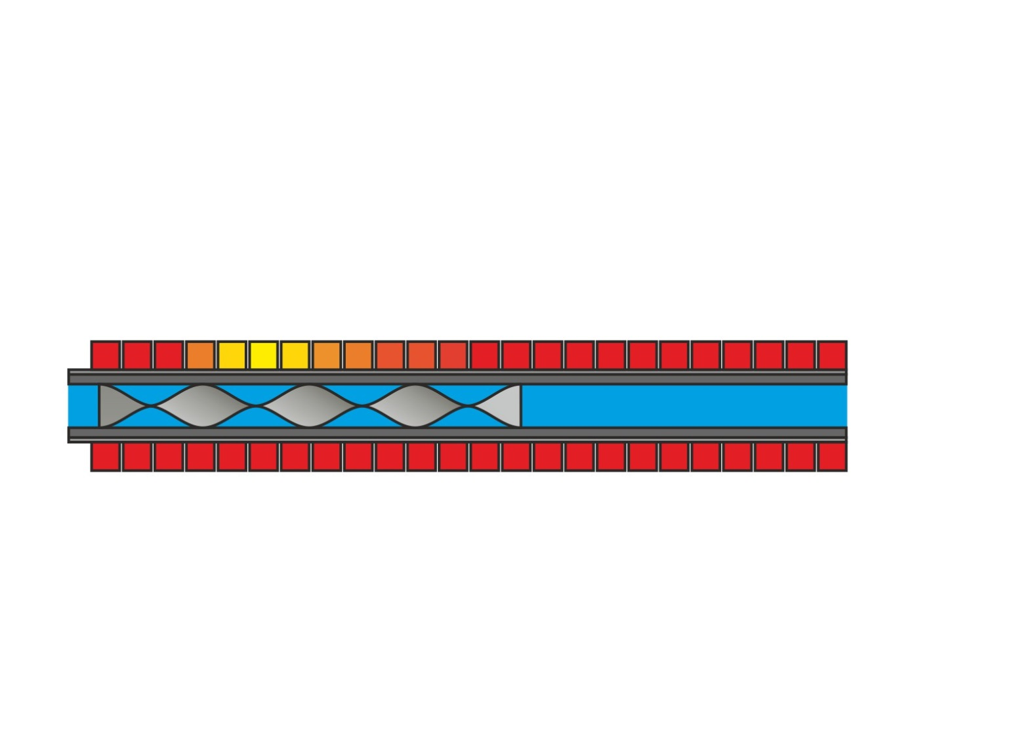
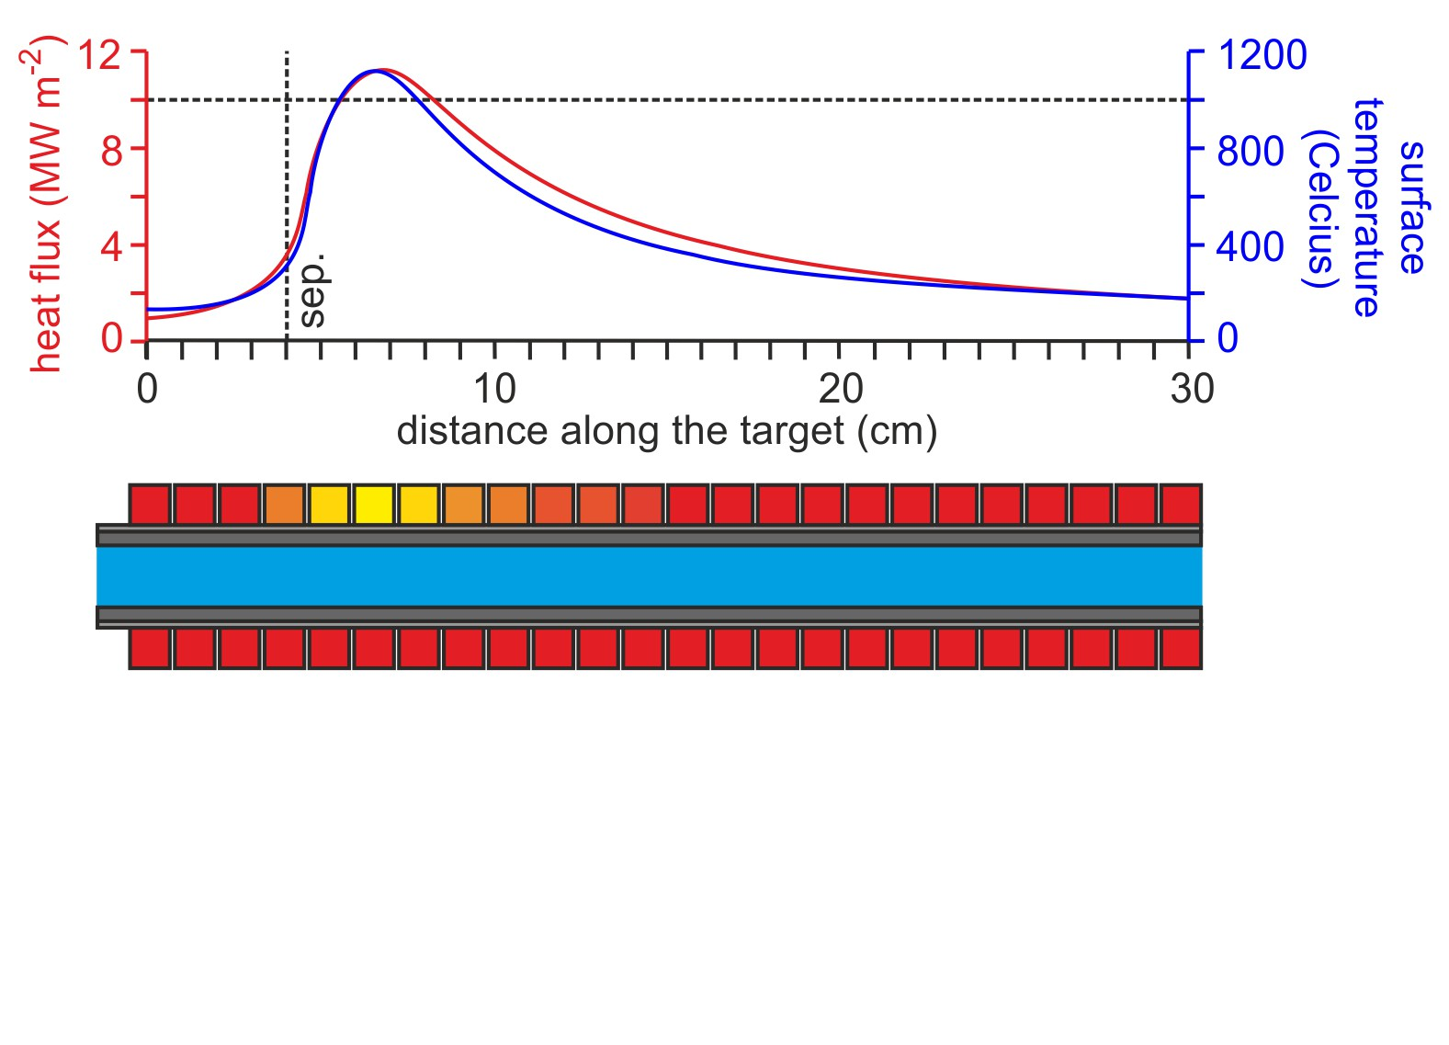
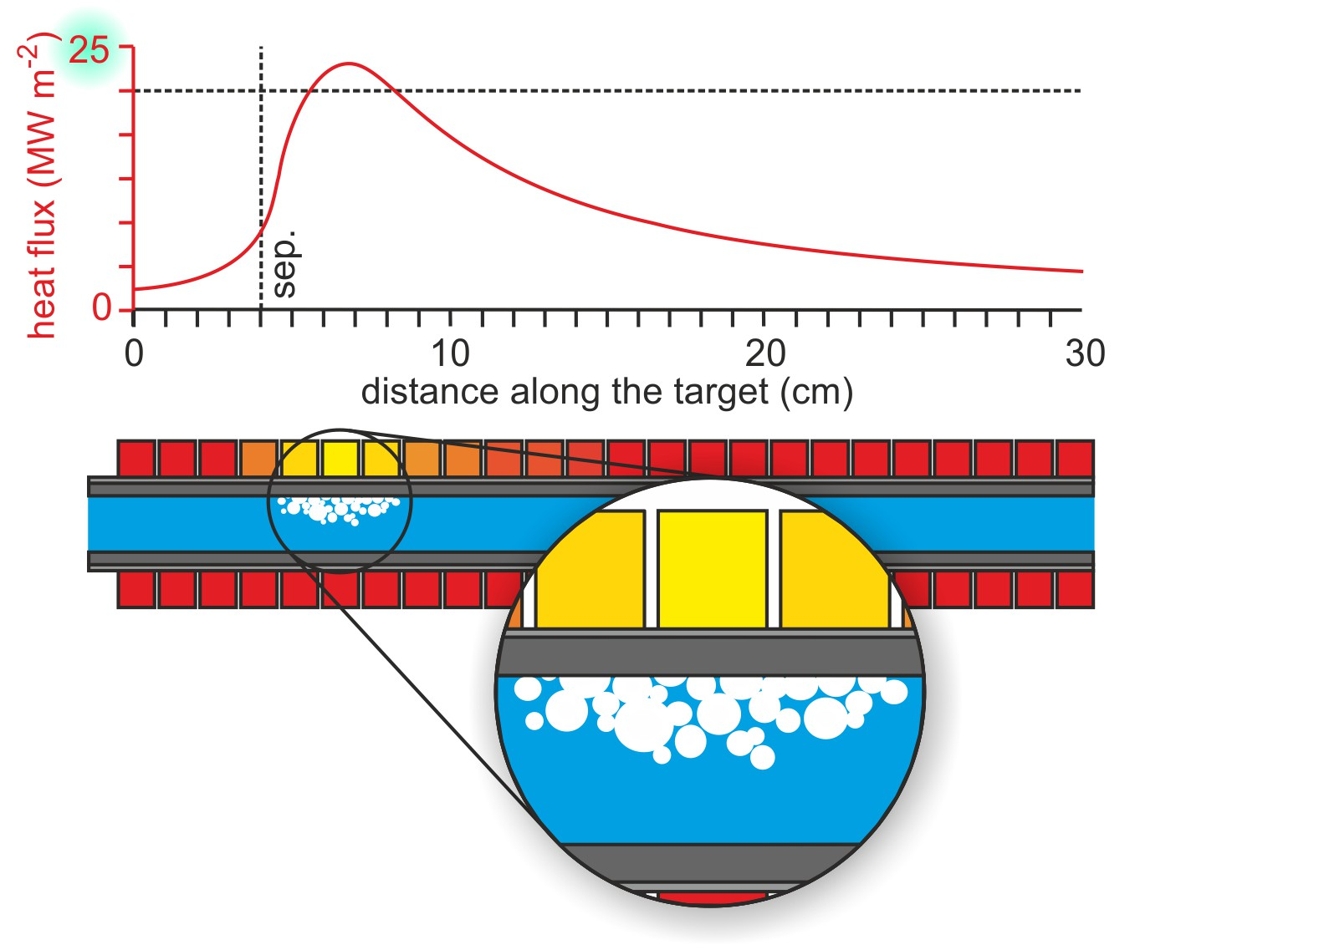
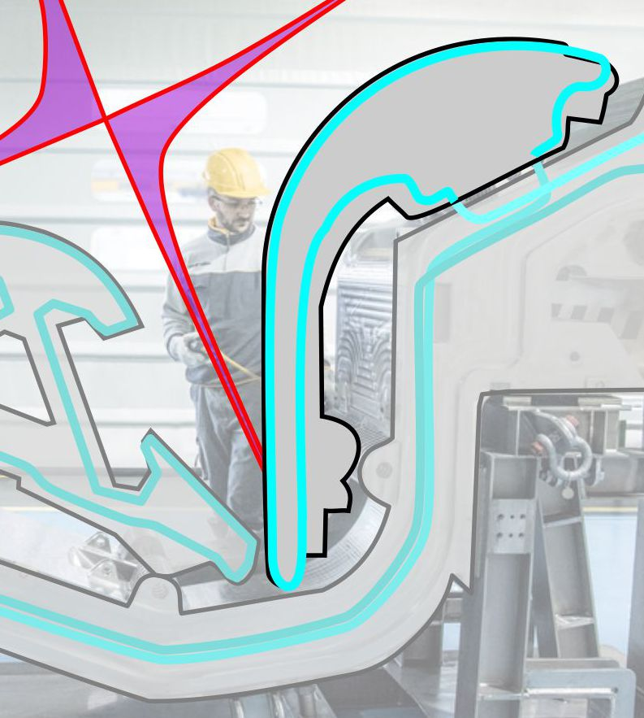
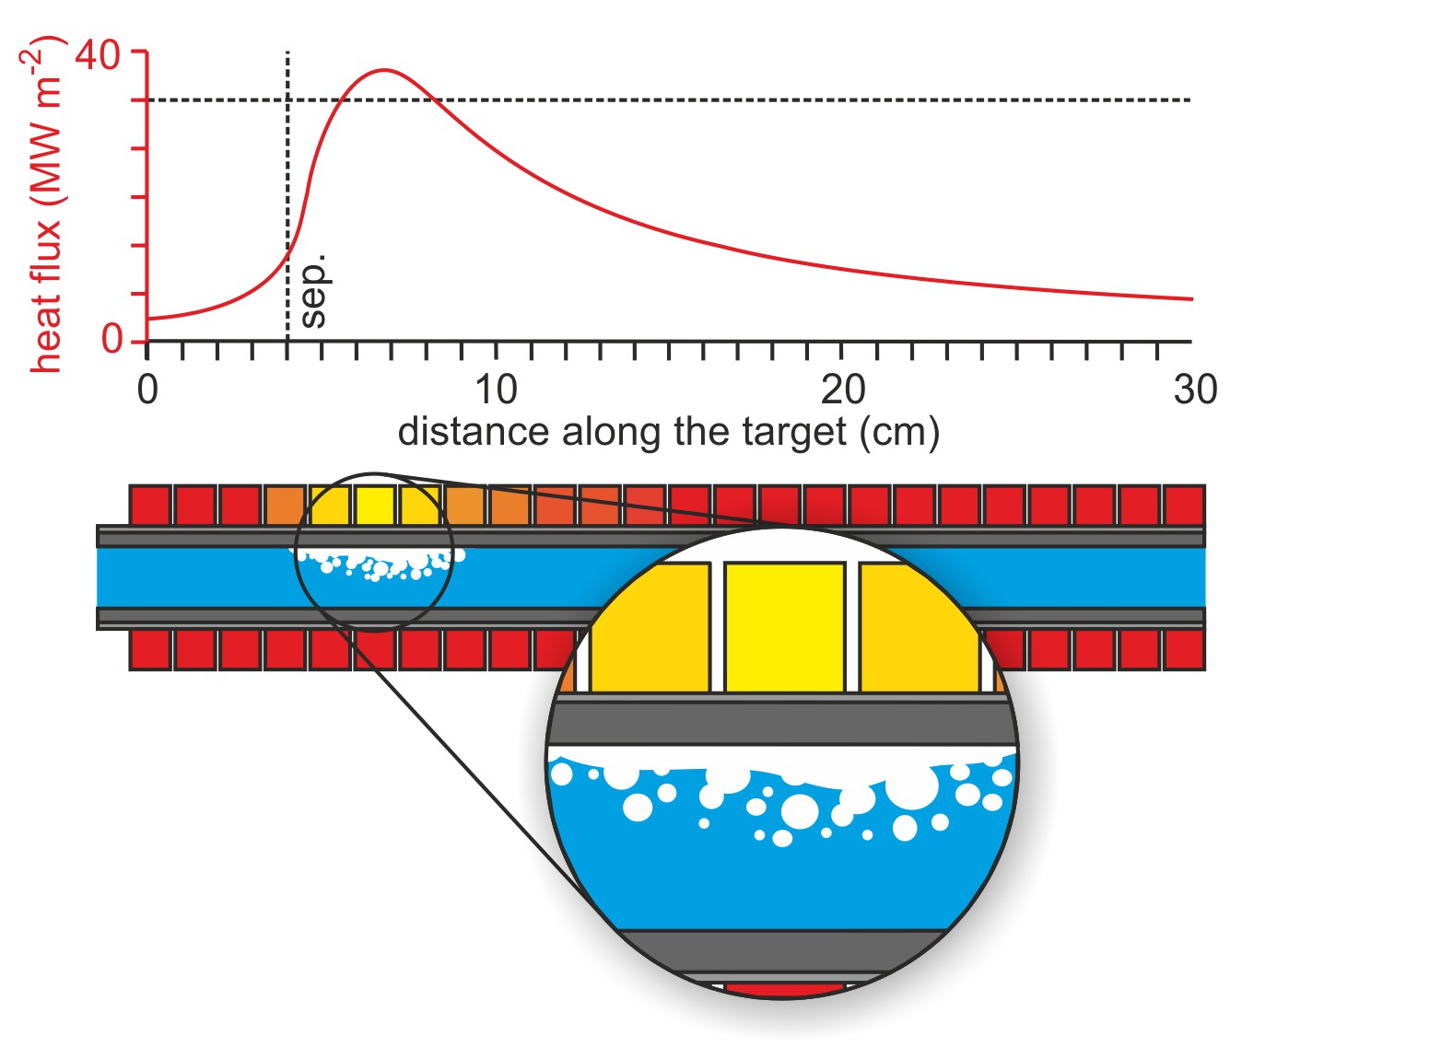
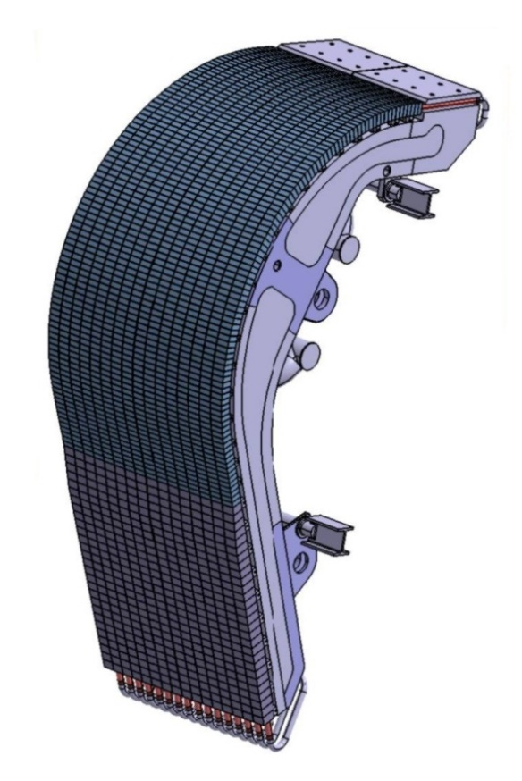
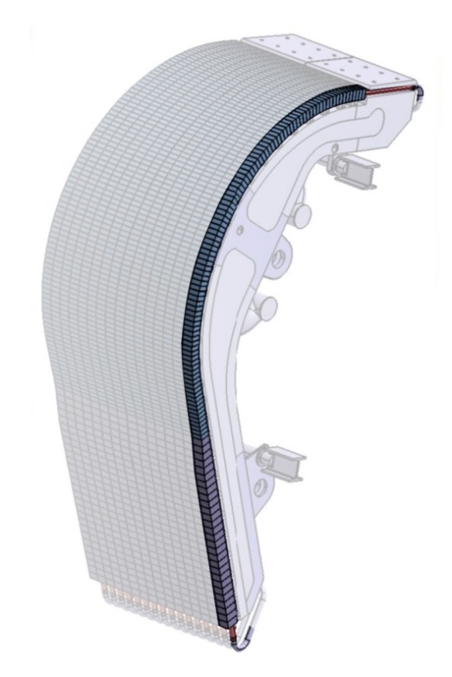
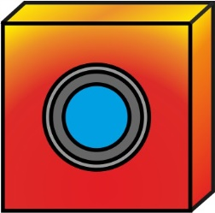
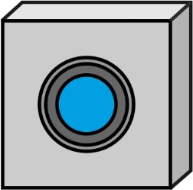
PREFACE | ITER PFCs | HIGH-DUTY CYCLE | SUMMARY
The Divertor – Plasma Facing Units (PFUs) and mono-blocks
TUNGSTEN MONO-BLOCKS
!

Slide 19
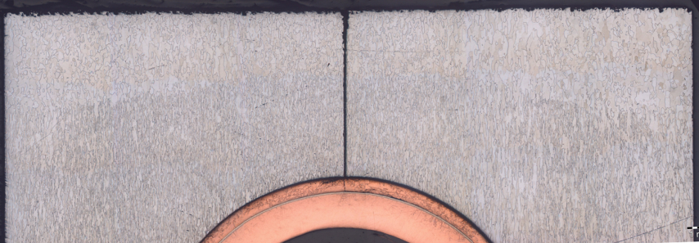
PREFACE | ITER PFCs | HIGH-DUTY CYCLE | SUMMARY
The Divertor – Plasma Facing Units (PFUs) and mono-blocks
Only happening for the highest heat-flux specification of 20 MW m⁻² for 10 seconds.
“ITER turbulence.” – A. Kukushkin
Inventing as we go – many systems have had development issues.

Slide 20
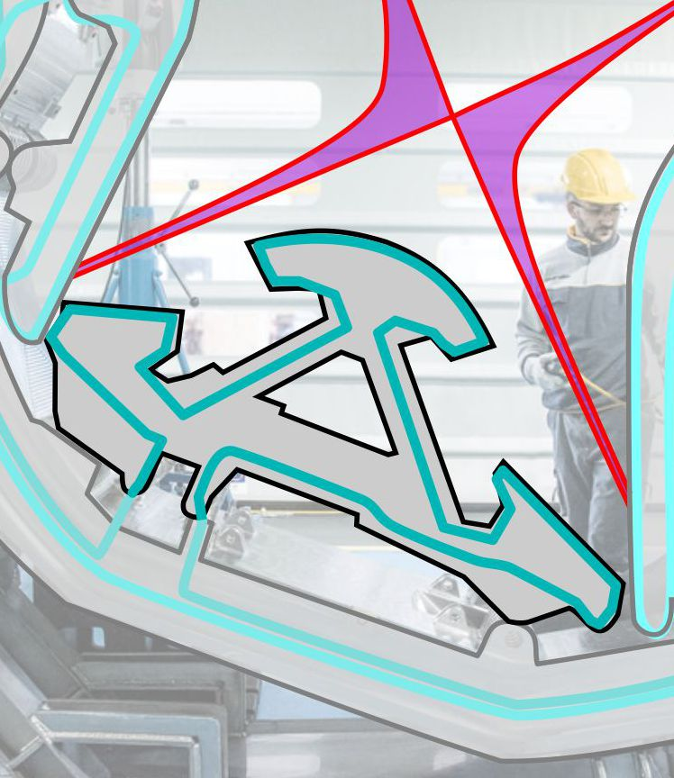
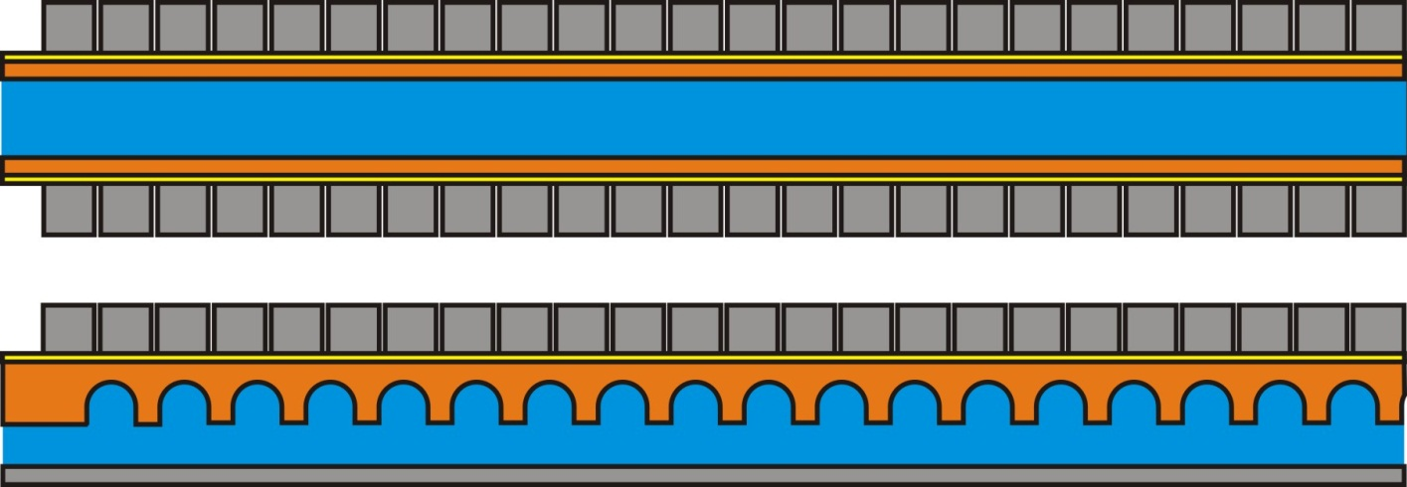
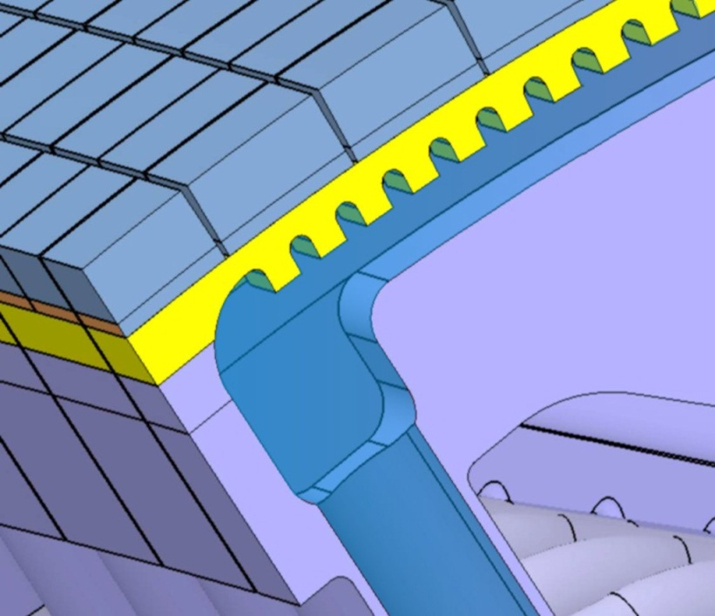
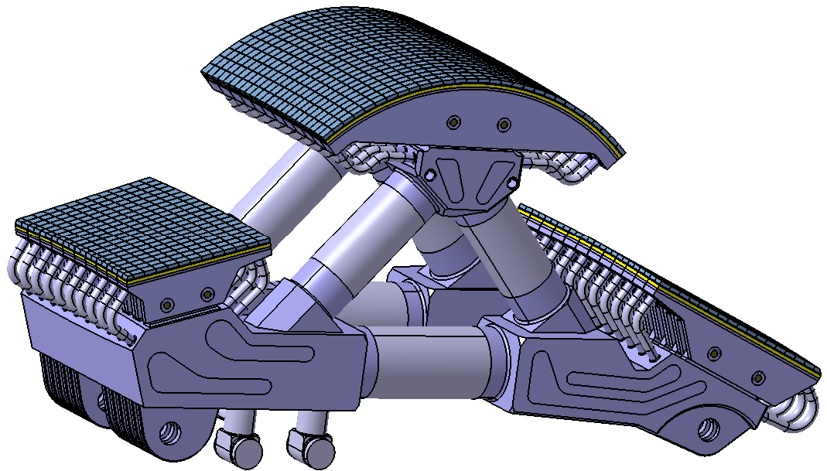
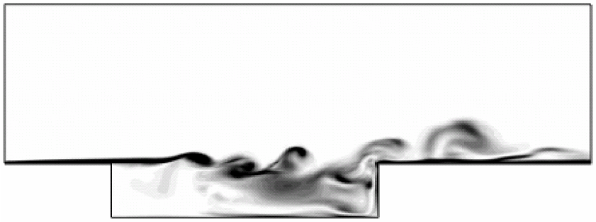
PREFACE | ITER PFCs | HIGH-DUTY CYCLE | SUMMARY
The Dome
W FLAT TILE ARMOUR
HYPER-VAPOTRON
EDDY SIMULATIONS
[O. Aybay, Fluid Mechanics and Multidisciplinary Design, 2010]
FLOW

Slide 21
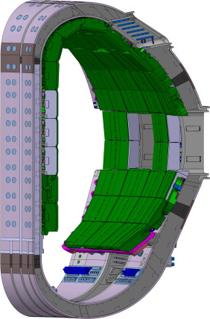
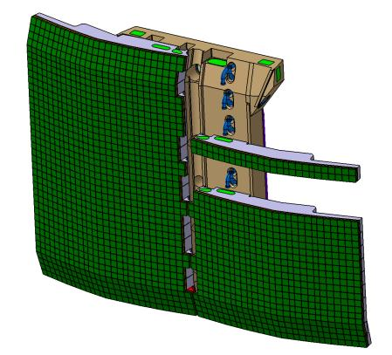
PREFACE | ITER PFCs | HIGH-DUTY CYCLE | SUMMARY
First Wall Panels (FWPs)
BERYLLIUM TILES

Slide 22
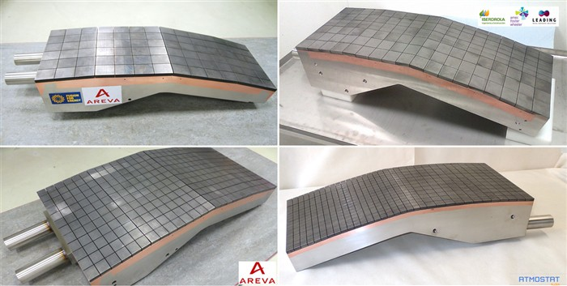
PREFACE | ITER PFCs | HIGH-DUTY CYCLE | SUMMARY
First Wall Panels (FWPs) – Mock-ups

Slide 23
…
Overview
PREFACE | ITER PFCs | HIGH-DUTY CYCLE | SUMMARY

Slide 24
PREFACE | ITER PFCs | HIGH-DUTY CYCLE | SUMMARY
Plasma fluence in high duty-cycle devices
Start the pulse… and go for a coffee.
One morning of ITER operation = three decades of JET, in terms of plasma to surfaces.

Slide 25
PREFACE | ITER PFCs | HIGH-DUTY CYCLE | SUMMARY
R.A.M.I. – Engineering considerations for high duty-cycle
Reliability. Accessibility. Maintainability. Inspectability.

Slide 26
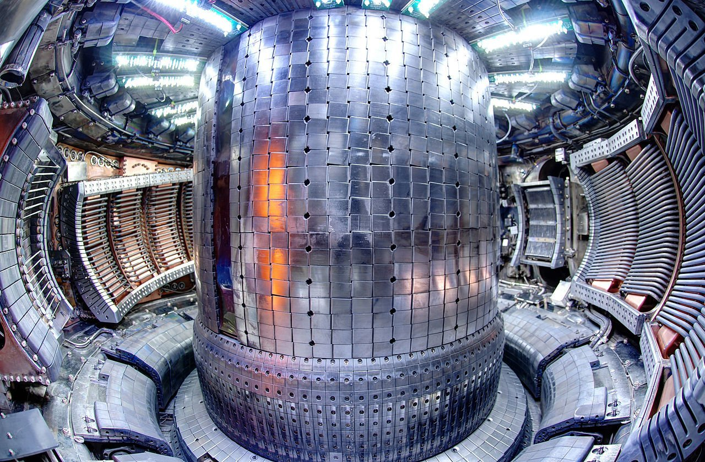
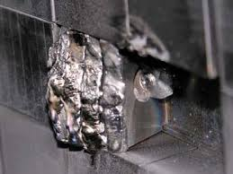
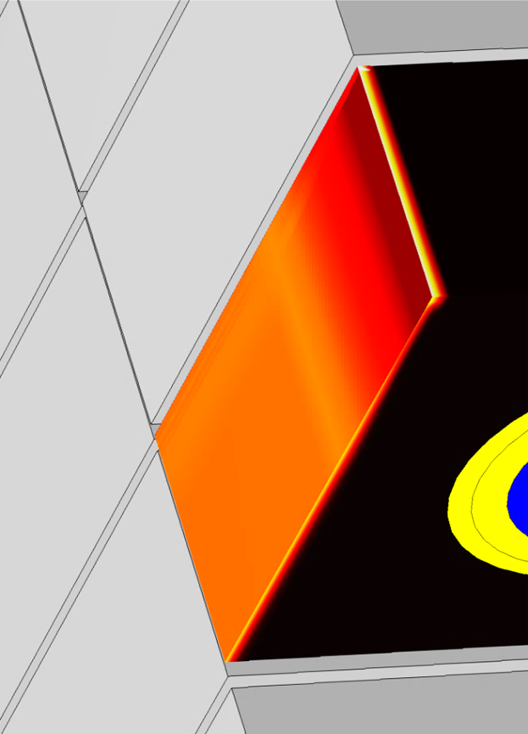
PREFACE | ITER PFCs | HIGH-DUTY CYCLE | SUMMARY
Divertor – Discrete tiles and leading edges
Small tiles lower thermal stress, but give many edges that can initiate cascade failure.
[B. Lipschultz]
ELM ION
MELTING IN
ITER?
[J. Gunn]
ALCATOR C-MOD

Slide 27
PREFACE | ITER PFCs | HIGH-DUTY CYCLE | SUMMARY
Divertor divertor – Large modular components
In ITER, the entire cassette is thrown away if the strike-point surface is damaged.
Replacement time: 6-9 months, which is impractical for a power plant.

Slide 28
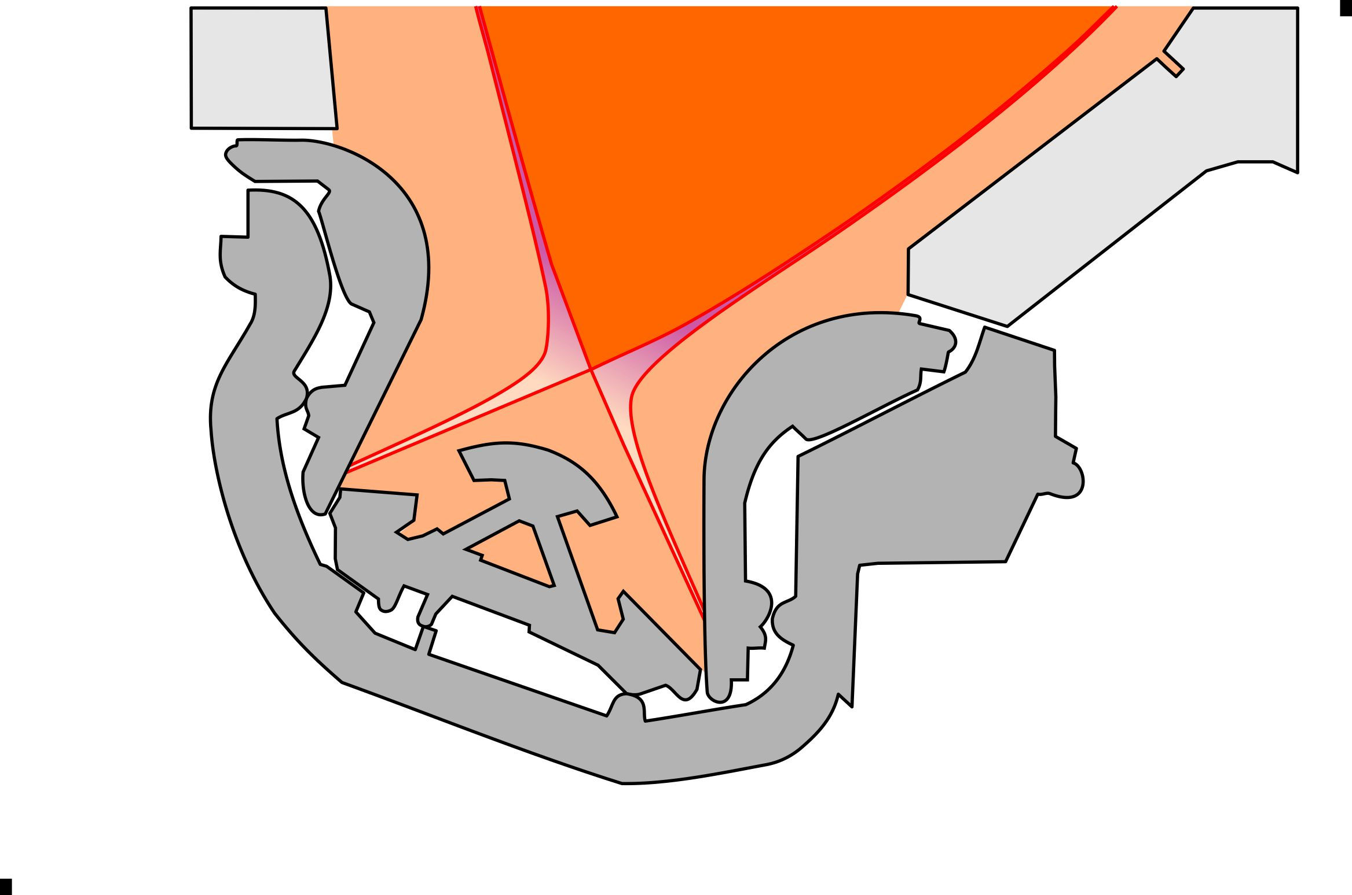
PREFACE | ITER PFCs | HIGH-DUTY CYCLE | SUMMARY
Divertor – Photon dissipation
Strong impurity seeding: 95% of the power escaping the core is radiated (70% in ITER).

Slide 29
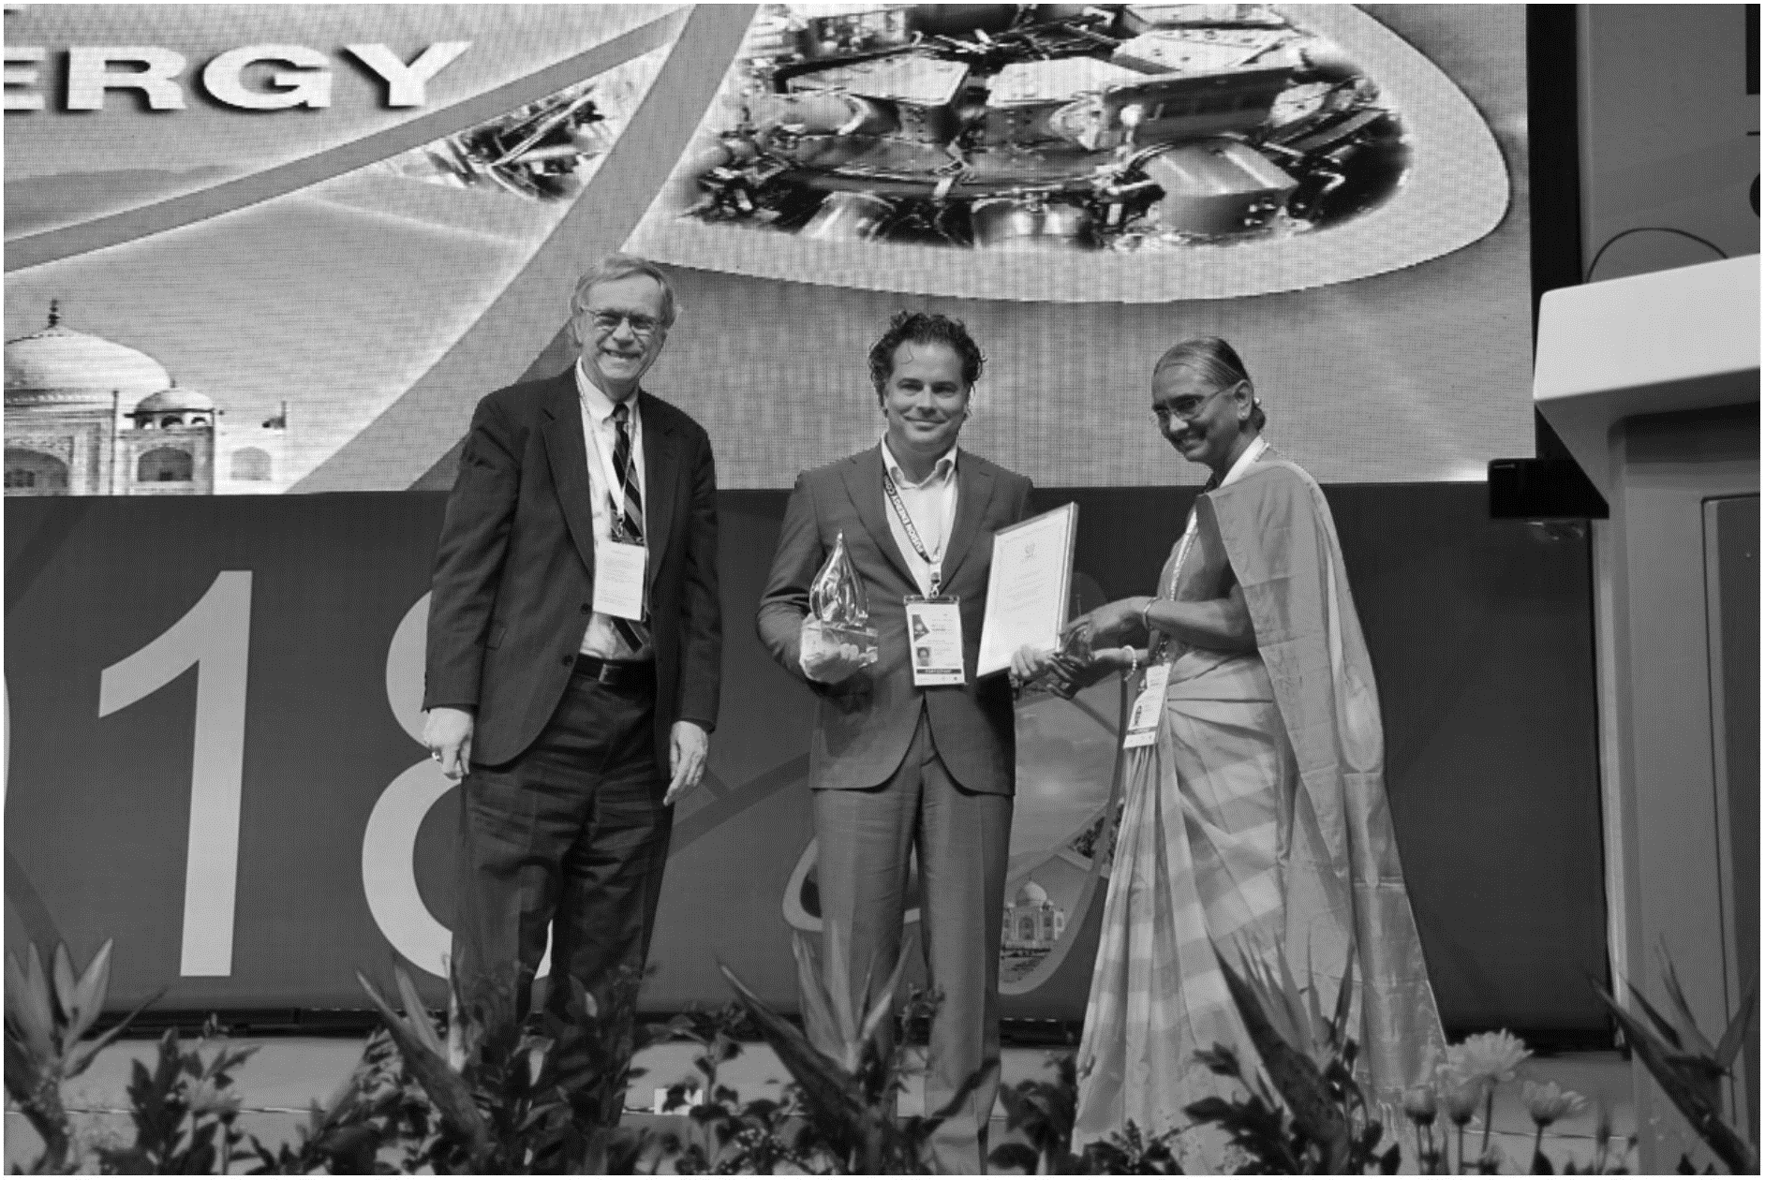
PREFACE | ITER PFCs | HIGH-DUTY CYCLE | SUMMARY
Divertor – Photon dissipation

Slide 30
PREFACE | ITER PFCs | HIGH-DUTY CYCLE | SUMMARY
Divertor – Photon dissipation
“Confinement predictions for DEMO under these conditions require future work.”
[Kallenbach 2015]

Slide 31
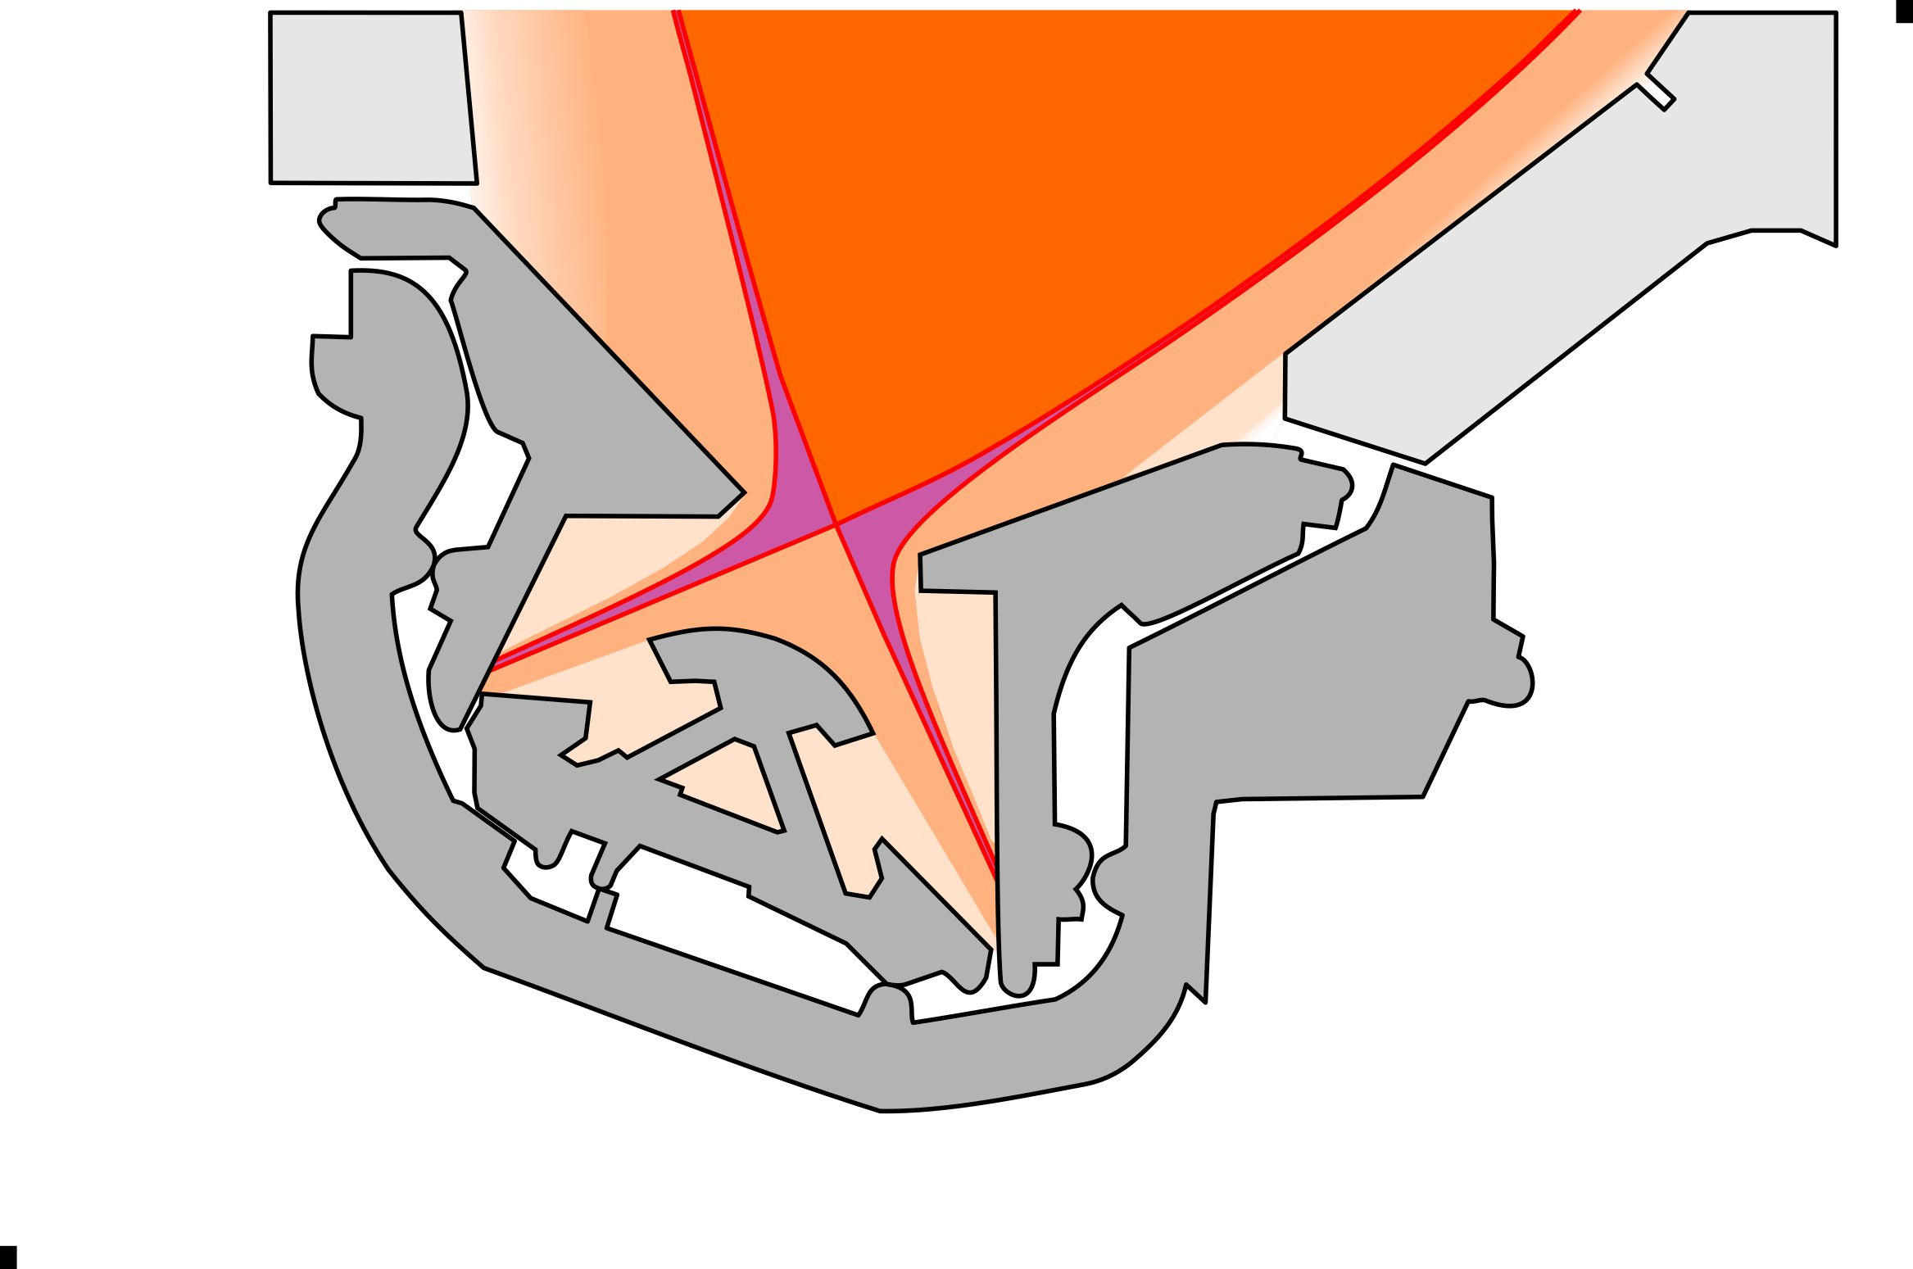
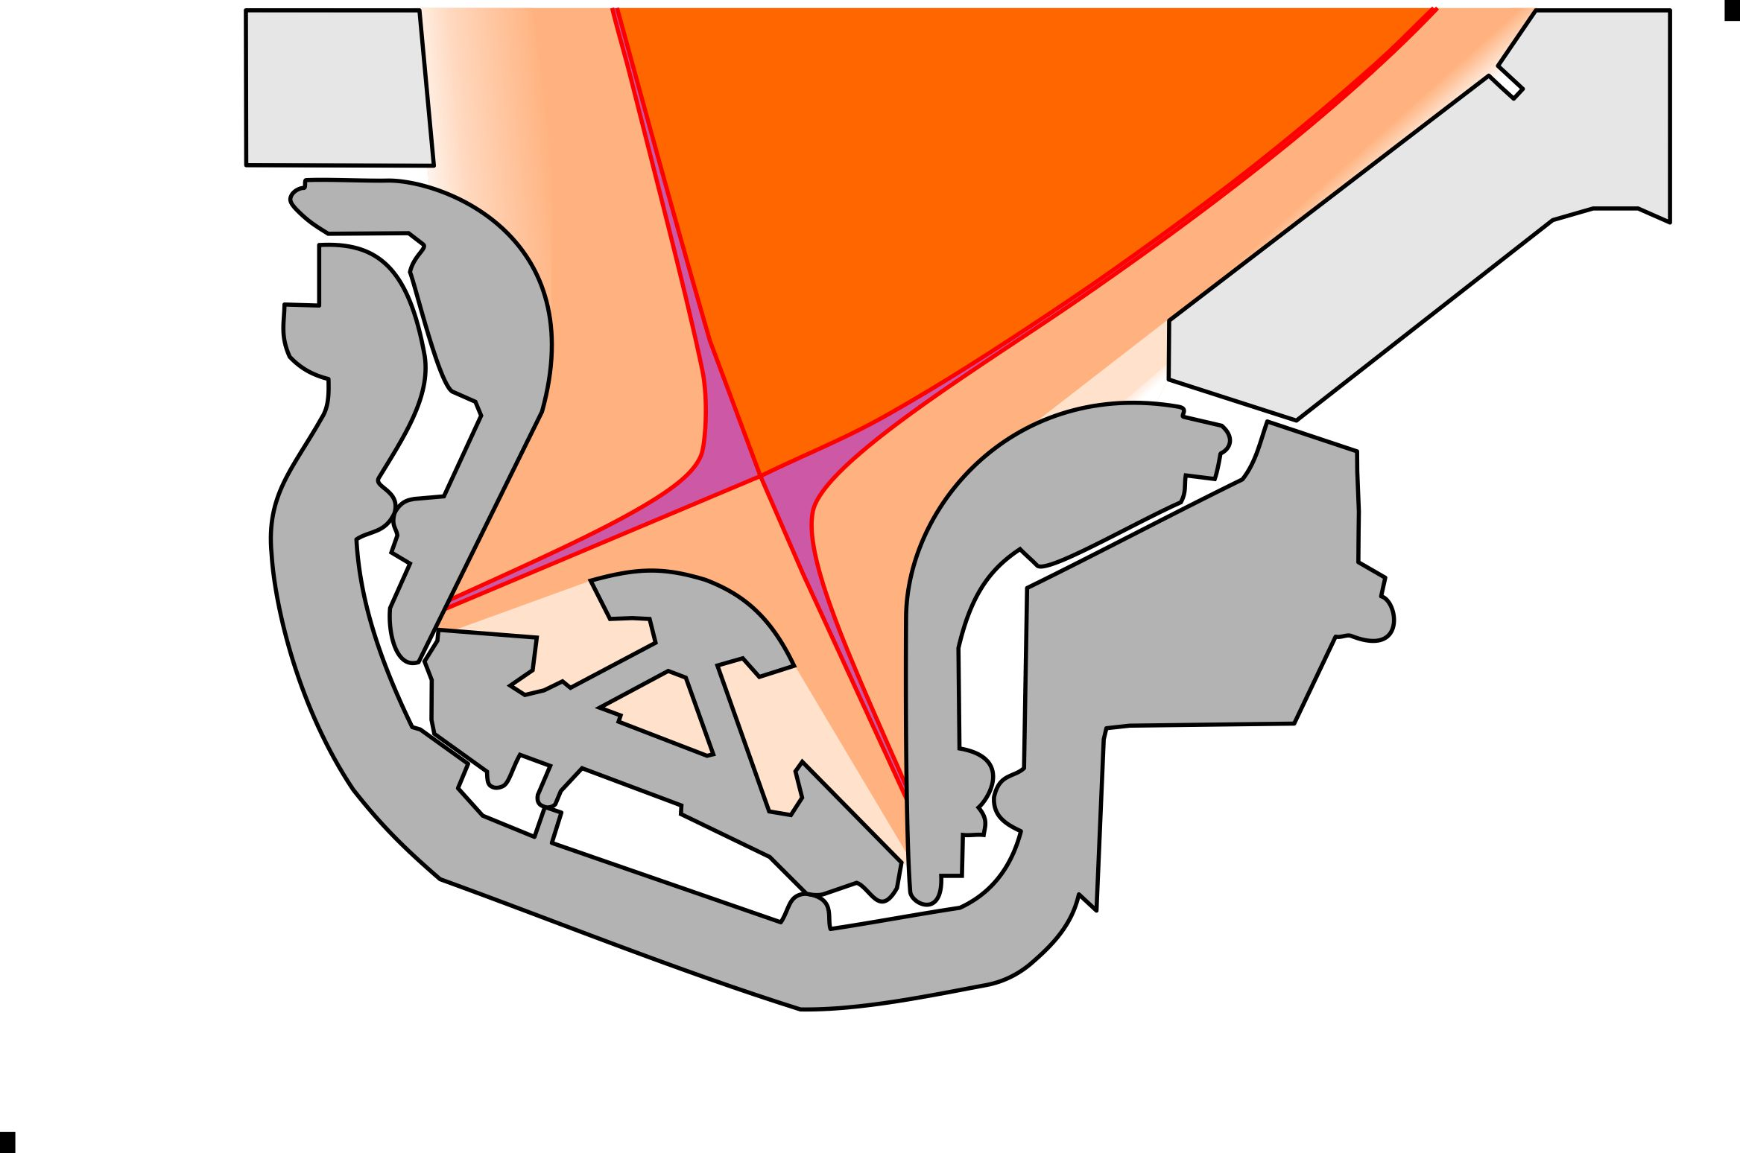
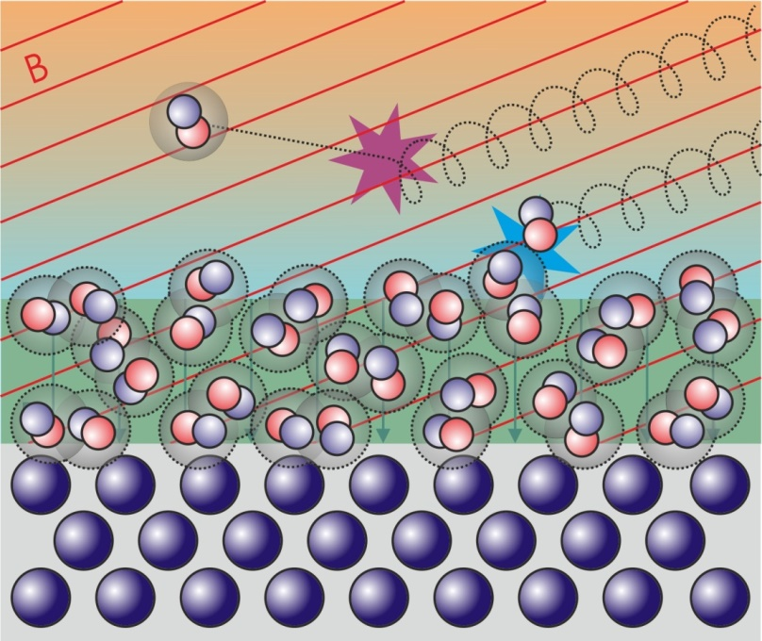
PREFACE | ITER PFCs | HIGH-DUTY CYCLE | SUMMARY
Divertor – Neutral particle dissipation
Needs study.
Assume a single plasma scenario device, so that the baffle geometry can be optimized.
Atomic physics does not scale with size – want greater access to the power channel.

Slide 32
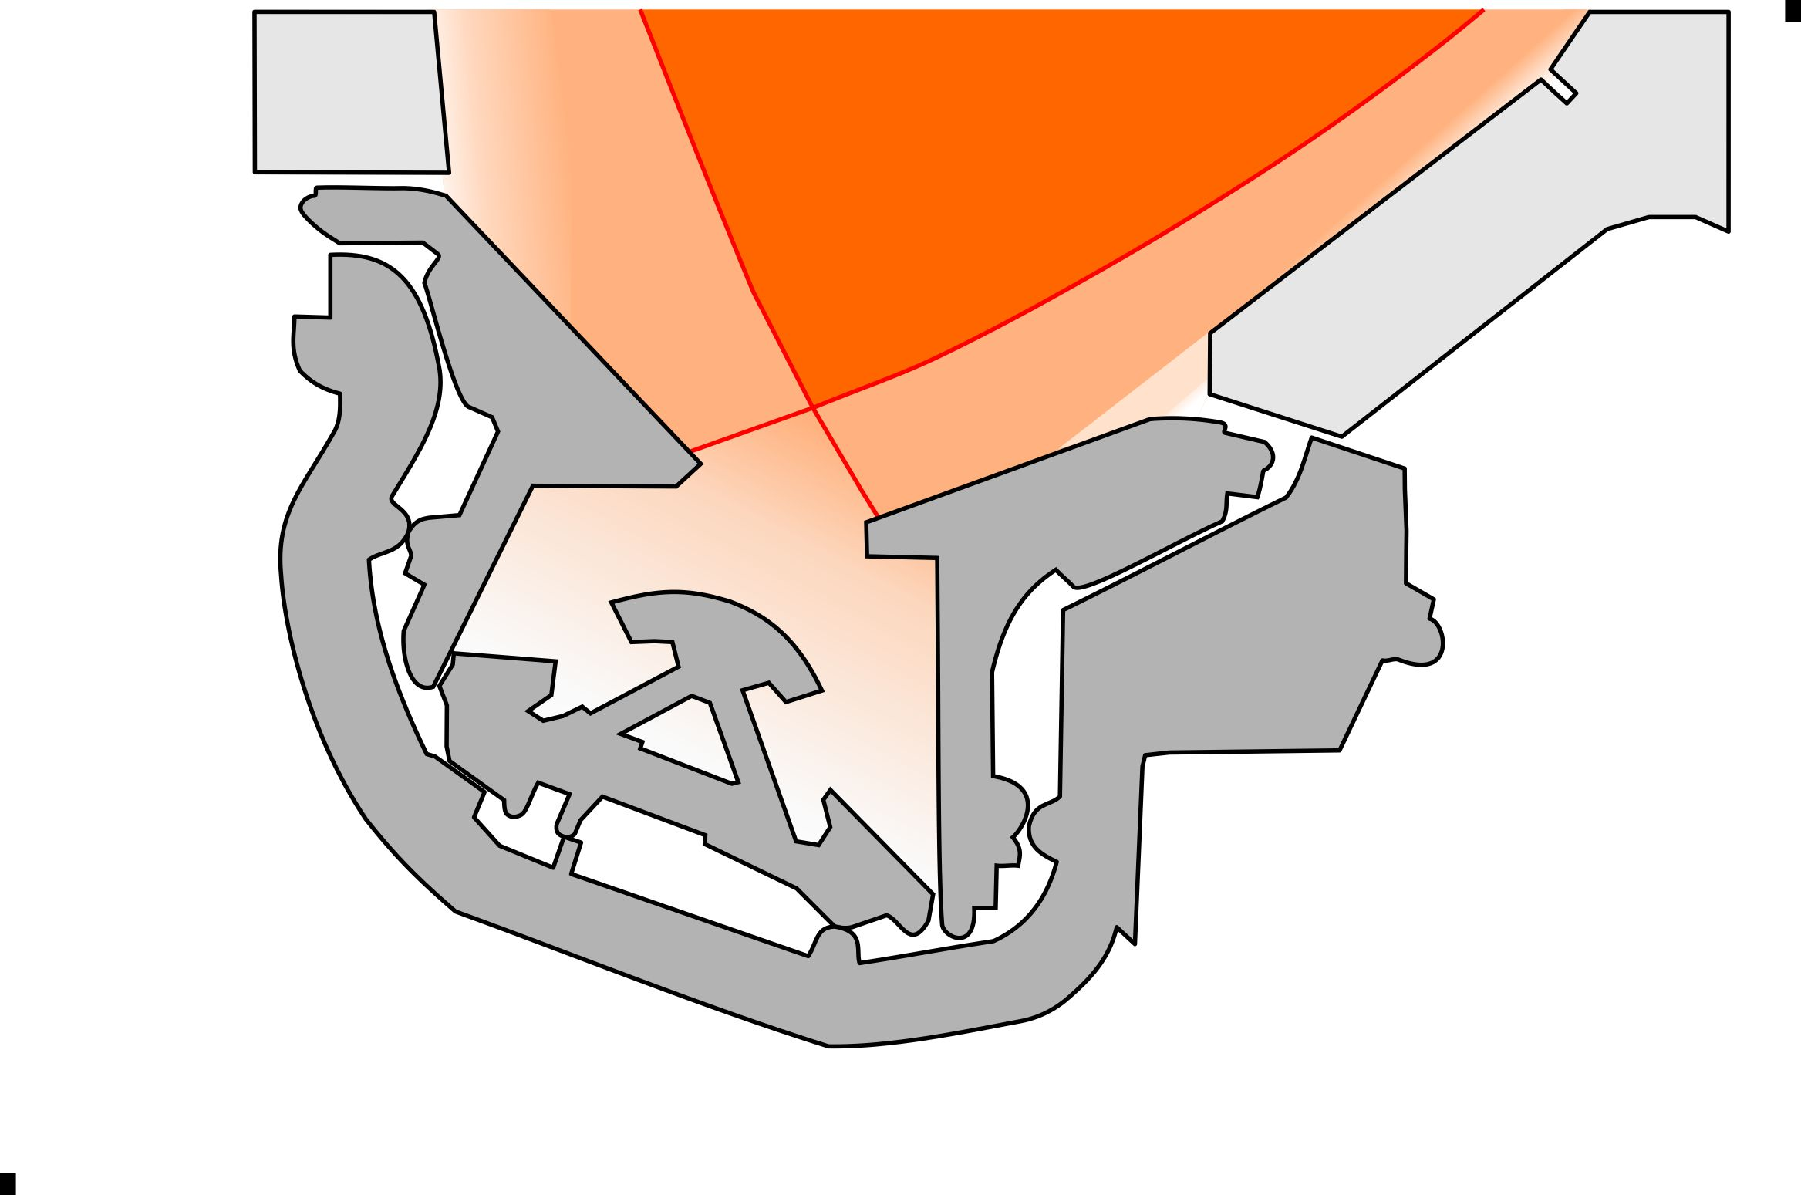
PREFACE | ITER PFCs | HIGH-DUTY CYCLE | SUMMARY
(Divertor – H-mode jump start during plasma start-up)
(Power threshold is lower for shorter divertor legs, so easier access to D-T power.)

Slide 33
PREFACE | ITER PFCs | HIGH-DUTY CYCLE | SUMMARY
Divertor – “Rapid Strike-Point Replacement”
3D isotropic heat transport
Thermal conductivity 5x higher than copper
Zero thermal expansion
Unparalleled thermal shock resistance
ANSYS: surface temperature
increase limited to 100 degrees – rather than mono-block failure
[M. van den Berg]
Resistant to chemical erosion
Resistant to neutron damage
Minimal leading edges
Replacable

Slide 34
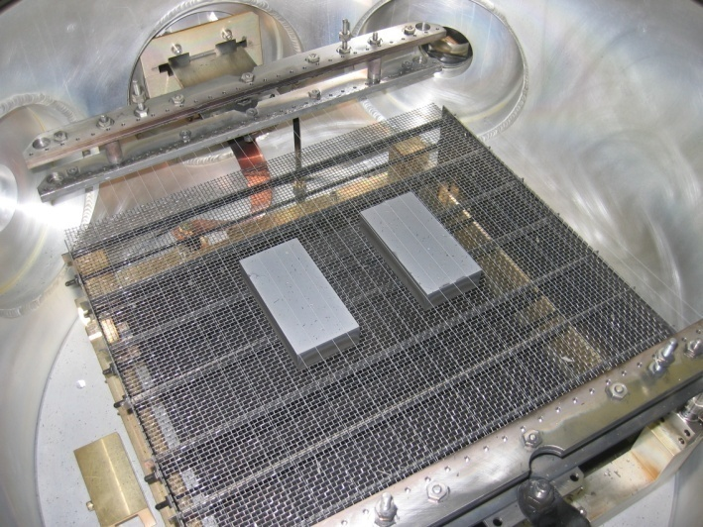
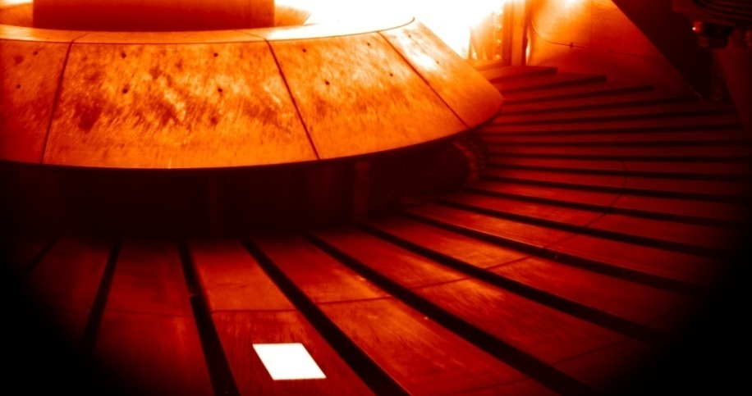
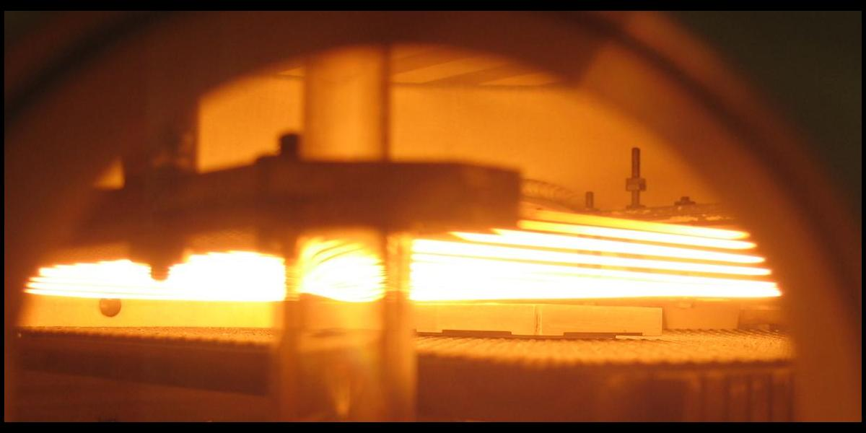
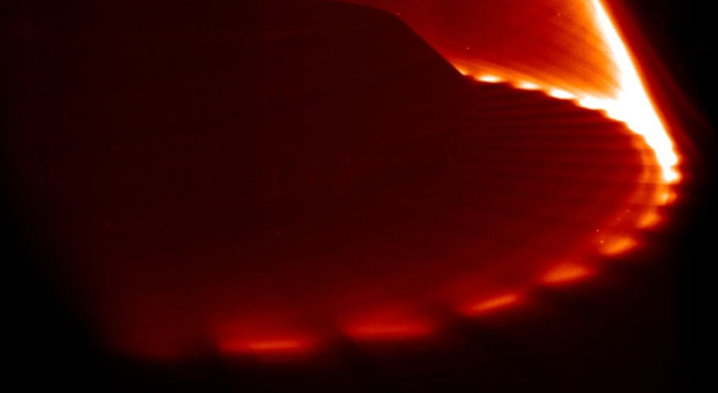
PREFACE | ITER PFCs | HIGH-DUTY CYCLE | SUMMARY
Divertor – Diamond
HWU
MAST

Slide 35
PREFACE | ITER PFCs | HIGH-DUTY CYCLE | SUMMARY
Divertor – Diamond

Slide 36
PREFACE | ITER PFCs | HIGH-DUTY CYCLE | SUMMARY
Divertor – Diamond
Joint aerospace-fusion development proposal to CNES in September, still alive.

Slide 37
PREFACE | ITER PFCs | HIGH-DUTY CYCLE | SUMMARY
Main wall – Main Chamber Recycling and Charge-eXchange (CX)
Charge-exchange (CX):
D⁰_{slow} + D⁺_{fast} → D⁺_{slow} + D⁰_{fast}
EIRENE neutral transport code (divertor sources off)
[D. Reiter, FZJ]
(ITER boundary plasma may be opaque to neutrals, so no core fueling from gas puffs.)

Slide 38
PREFACE | ITER PFCs | HIGH-DUTY CYCLE | SUMMARY
Main wall – Erosion from CX
“Have we been worrying about the wrong problem?” – P. C. Stangeby
MAIN WALL CHARGE-EXCHANGE EROSION [Stangeby, ARIES Town Meeting 2010]
For 300 eV T charge-exchange sputtering of walls | P_{heat} [MW] | annual run time [s/year] | beryllium net wall erosion rate [kg/yr] | boron net wall erosion rate [kg/yr] | carbon net wall erosion rate [kg/yr] | tungsten net wall erosion rate [kg/yr]
DIII-D | 20 | 10⁴ | 0.13 | 0.11 | 0.08 | 0.16
JT-60SA | 34 | 10⁴ | 0.22 | 0.19 | 0.15 | 0.27
EAST | 24 | 10⁵ | 1.6 | 1.2 | 0.82 | 1.8
ITER | 100 | 10⁶ | 77 [29] | 64 | 44 [53] | 92 [41]
FDF | 100 | 10⁷ | 610 | 500 | 340 | 740
Reactor | 400 | 2.5x10⁷ | 6500 | 5300 | 3700 | 7900 [5000]
A Kukushkin. B2-EIRENE calculation.
K Lackner. EU EFP Workshop on W. Velence, Hungary, Dec 7-9 2009.
Replace the wall regularly? No. Need to control main chamber CX erosion.

Slide 39
PREFACE | ITER PFCs | HIGH-DUTY CYCLE | SUMMARY
Main wall – Remove the neutrals
…
with liquid lithium
Needs study.

Slide 40
PREFACE | ITER PFCs | HIGH-DUTY CYCLE | SUMMARY
Main wall – If the boundary is opaque to neutrals: “Gas wall”?
Increase CX, but cool the boundary plasma to stay below the sputtering threshold?
toroidal circumference at injection location
distance along the plasma facing wall
Needs study.

Slide 41
…
Overview
PREFACE | ITER PFCs | HIGH-DUTY CYCLE | SUMMARY

Slide 42
PREFACE | ITER PFCs | HIGH-DUTY CYCLE | SUMMARY
Concluding remarks
There are issues to be resolved if electricity from fusion energy is to make it onto the grid – many are complex and required highly developed problem solving skills
Please think as broadly as possible, and beware of “idea inertia” and The System
ITER won’t be running for quite a while, but coming up with good designs for post-ITER machines requires a lot of thinking and experimentation now
Gentle movement towards engineering physics is encouraged
Consider aiming for engineering guidance rather than prediction
It is likely that civil society will experience a high level of stress this century – sustainable baseload energy from fusion is needed sooner rather than later
Akers Doctrine: Look for friends, i.e. other R&D areas that share your problems

