Slide 1
The ITER Research Plan
Alberto Loarte
with contributions from Science Division and IRP contributors from ITER Members institutions and Domestic Agencies
Science Division
Science and Operations Department
The views and opinions expressed herein do not necessarily reflect those of the ITER Organization.

Slide 2
Content
ITER project goals and design
The staged approach and the ITER Research Plan (IRP)
Phases of the ITER Research Plan
  Main objectives of each Phase of the IRP
  Highlights of some open issues and required R&D
Conclusions

Slide 3
ITER project goals
ITER’s overall programmatic objective:
  to demonstrate the scientific and technological feasibility of fusion energy for peaceful purposes
  to design, construct and operate a tokamak experiment at a scale which satisfies this objective
ITER is a tokamak designed to confine a DT plasma in which α-particle heating dominates all other forms of plasma heating ⇒ an experimental nuclear fusion reactor
  ITER is designed to achieve P_{fusion} = 500 MW with gain Q_{DT} = P_{fusion}/P_{heating} ≥ 10 for pulses of 300-500 s
  ITER aims to achieve P_{fusion} ≥ 350 MW with Q_{DT} ≥ 5 for pulses of 1000- 3000 s
  ITER aims at exploring “controlled ignition” (Q_{DT} ≥ 30)

Slide 4
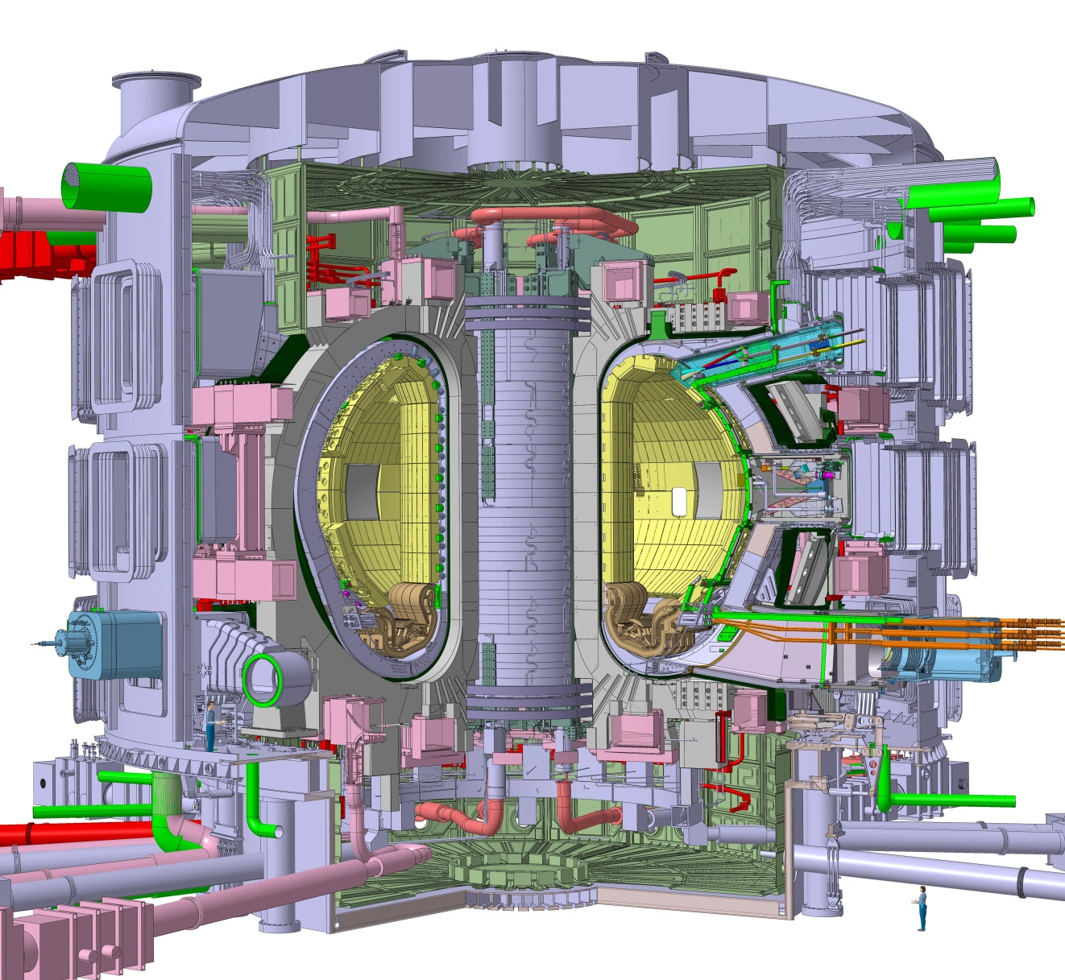
ITER - Main Design Features
Shielding Blanket Modules Be - S/Steel
Central Solenoid
Nb₃Sn-SC
Port Plug:
H&CD, Diagnostics
Poloidal Field Coil
NbTi-SC
Internal coils: ELM & RWM control,
Vertical stability
Toroidal Field Coil
Nb₃Sn-SC
Cryostat
S/Steel
Divertor
W - S/Steel
Torus Cryopump
Vacuum Vessel
S/Steel

Slide 5
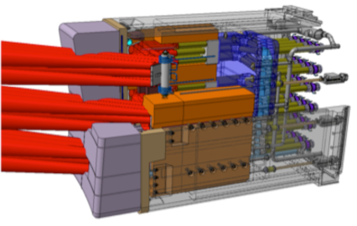
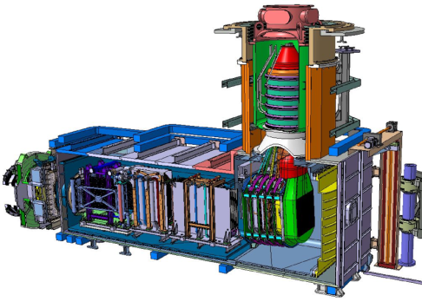
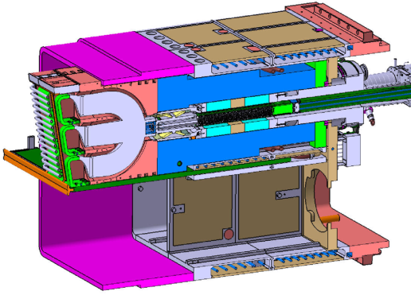
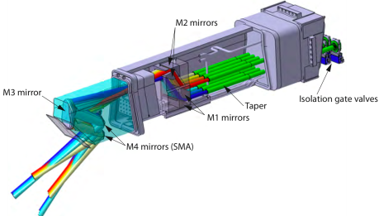



ITER Heating Systems
NB
Neutral Beam
33MW
IC
Ion Cyclotron 40-55MHz
20MW
EC
Electron Cyclotron 170GHz
20MW
P_{heating} for P_{fusion} = 500 MW (Q_{DT} = 10) scenario: 50MW
Upgrades to a total heating power of 130 MW are foreseen

Slide 6
The Staged Approach and the ITER Research Plan (IRP)

Slide 7
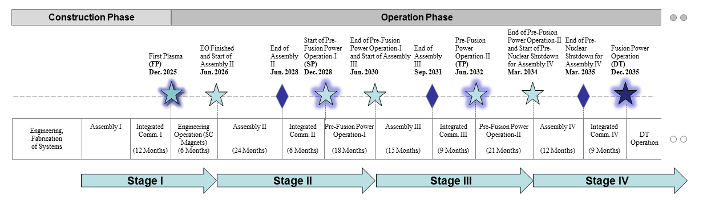
The Staged Approach to DT Operations
Not all ITER systems will be available day → Staged Approach to DT operations and project goals
Basic tokamak configuration for First Plasma → Progressive installation of Plasma Facing Components, In-vessel coil power supplies, fuelling and H&CD systems, Diagnostics up to DT operation

Slide 8
Overview of ITER Plant Configuration
Stage | PFCs | H&CD | Fuelling | Disruption Mitigation | In-Vessel Coils + PS | Test Blanket Modules
First Plasma & Engineering Operation | Temporary steel PFCs | ECH 7 MW | Gas (partial system) | None | None | None
PFPO-1 | Full Be wall & W divertor | ECH 20 MW (+ 10 MW upgrade ?) | Gas (partial system) Pellets (partial system) | Full system | Vertical Stability ELM control (partial system) | None
PFPO-2 | Full Be wall & W divertor | ECH 20 MW ICH 20 MW NBI 33 MW | Gas Pellets | Full system + Upgrades ? | Vertical Stability ELM control | EM-TBM
FPO | Full Be wall & W divertor | ECH 20 MW ICH 20 MW NBI 33 MW + Upgrades ? | Gas Pellets + pellet upgrades ? | Full system + Upgrades ? | Vertical Stability ELM control | Nuclear-TBMs

Slide 9
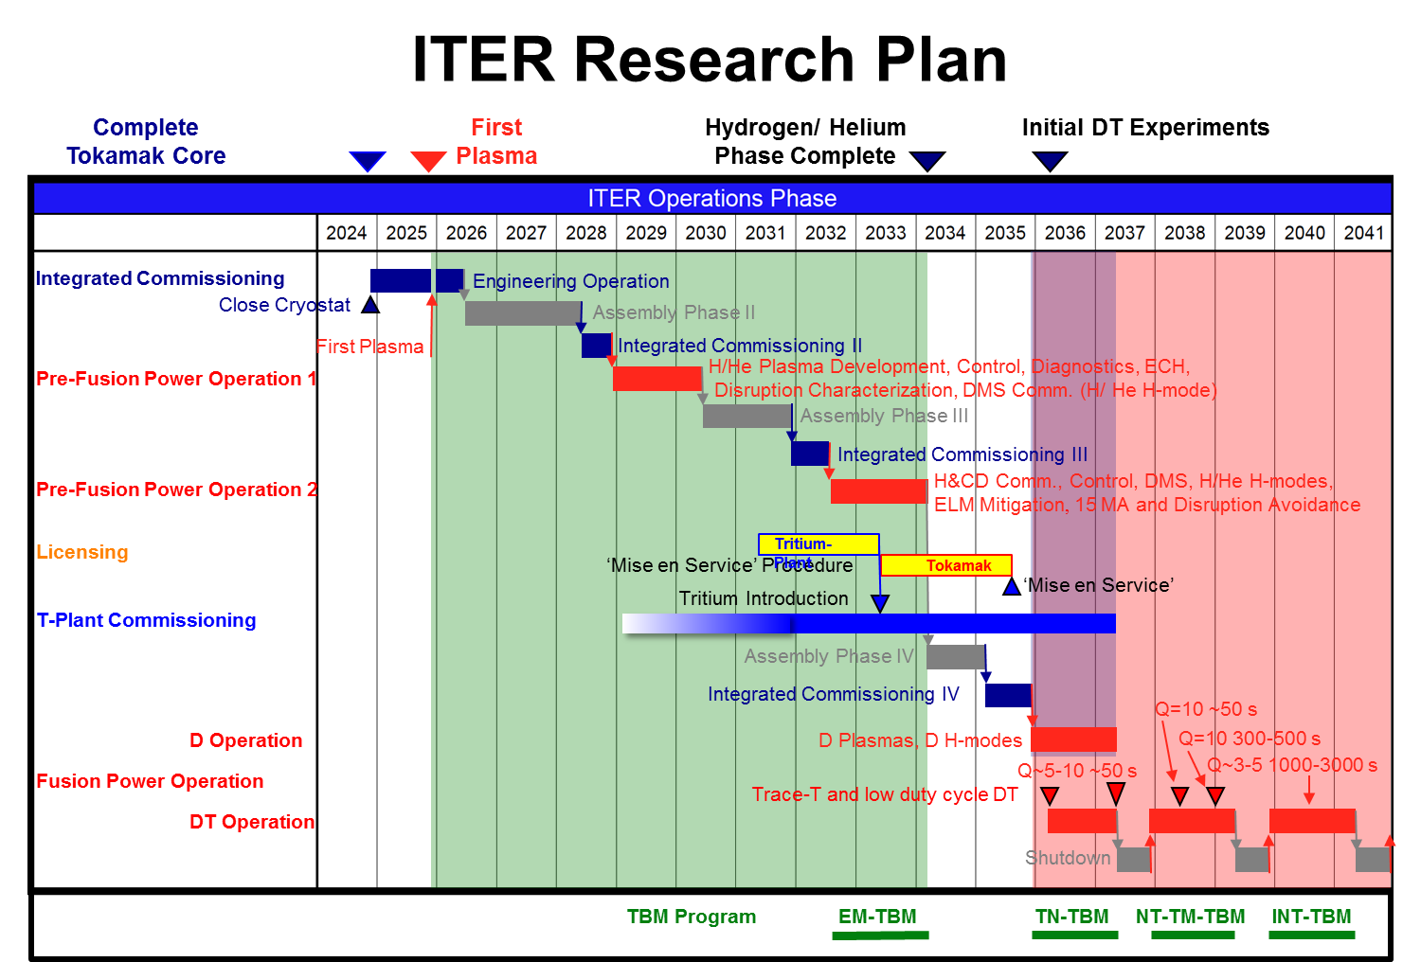
ITER Research Plan (IRP) within Staged Approach
IRP → strategy for R&D to achieve Project goals : Q = 10 (300-500 s), Q = 5 (1000 s) & Q = 5 steady-state starting from First Plasma
R&D supported by available systems in each phase of Staged Approach

Slide 10
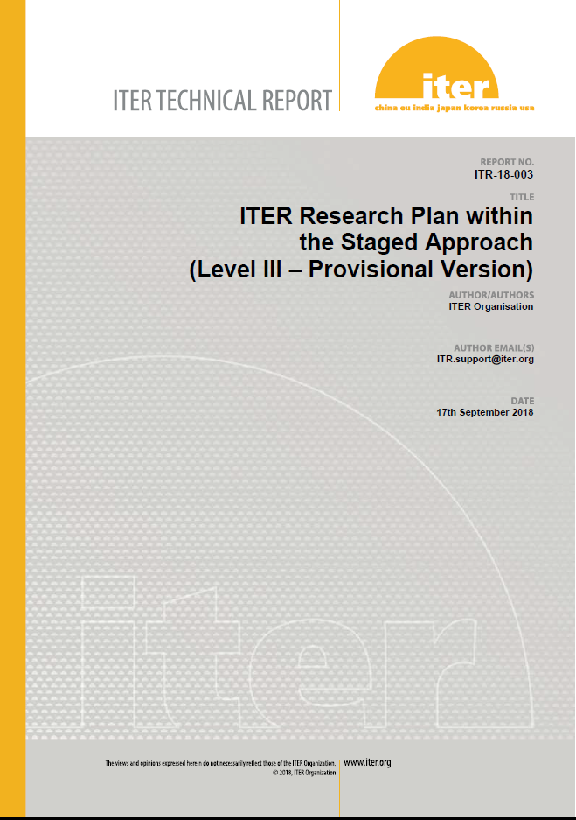
Release of ITER Research Plan as ITER Technical Report
Elaboration of IRP supported by experts from ITER Members’ fusion R&D institutions and Domestic Agencies
ITER Research Plan is publicly available as ITER Technical Report (ITR-18-003) https://www.iter.org/technical-reports
IRP informs the fusion community on details of experimental plans to achieve project’s goals to define the supporting R&D required

Slide 11
Phases of the ITER Research Plan: Objectives and some open R&D issues

Slide 12
Integrated Commissioning-First Plasma- Engineering Commissioning
Integrated Commissioning:
  Integrated commissioning of:
    Required plant systems (central control systems, power supplies, cooling/baking, vacuum, cryogenics etc.)
    Magnet systems to level required for FP (nominally 50% maximum current)
    ECRH, diagnostics, fuelling, GDC, PCS systems
  Magnetic diagnostic calibration
First Plasma:
  100 kA/2.65T 100 ms milestone with ECH assisted start-up
Engineering Commissioning (~6 months):
  Performance tests of all Magnet systems to full current (TF upto 5.3 T)
  Definition of strategy to align plasma facing components
  Studies of Ohmic start-up

Slide 13
PFPO-1: Overview
Main elements of experimental programme:
  Development of plasma control capability (PCS), including CIS/CSS plasma-related functions:
    Commissioning of plasma magnetic control, core plasma density and impurity control, first wall protection system
    Characterization of limiter/ divertor heat loads
  Development of diverted plasma scenarios for robust operation up to 10 MA (with B_{T} over range 1.8 – 5.3 T) in L-mode
  Disruption prediction, avoidance and disruption/runaway electron mitigation systems → successful disruption mitigation essential to progress with IRP
  ECRH commissioning to 20-30 MW @ 170 GHz → 5 MA/1.8T H-mode operation
  Exploitation of VS coils and Error Field Correction Coils → proposed early functional tests of ELM coils for ELM mitigation and EFC without TBMs

Slide 14
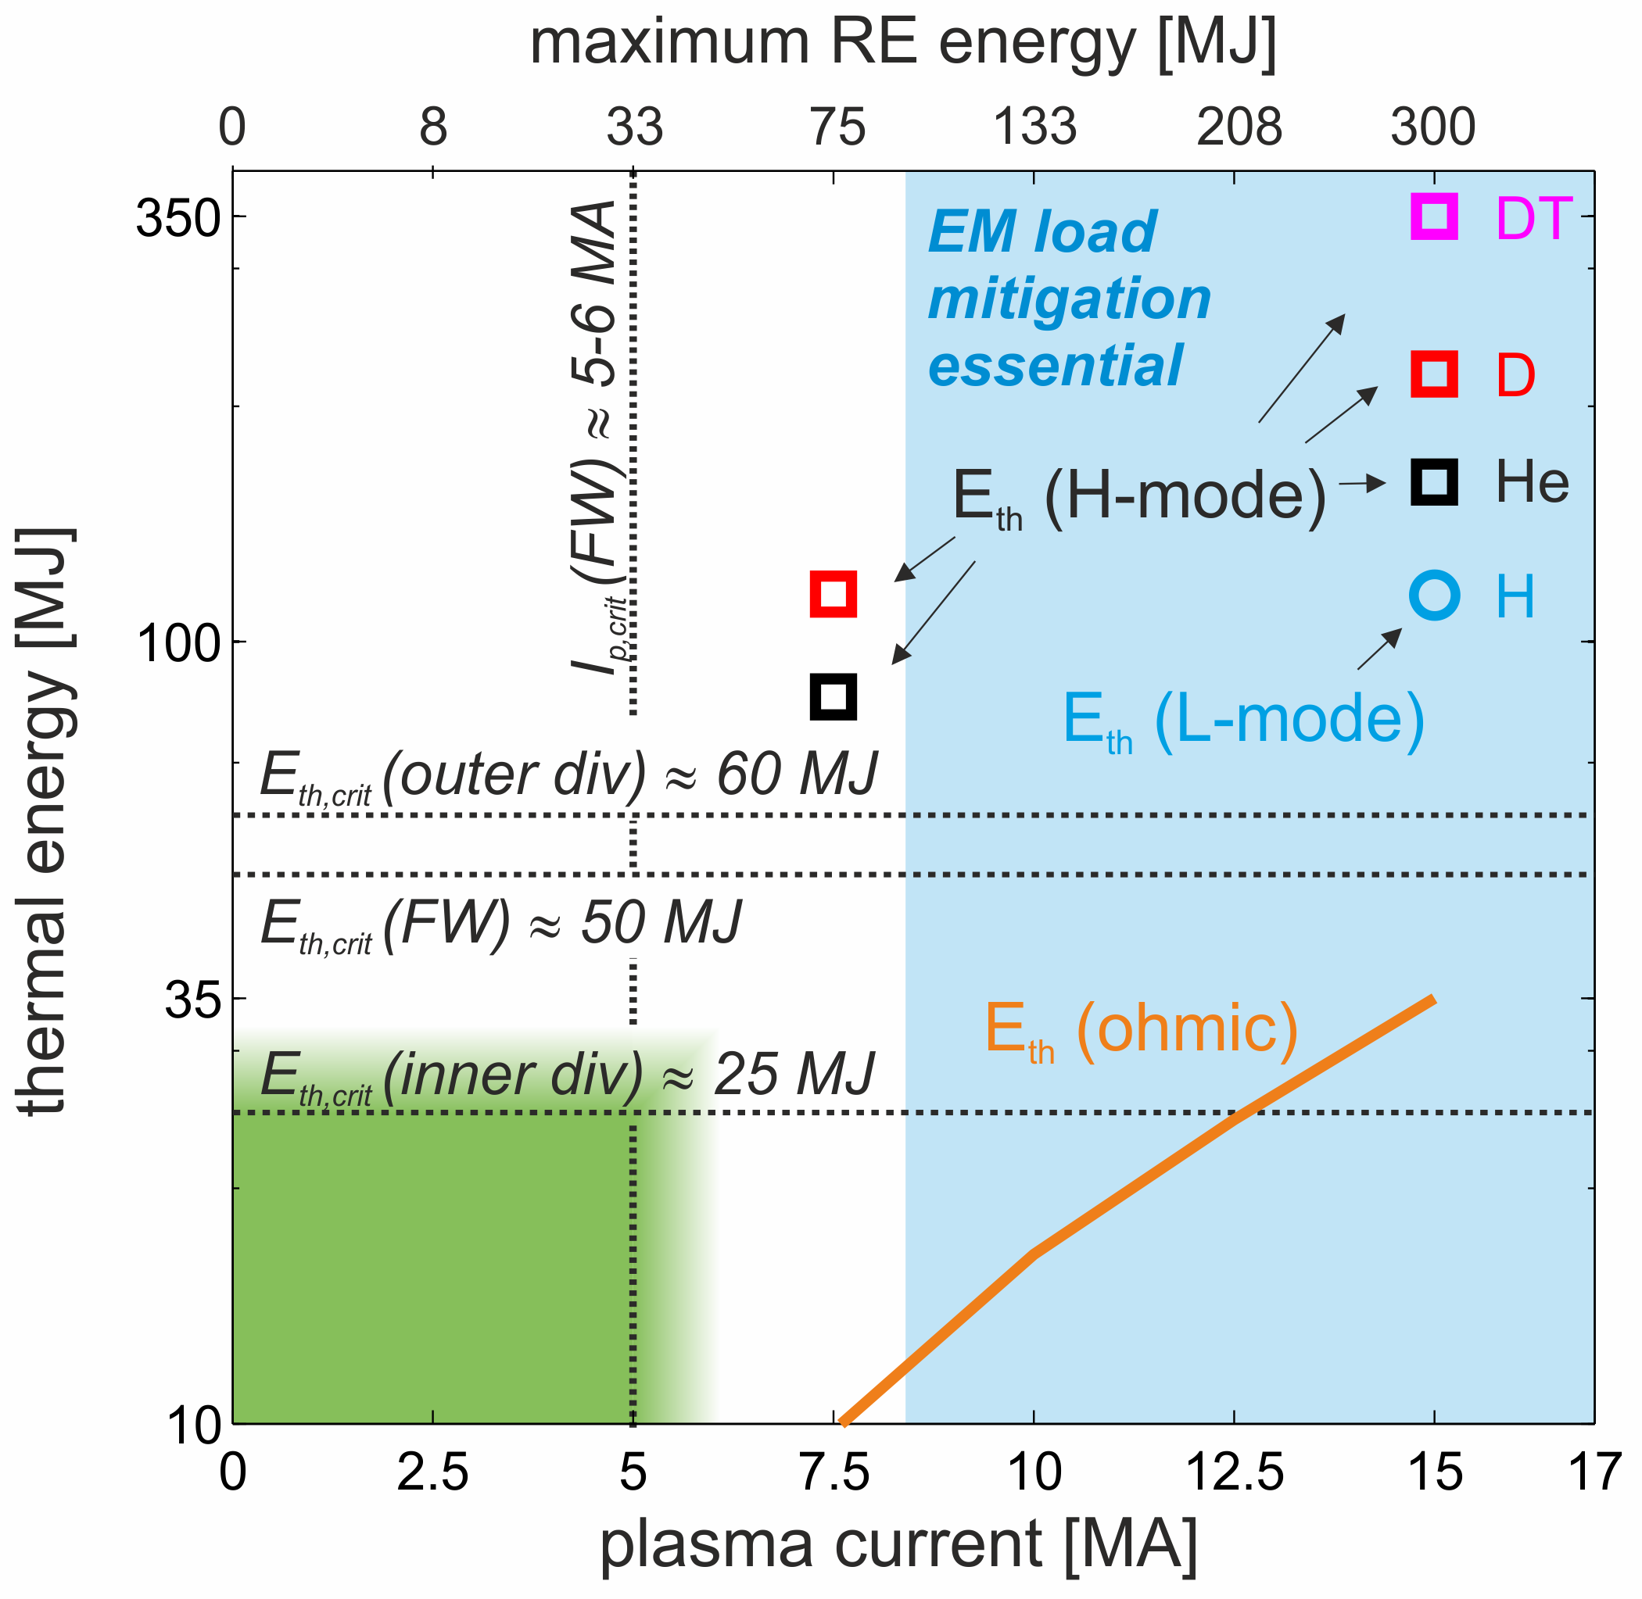
PFPO-1 - Disruption Loads and Mitigation
Quantitative analysis of thermal and EM loads for unmitigated disruptions in ITER:
  EM loads imply DMS essential above 8.4 MA
  Green: operational space where no risk of melting of W-divertor
  Orange line: W_{th} for ohmic plasmas
  maximum RE energy is most pessimistic estimate in case of full magnetic energy conversion
R&D is required to :
  Refine predictions of thermal, electromagnetic and runaway loads
  Disruption avoidance schemes
  Disruption prediction → trigger for mitigation

Slide 15
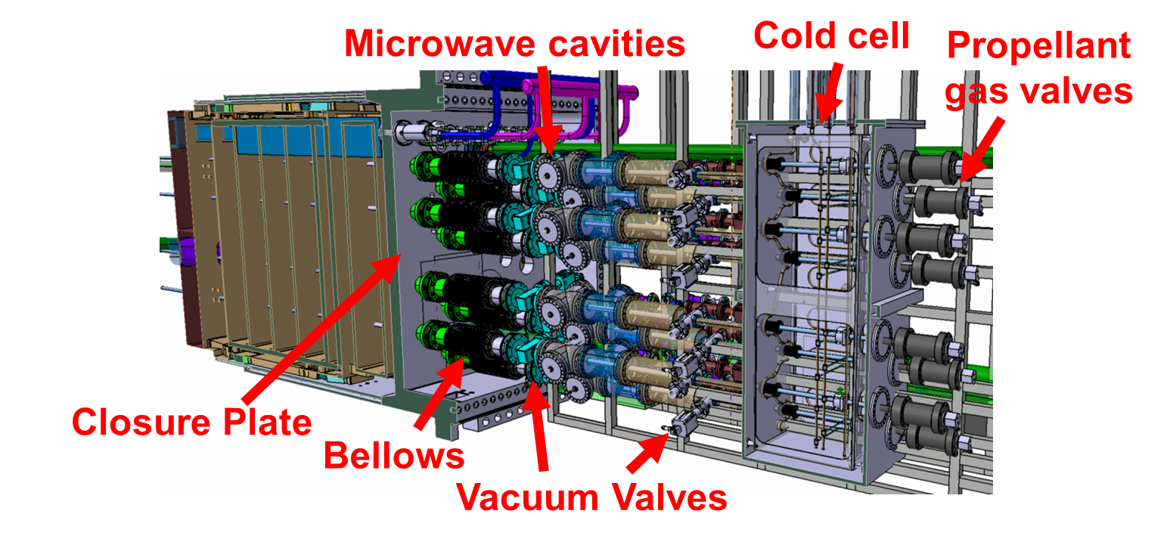
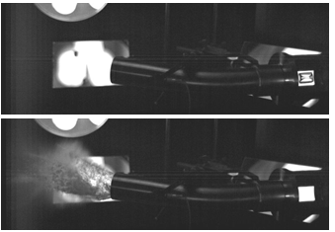
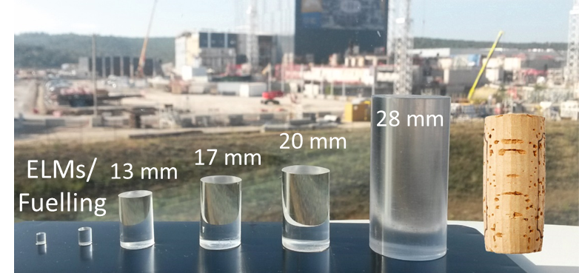
R&D on Disruption Mitigation System (DMS)
The DMS is a key plant system for ITER to achieve its goals
Injection capabilities for effective DMS:
≤ 32 x 28 mm pellets in 3 equatorial ports
3 x 13-20 mm pellets in 3 upper ports
Ne, Ar, D₂
Lehnen
IAEA 2018
L. Baylor, TSD Workshop Princeton 2017
More information on DMS and required R&D in M. Lehnen’s presentation
Notes:
The Disruption Mitigation System of ITER must be highly reliable and effective and is required from early operation on. ITER has decided to increase the injection capabilities to meet requirements based on present day knowledge. Up to 32 pellets of 28 mm diameter can be injected through EPs and 3 of medium size through UPs. The right hand side shows a preliminary design of the integration of 8 injectors in one third of an equatorial port plug. Significant gaps exist still in the physics basis for disruption mitigation and the injection technology has to be developed for the ITER requirements. The ITER DMS task force has been established to implement the plan for design validation and engineering studies. This plan includes a) scientific validation of the concept including tokamak experiments and theory & modelling tasks; b) technology developments to adapt the SPI technology to the ITER needs; c) studies to assess the possible need for later DMS upgrades. To ensure timely integration of such upgrades should they be required in a later phase of the project, it will be essential that alternative technology or alternative concepts are developed by the ITER community.

Slide 16
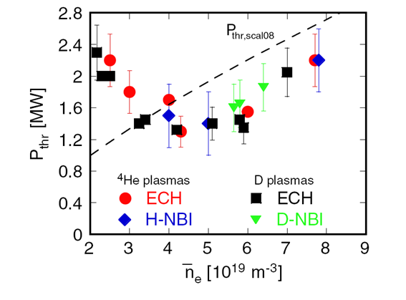
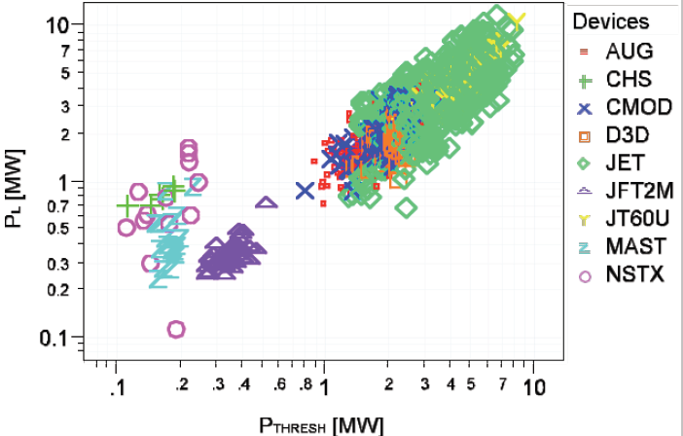
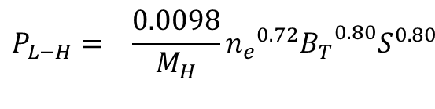
H-mode access in PFPO-1
H-mode confinement essential to achieve ITER’s goals but P_{LH}^{ITER} from scalings has large uncertainties due to physics unknowns → H-mode access in PFPO-1 is important for IRP risk mitigation
Available power level (ECH 20 MW baseline + 10 MW upgrade under discussion) → 5 MA/1.8T H-mode operation (0.36 ≤ <n_{e}>/ n_{e} ≤ 0.5)
R&D required → confirmation of physics determining n_{min}^{L-H} (ion heat flux – Ryter NF 2014)

Slide 17
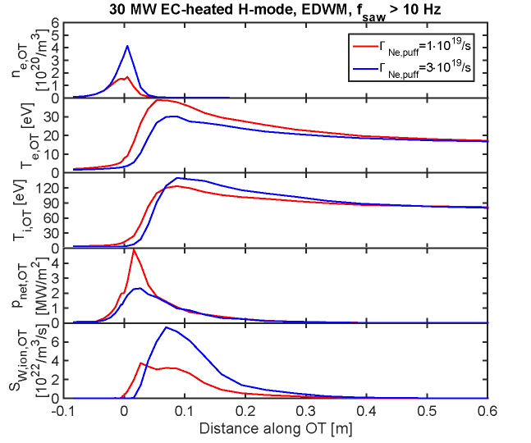
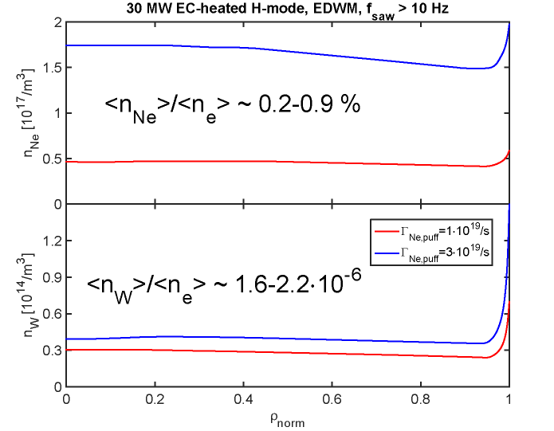
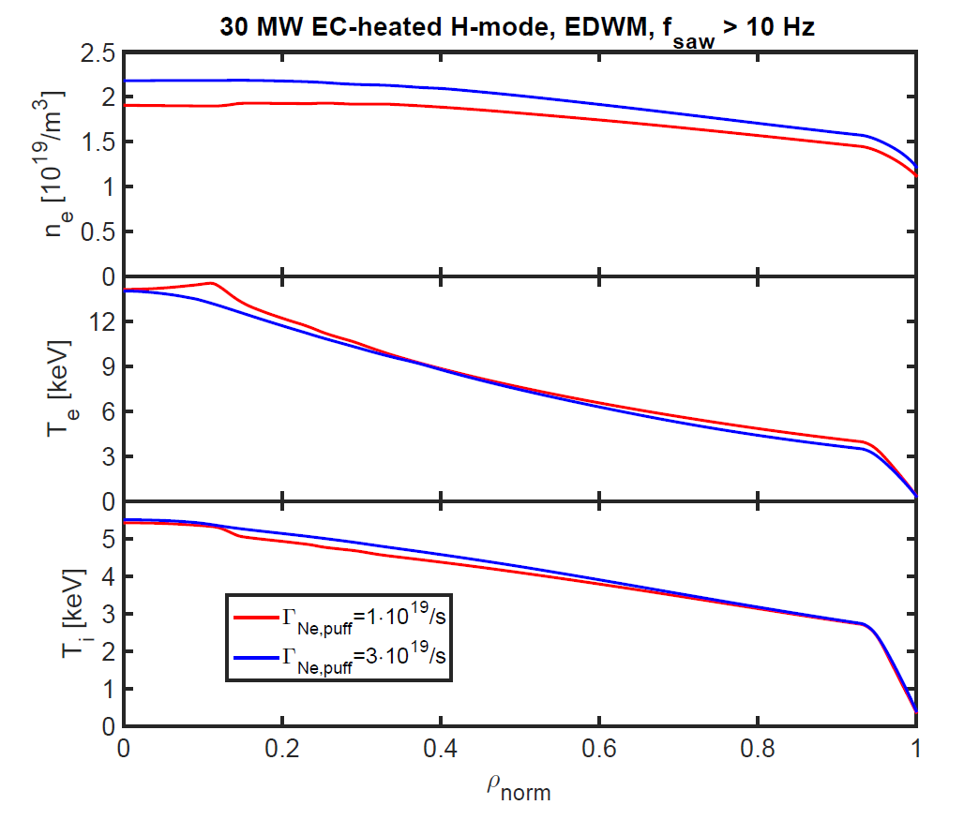
ECH heated 5 MA/ 1.8 T H-modes <n_{e}/n_{GW} > ~ 0.4-0.5 in PFPO-1
Low <n_{e}> H-mode operation in PFPO-1 has specific features : low core plasma electron-ion coupling and “hot” divertor plasma (q_{div} and W production)
Simulations shows q_{div} and core W are OK due to good edge screening
Outer divertor
T_{e}/T_{i} > 2.5
.
R&D → Core particle/energy transport in dominant e-heated H-modes and W screening in pedestal with flat n_{ped} profiles

Slide 18
3. Pre-Fusion Power Operation 2
Main elements of programme in H for L-mode plasmas:
  commissioning of HNB (33 MW), ICRF (20 MW) and DNB with plasma
  extend capability for disruption prediction, avoidance and mitigation
  demonstration of divertor heat flux control at higher P_{aux}
  demonstration of 15 MA/5.3 T L-mode plasmas at highest P_{aux}
  characterization of key aspects of PWI in ITER environment → S. Lisgo’s talk

Slide 19
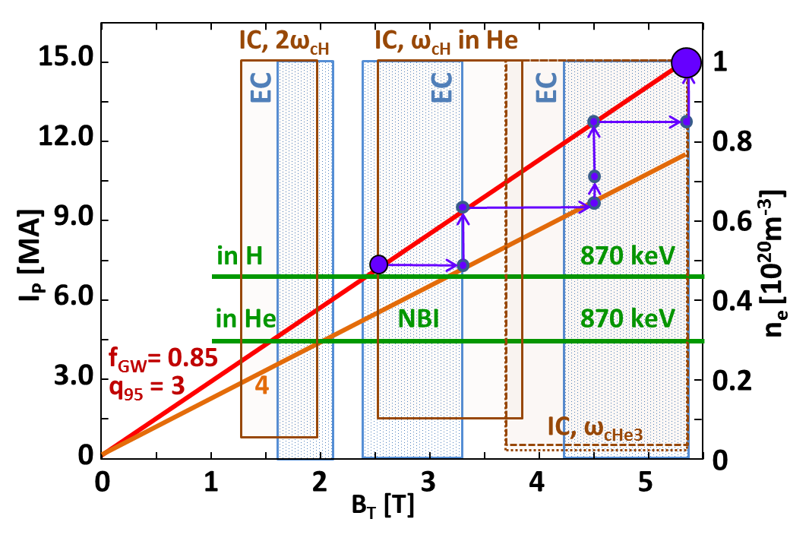
PFPO-2 – 15 MA L-mode Development
Strategy for development of 15 MA L-mode scenario revisited with options for expansion of operating space:
  development of favoured set of I_{p}/B_{t} steps in preparation for D/DT phase
  assess impact of fuelling, H&CD mix, ECRH on-/off-axis on L-mode plasma confinement/ transport
  optimization of flux consumption to maximize flat-top duration
  demonstration of integrated 15 MA/5.3 T scenario with ~50 s flat-top
  R&D → need for central heating to avoid W accumulation in L-mode

Slide 20
PFPO-2 – H-mode Studies
H-mode operation and ELM control in H/ He plasmas:
  Extend studies of H-modes in H/He at 3.5 – 5 MA/1.8 T:
    aim to identify effect of TBMs on H-mode performance
    expand operation in 5 MA/1.8 T H H-modes by P_{IC} and low energy NBI possible (note TF ripple)
    commissioning of ELM control coils and demonstration of ELM suppression with magnetic perturbations with n = 2 – 4, q₉₅ = 3 – 4.3
  establishment of H-mode at 7.5 MA/ 2.65 T (in He/ H as P_{LH} allows):
    determination of H-mode access conditions at ITER scale in H and He and develop programme around most favourable scenario (note possible use of Ne seeding)
    extensive characterization of H-mode behaviour: exploring ELM control, density and impurity control etc over range 5 – 7.5 MA
  development of long-pulse H-modes at 7.5 MA/ 2.65 T:
    high non-inductive current fraction (up to 60%) due to I_{NB} + I_{bs} could allow H-mode duration at 7.5 MA to be extended towards 1000 s

Slide 21
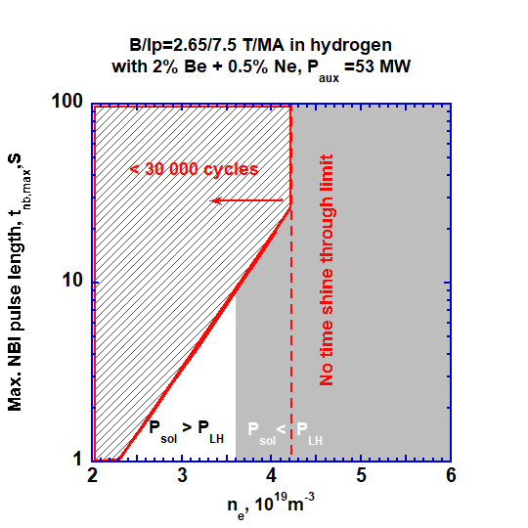
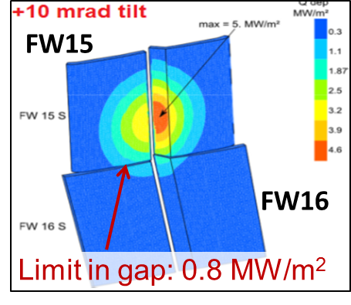
Hydrogen 7.5 MA /2.65 T H-mode operation in PFPO-2
7.5 MA/2.65 T hydrogen H-mode operation very restricted with 33 MW NBI + 20-30 MW ECH (inefficient ICRH scheme & NBI shine-through)
R&D → validation of NBI shine-through modelling for E_{NBI} ≥ 500 keV

Slide 22
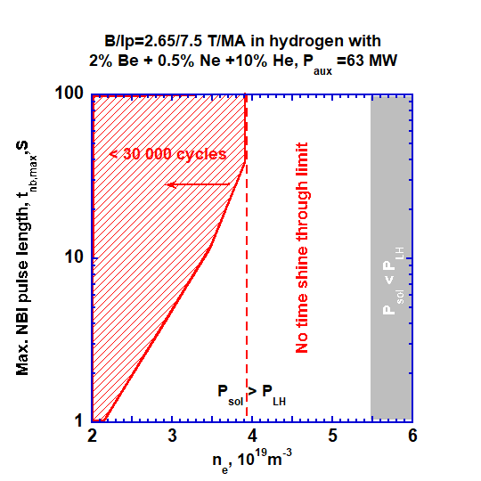
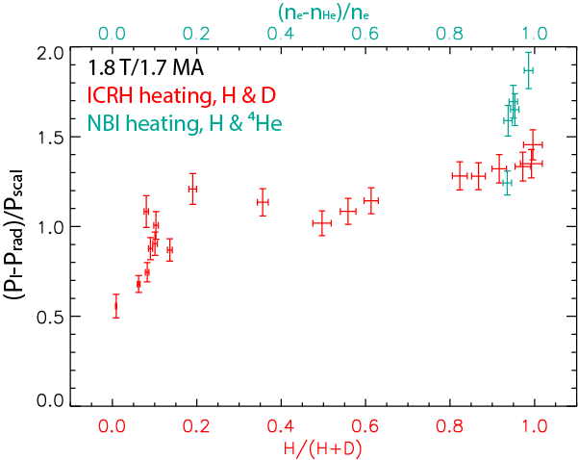
Hydrogen + 10% He 7.5 MA /2.65 T H-mode operation in PFPO-2
P_{LH} reduction for H + 10 % He plasmas → wide operational space for H-dominant 7.5 MA/2.65T H-modes in PFPO-2
JET – J.C. Hillesheim 2016 IAEA
R&D → confirmation and determination of physics behind P_{LH} reduction for H + 10 % He plasmas and H + 10 % He H-mode characteristics

Slide 23
4. Fusion Power Operation – D Plasmas
First period of FPO phase centres on machine recommissioning and D H-mode development:
  recommissioning of tokamak operation for D plasmas:
    commissioning of H&CD system in D (HNB at 1 MeV D⁰)
    development of 15 MA/5.3 T D L-mode scenario
    H-mode access: establishment of D H-modes in range 5 – 7.5 MA/2.65 T
    re-establishment of ELM control techniques in D H-modes
  studies of H-mode plasmas in D:
    integrated 7.5 MA/2.65 T H-mode scenario (long pulse/ high power) with H₉₈~1
    trace-T experiments to initiate DT operation, investigate fuelling and fuel transport
    extension of H-mode operation towards 15 MA/ 5.3 T, preparing DT scenarios
    confirmation of reliable operation of DMS at high current and power
    range of PWI studies on wall conditioning, fuel retention, material migration, heat load characterization and detachment control
    Initial development of long-pulse scenarios

Slide 24
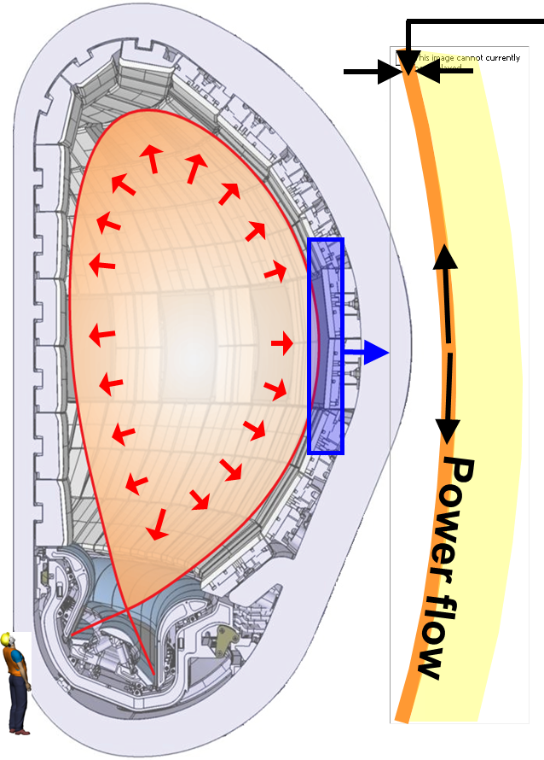
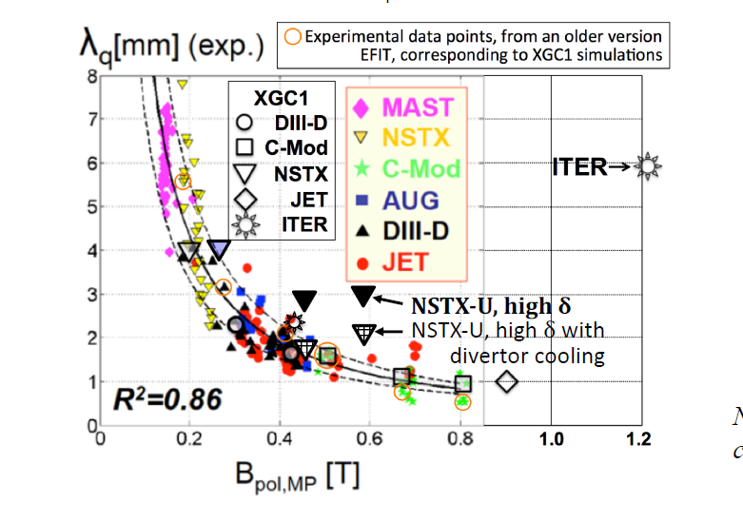
Stationary Power fluxes in medium/high current H-modes
Degree of q_{div} control/reduction depends on λ_{q} → R&D required to determine λ_{q} (I_{p}) in ITER
Transport bifurcation may take place as I_{p} increases
λ_{q}
15 MA
5 MA

Slide 25
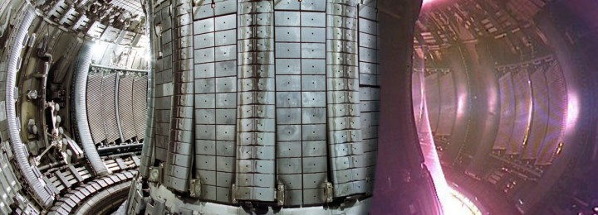
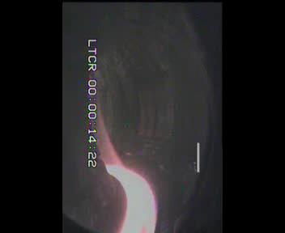
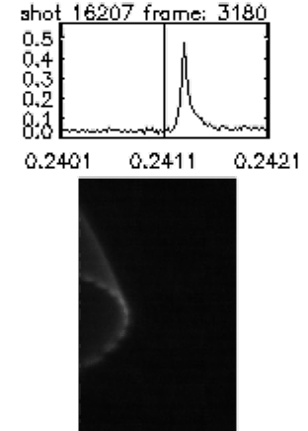


Power Fluxes to PFCs during ELMs
ELMs lead to large localized deposition of power on PFCs
JET
ITER - JOREK
G. Huijsmans
MAST – A. Kirk

Slide 26
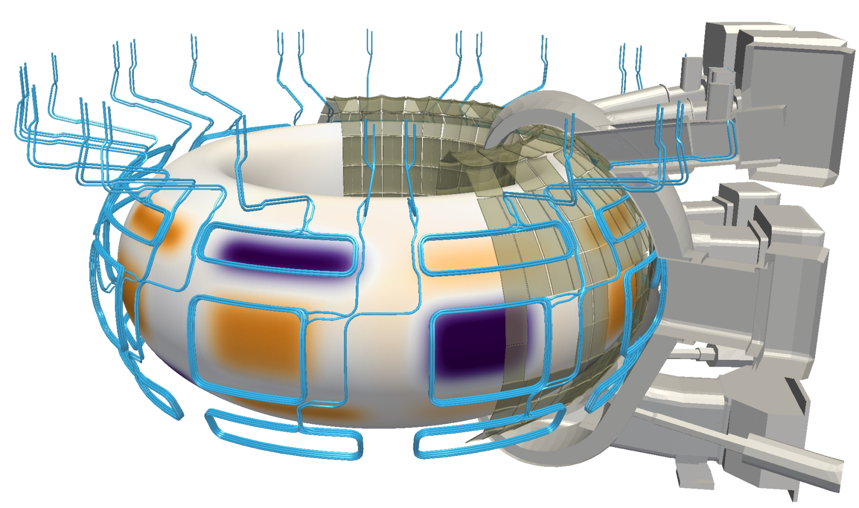
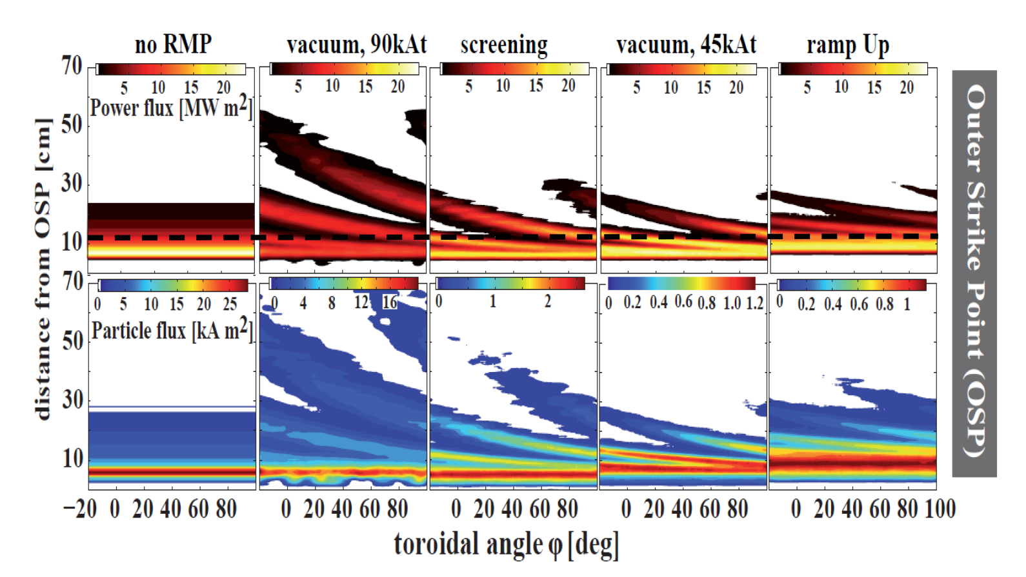

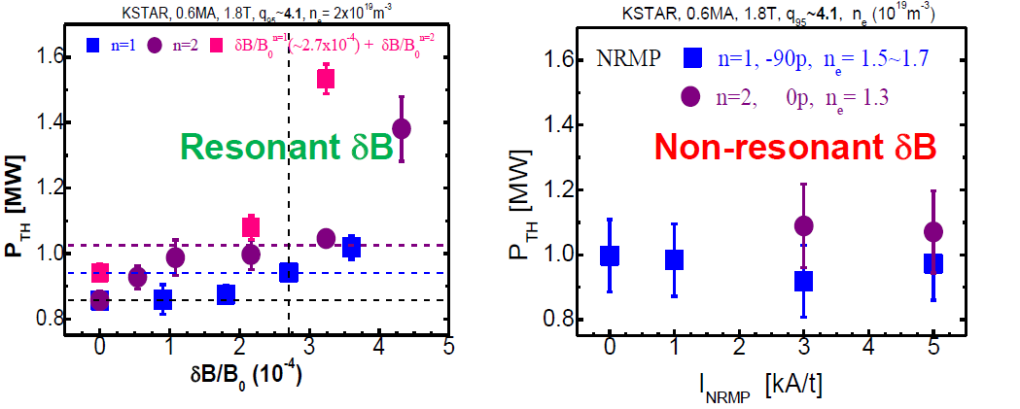

ELM control: Power Fluxes and Effects on H-modes
ELM control by 3-D fields will be mandatory as H-modes are developed to higher I_{p}
  R&D to minimize effects on H-mode access and confinement quality
  R&D to optimize divertor power loads and radiative divertor operation

Slide 27
4. FPO – DT Inductive Plasmas
Development of fusion power production in DT inductive scenarios:
  development of integrated DT H-mode operation at 7.5 MA/ 2.65 T:
    development of D H-mode operation with increasing T concentration (10% to >50%)
    extension of H-mode operation towards high power and longer pulses (at least several tens of seconds)
    adaptation of control functions to fusion power operation
  development of fusion power production in DT:
    development towards 15 MA/5.3 T DT H-mode operation, varying fuel mix to manage fusion power production and control issues
    confirmation of reliable operation of DMS as fusion power increased
    extension of plasma control capability in DT, including heat exhaust & fusion burn control
    optimization of Q towards short-pulse Q ~ 10 operation at several hundred MW fusion power → extension towards 300-500s
    programme of burning plasma studies at long timescales
    exploration of possibilities for achieving Q > 10 in transient or stationary conditions

Slide 28
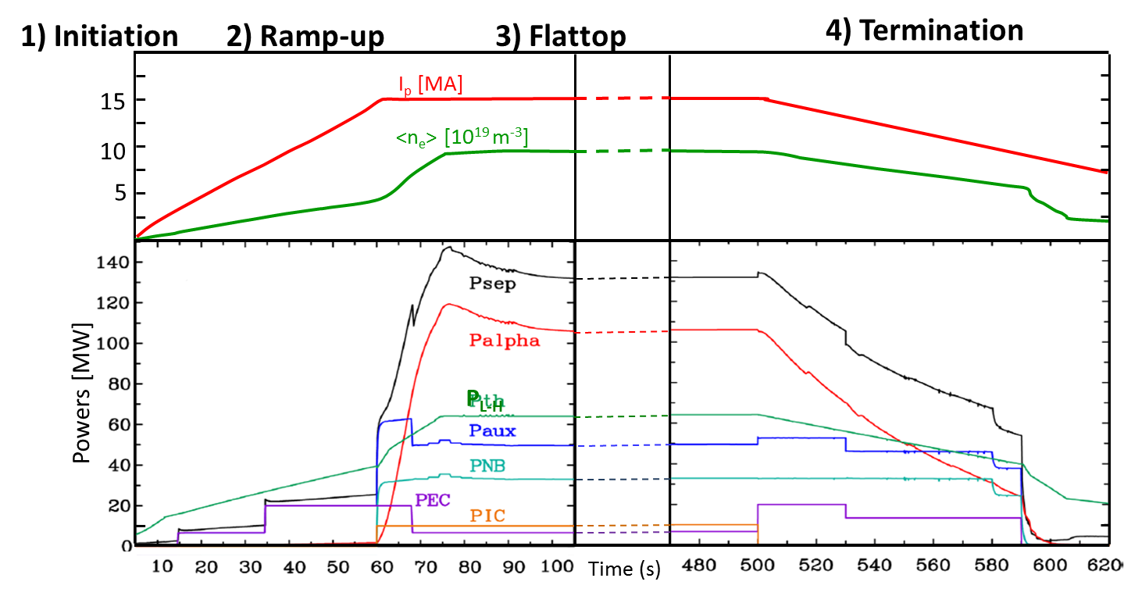
Stages of ITER baseline H-mode 15 MA / 5.3 T scenario
Notes:
plasma termination: elongation is decreased, for better vertical stability.
it decreases the energy confinement time, hence it decreases the energy content / alpha power.

Slide 29
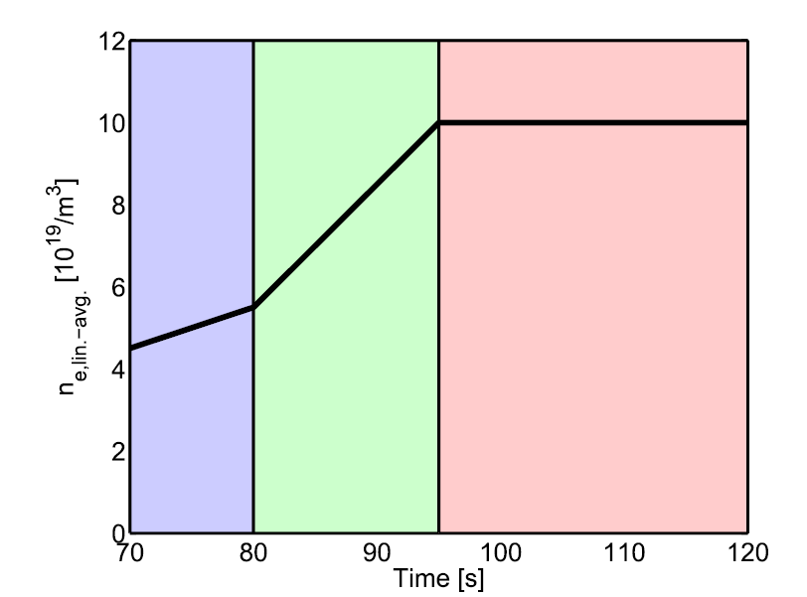
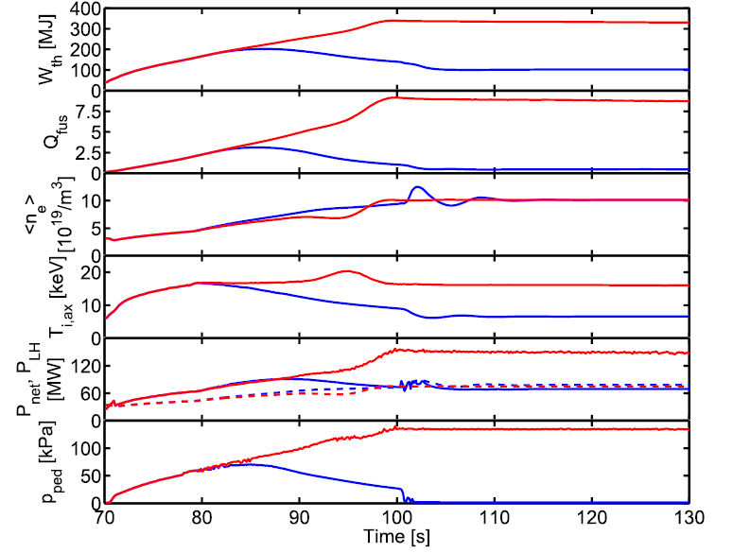
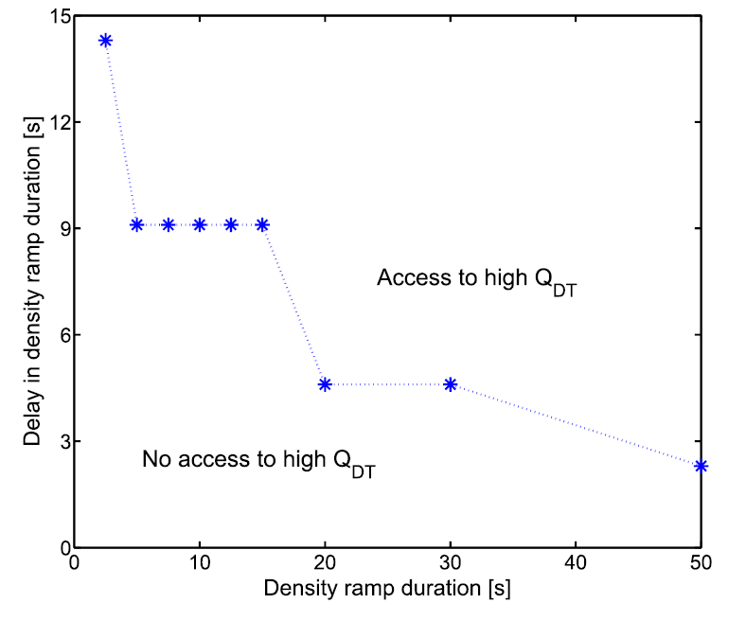
  Entrance to Q =10 burn
P_{add} = 73 MW in ITER is similar to the power level to access H-mode → build-up of alpha heating essential to access burn conditions
Understanding of transport in after L-H transition and tailoring of P_{add}/<n_{e}> and is critical in the access to burn phase → R&D required
50 MW of Heating
Notes:
29

Slide 30
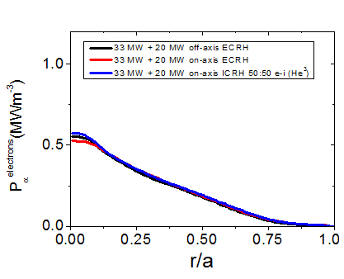
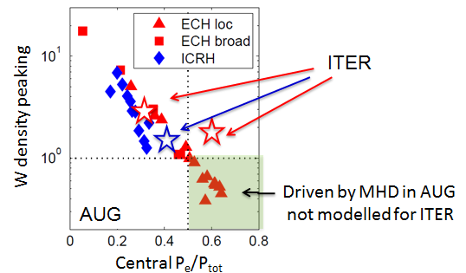
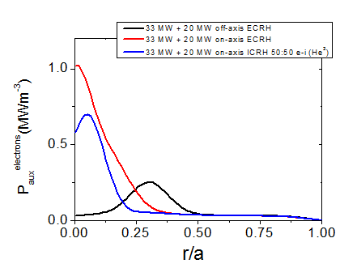


Tungsten transport in ITER Q = 10 plasmas
ITER has a tungsten divertor → possible accumulation in the core
ITER H&CD schemes can modify plasma parameters due to higher power density in the core → quantitative details depend on transport (R&D required)
$P_{α}$ to electrons
Heating the centre affects W transport:
Power (MW/m²)
Normalized radius
W density peaking
Casson, PPCF (2015)
Angioni, NF (2017)
$P_{H\&CD}$ to electrons
33 MW NBI +
─ 20 MW off-axis EC
─ 20 MW on-axis EC
─ 20 MW on-axis IC
Power (MW/m²)
Central P_{e}/P_{tot}
→ Central heating can avoid tungsten accumulation in the core
Normalized radius

Slide 31
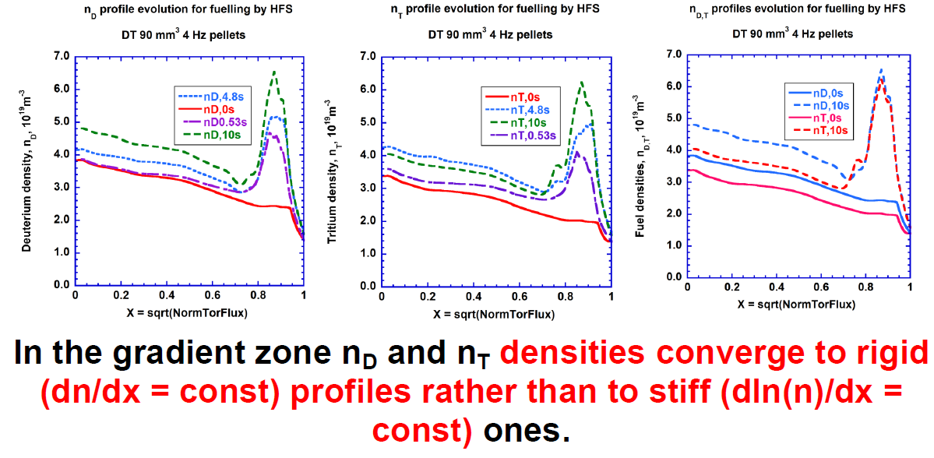
Fuelling and DT mix control
Fuelling of ITER plasmas uncertain → key for IRP and DT control
  Gas fuelling/recycling ineffective due to poor neutral penetration in core plasma
  Pellet deposition is peripheral due to high edge T_{e},n_{e} → core fuelling strongly dependent on post-pellet density relaxation by transport processes
  R&D required to optimize plasma fuelling with minimum use of T and DT mix control

Slide 32
4. FPO – DT Long-Pulse Plasmas
Programme towards long-pulse burning plasma studies developed:
  Hybrid scenarios targeting Q ≥ 5 for periods of ~1000 s
    redevelopment of ~5.6 MA/2.65 T hybrid scenario with q₉₅ = 4, H₉₈ ≥ 1 for DT plasmas – retune feedback control, study isotope effects
    extension of q₉₅ = 4 hybrid regime to ~11.2 MA/ 5.3 T, optimizing current drive
    optimizing H₉₈ and Q towards values ≥ 5, extending pulse length towards 1000 s, with high β_{N} and high f_{NI} (>0.6)
Programme towards long-pulse burning plasma studies developed:
  Fully/ quasi-non-inductive scenarios, Q ~ 3 - 5, q₉₅ ≥ 5
    initial target would be demonstration of very long, fully non-inductive pulses, ~3000 s, with modest Q ~ 2 (eg 7.9 MA/5.3 T) at H₉₈ ~ 1.2
    optimization of density, current drive, plasma confinement and MHD stability could allow gradual increase in Q to range 3 - 5, if H₉₈ ~ 1.4 - 1.6 can be achieved
    as these scenarios developed, wide range of burning plasma studies and PWI studies would accompany

Slide 33
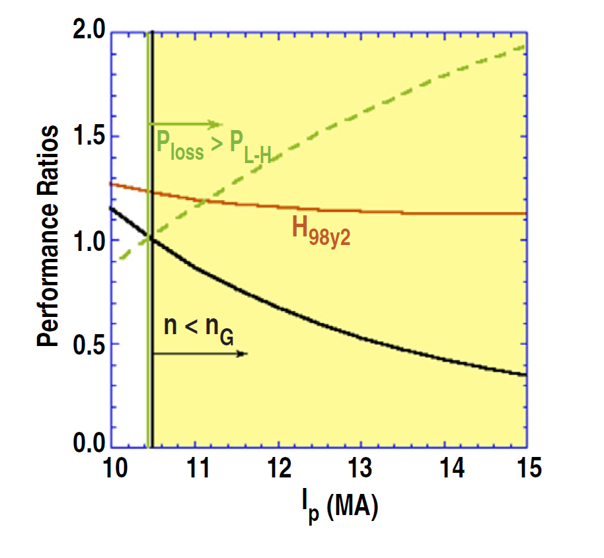
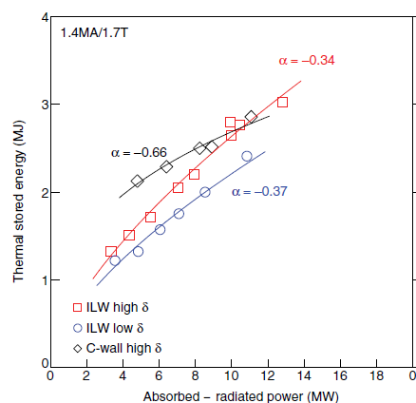
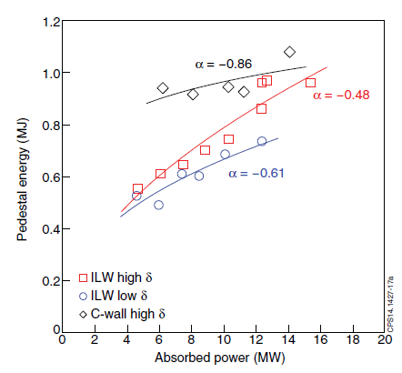
4. FPO – DT Long-Pulse Plasmas
Q = 5 long pulse operation relies in better than H-mode confinement
Better than H-mode confinement in experiments results from many factors in experiments not all extrapolable to ITER → R&D required to determine dominant factor and optimization for ITER
  Improvement of core transport:
    q-profile shape (MHD and transport)
    Increased plasma rotation (shear)
    Increased fast particle population (affecting transport)
    Increased NBI penetration due to low <ne>
    …
  Positive core-pedestal feedback loop
    high β_{core} → high β_{ped} → higher β_{core}
Q = 5
H-mode → α = -0.67
JET

Slide 34
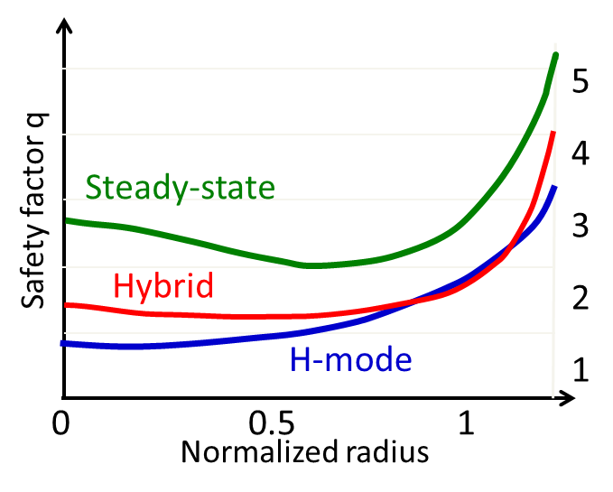
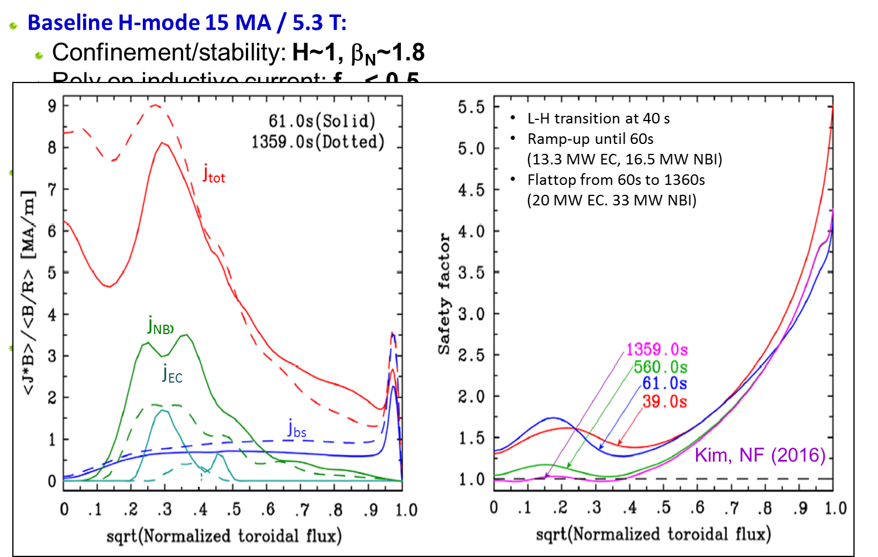
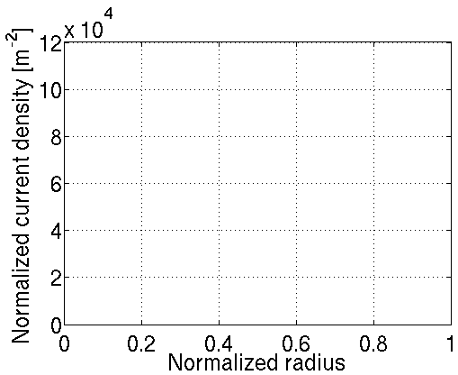



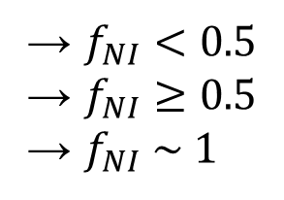
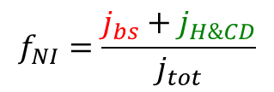

Inductive / hybrid / steady-state scenarios in ITER
Inductive H-mode: 15 MA / 5.3T, Q=10, 300-500s
Hybrid long pulse: ~ 12.5 MA / 5.3T, Q=5, 1000s
Steady-state: ~ 10 MA / 5.3T, Q=5, 3000s
→ $f_{NI}<0.5$
→ $f_{NI}≥0.5$
→ $f_{NI} \sim 1$
$$j_{tot}=j_{ohm}+j_{bs}+j_{H\&CD}$$
$$f_{NI}=\frac{j_{bs}+j_{H\&CD}}{j_{tot}}$$
Inductive H-mode
Hybrid
j_{tot}
Normalized current density [MA.m⁻²/MA]
j_{ohm}
j_{H&CD}
j_{bs}
Notes:
Legends: MA/m2 / MA

Slide 35
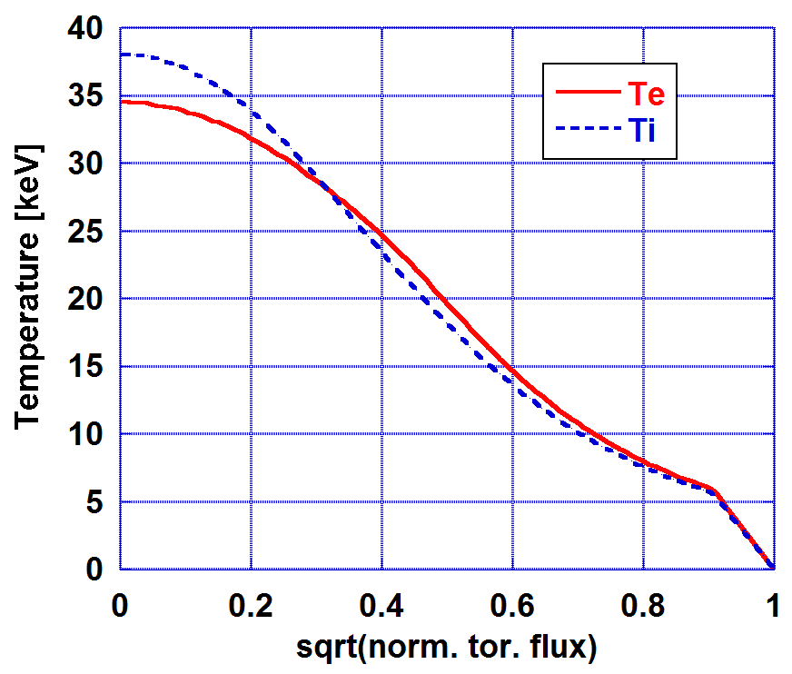
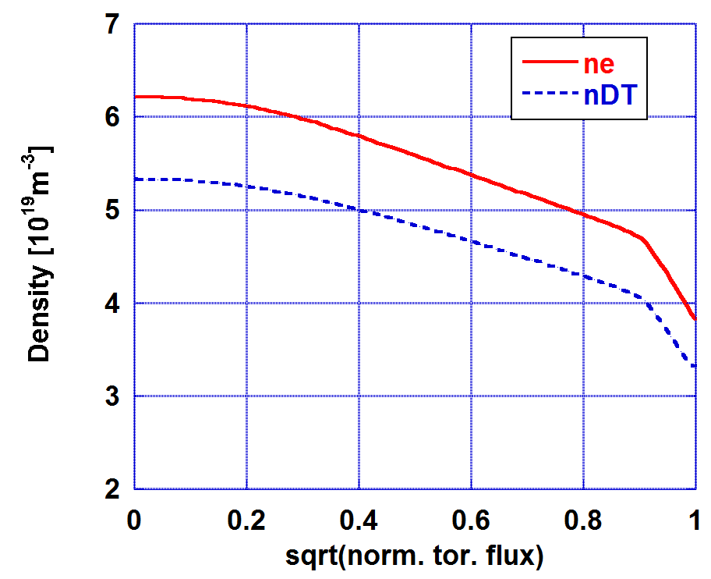
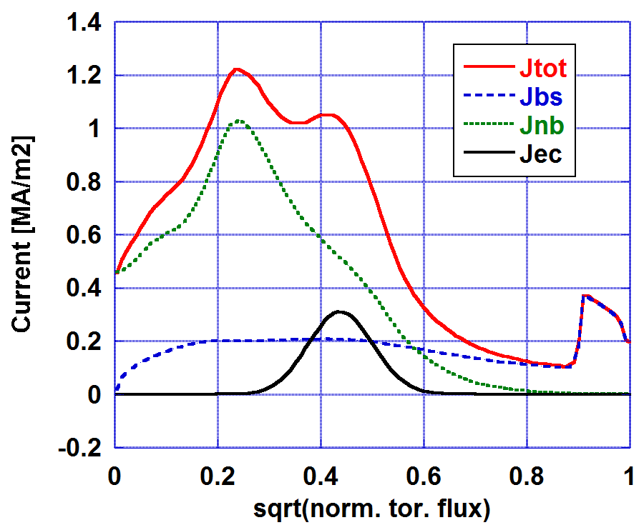

ITER steady-state Plasma
Plasma parameters
  I_{p}=10MA
  49.5MW NB + 20MW ECRH
  Fully non-inductive (f_{NI}=1.0)
  Q=5.02, f_{GW}=0.69
  H₉₈=1.5, 𝛽_{N}=3.02
  q_{min}=1.23
  T_{e}(0) = 34.5keV
  Pedestal bootstrap current
  remains moderate due to
  low grad-n|_{ped}

Slide 36


Capability of Varying Off-axis CD Critical to find Stable Solution
Ideal MHD stability improved with ECCD location moved inwards (A2e1, ρ_{ECCD}=0.35) : modification of local magnetic shear near the n=3 & 4 surfaces

Slide 37
Conclusions
The ITER Research Plan provides the experimental strategy to progress from First Plasma through to the achievement of Project’s goals: Q = 10 (300-500 s), Q = 5 (1000 s) & Q = 5 steady-state consistent with the Staged Approach
Details of the IRP are subject to refinement following results of R&D → experimental and modelling work to which you can contribute
Disruption Mitigation is essential to successful implementation of IRP
Development of validated models is essential to refine ITER plasma behaviour predictions and to refine IRP

